Slide 1
15d hMOs Blots 2021

Slide 2
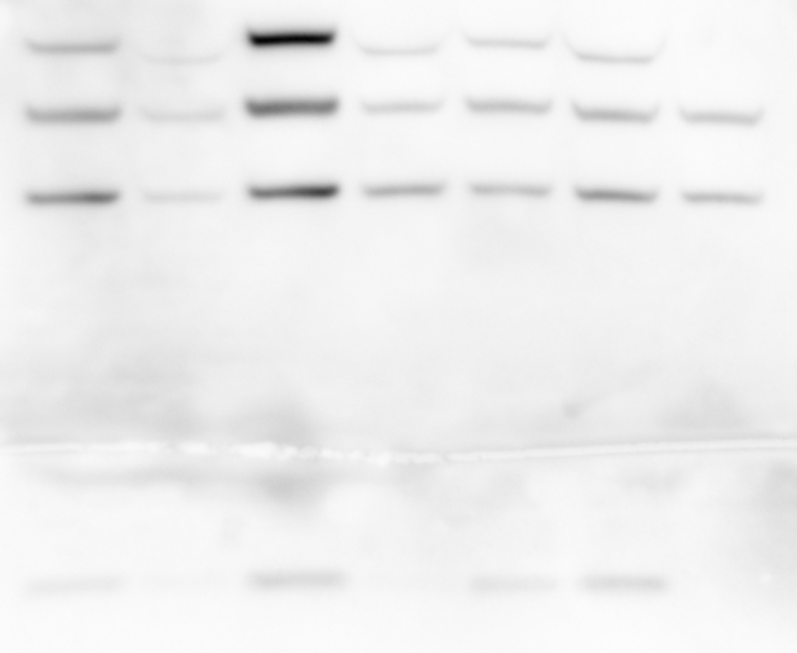
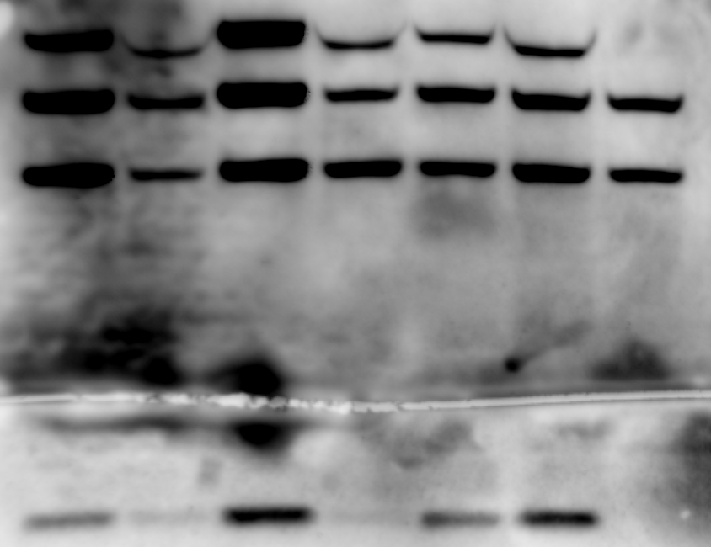
\\atlas.uni.lux\users\jennifer.modamio\DVB_group\2021\WBs\blots\e10_11_12_15dDiff_20210112\20210113_e10_15d_TUJ1_TH_syn_bactin_manuallyadapt\used for quantification
001-07
For quantification of TH-TUJ1-bACTIN
TH
TUJ1
Bactin
001-10
For quantification of a-syn
A-syn

Slide 3
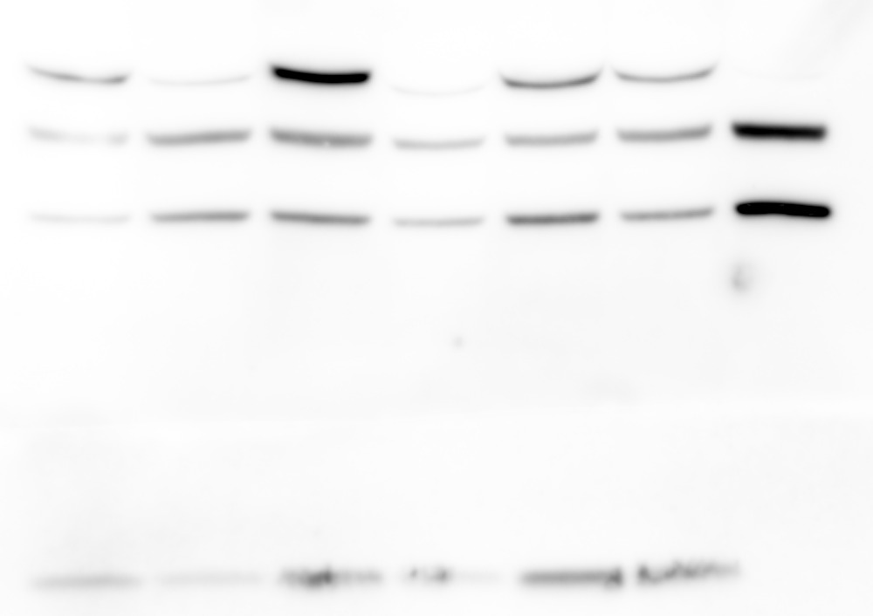
\\atlas.uni.lux\users\jennifer.modamio\DVB_group\2021\WBs\blots\e10_11_12_15dDiff_20210112\20210113_e11_15d_TUJ1_TH_syn_bactin_manuallyadapt\used for quantif
001-07
For quantification of TH-TUJ1-bACTIN
TH
TUJ1
Bactin
001-08
For quantification of a-syn
TH
A-syn

Slide 4
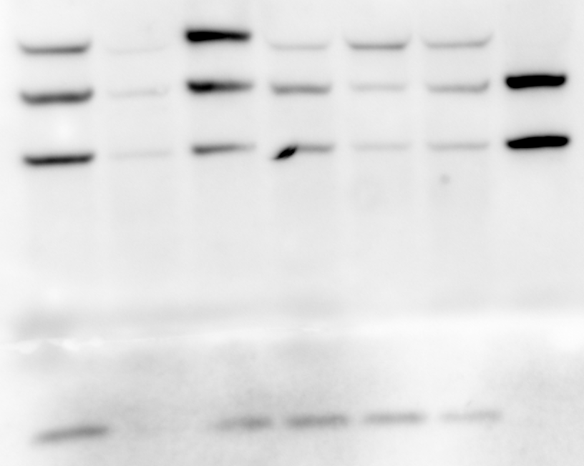
\\atlas.uni.lux\users\jennifer.modamio\DVB_group\2021\WBs\blots\e10_11_12_15dDiff_20210112\20210113_e12_15d_TUJ1_TH_syn_bactin_manuallyadapt
001-08
For ALL
TH
TUJ1
Bactin
A-syn

Slide 6
30d hMOs Blots 2021

Slide 7
\\atlas.uni.lux\users\jennifer.modamio\DVB_group\2021\WBs\blots\e10_11_12_30dDiff_20210112\membrane_1_e10_30d_TUJ1_TH_syn_bactin_manuallyAdapted\20210119_quantification
001-05
For quantification of TH-TUJ1-bACTIN
TH
TUJ1
Bactin
A-syn
001-07
For quantification of a-syn
A-syn

Slide 8
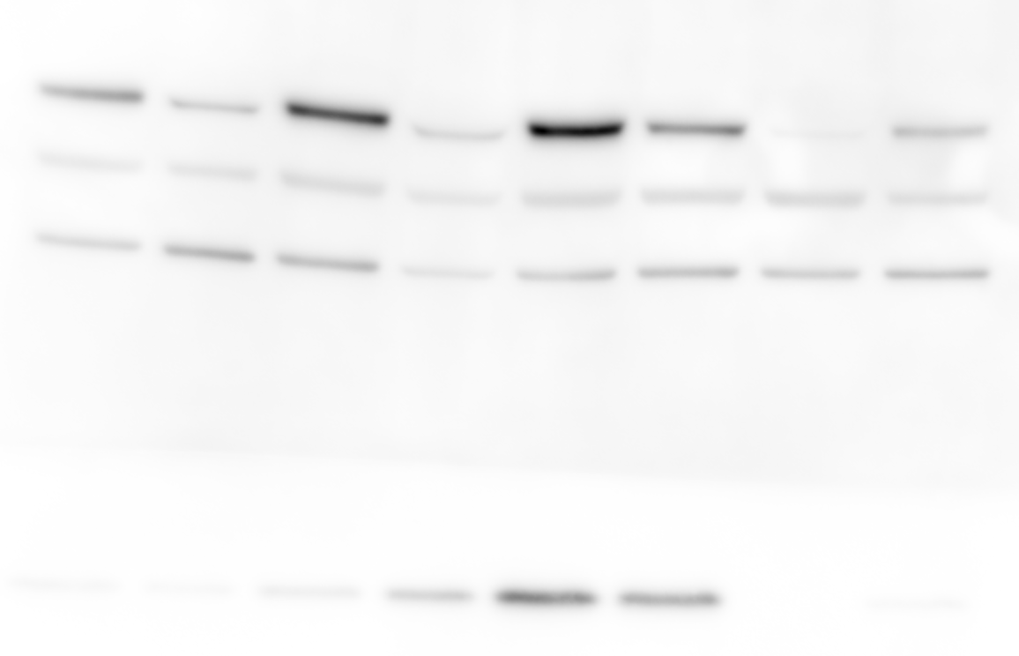
\\atlas.uni.lux\users\jennifer.modamio\DVB_group\2021\WBs\blots\e10_11_12_30dDiff_20210112\membrane_1_e11_30d_TUJ1_TH_syn_bactin_manuallyAdapted\20210119_quantification
001-05
For quantification of TH-TUJ1-bACTIN
TH
TUJ1
Bactin
A-syn
001-06
For quantification of a-syn
A-syn

Slide 9
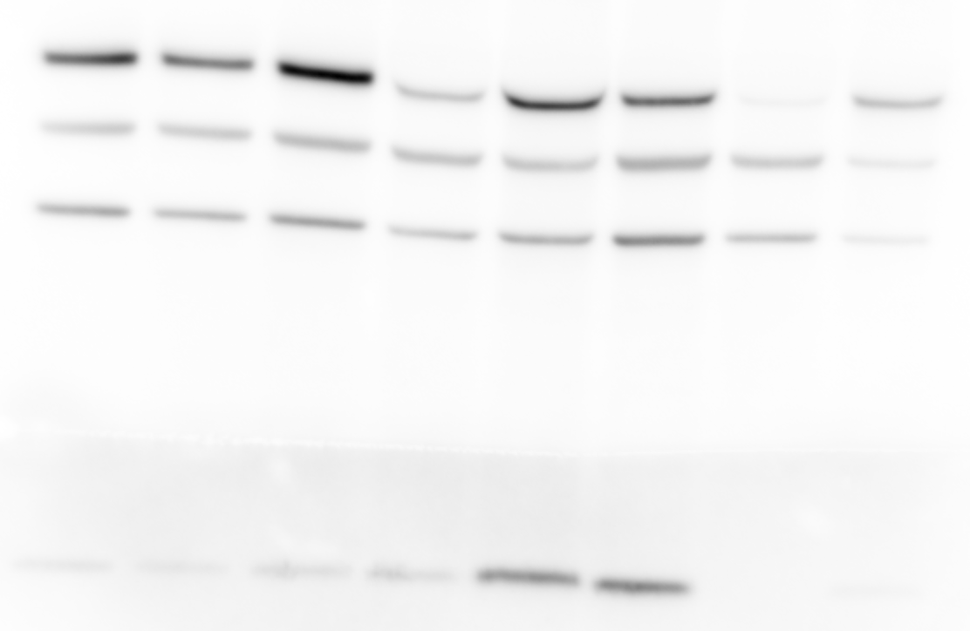
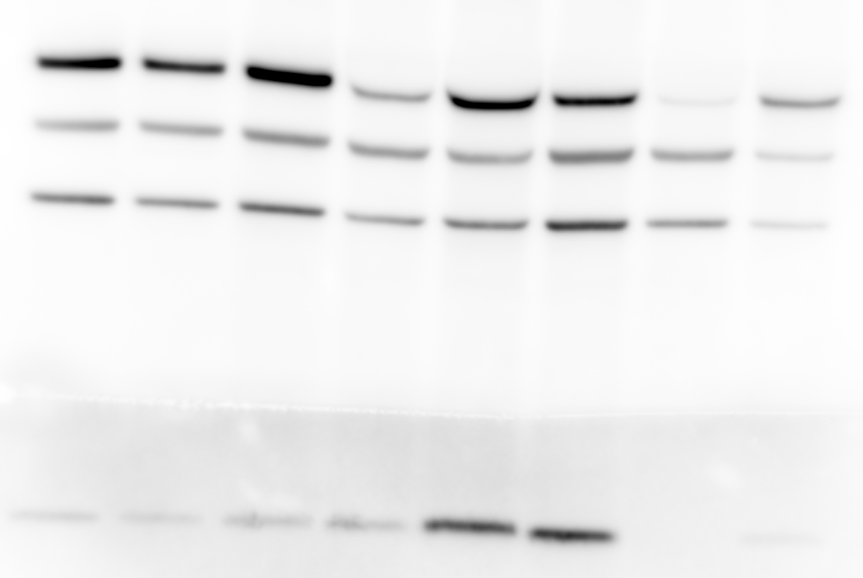
\\atlas.uni.lux\users\jennifer.modamio\DVB_group\2021\WBs\blots\e10_11_12_30dDiff_20210112\membrane_1_e12_30d_TUJ1_TH_syn_bactin_manuallyAdapted\cleaner2\20210119_quantification
001-05
For quantification of TH-TUJ1-bACTIN
TH
TUJ1
Bactin
A-syn
001-06
For quantification of a-syn
A-syn

Slide 10
Raw data – no normalized per biological replicate

Slide 11
Data normalized between biological replicates – normalized to WT322

Slide 12
50d hMOs Blots 2021

Slide 13
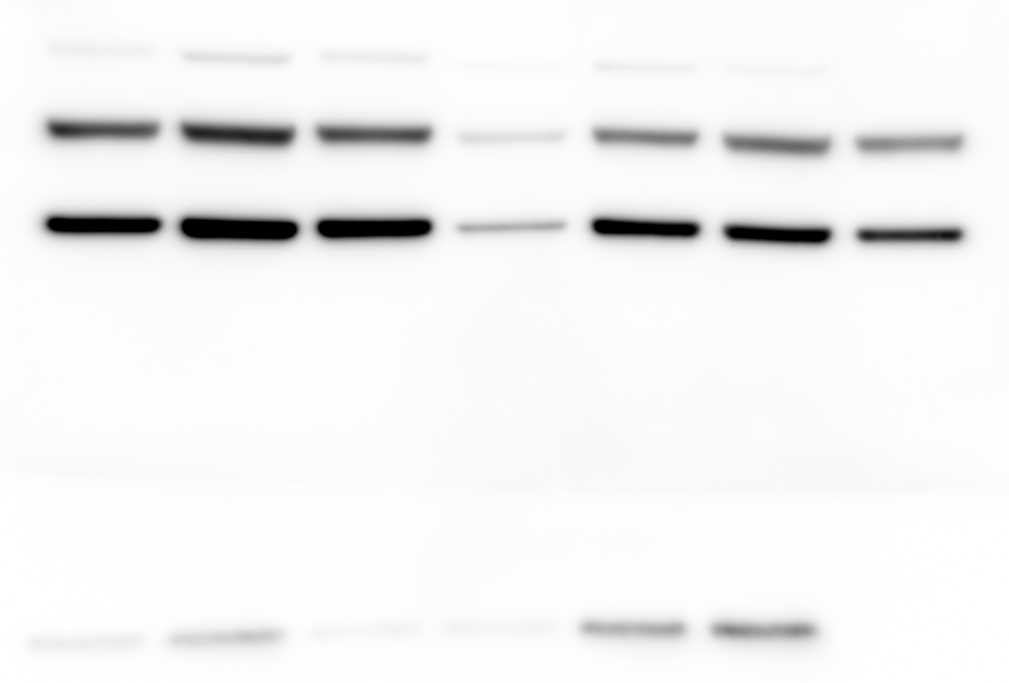
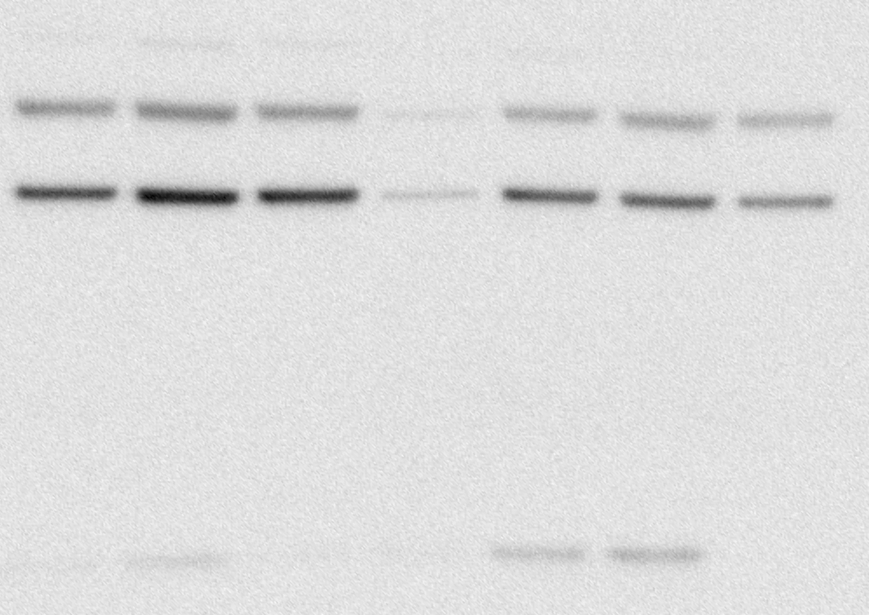
\\atlas.uni.lux\users\jennifer.modamio\DVB_group\2021\WBs\blots\e10_11_12_50dDiff_20210112\TH TUJ1 aSYN bACTIN\e10_50d_sy_TH_TUJ1_bactin\3rd
TH
TUJ1
Bactin
A-syn

Slide 14
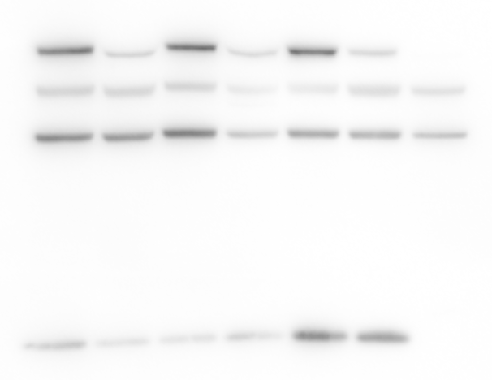
\\atlas.uni.lux\users\jennifer.modamio\DVB_group\2021\WBs\blots\e10_11_12_50dDiff_20210112\TH TUJ1 aSYN bACTIN\e11_e12_50d_sy_TH_TUJ1_bactin\2nd\quantification e11
TH
TUJ1
Bactin
A-syn

Slide 15
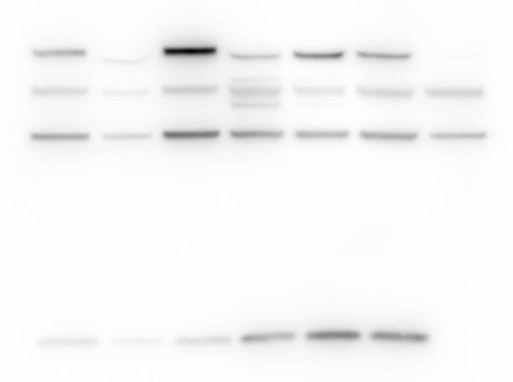
\\atlas.uni.lux\users\jennifer.modamio\DVB_group\2021\WBs\blots\e10_11_12_50dDiff_20210112\TH TUJ1 aSYN bACTIN\e11_e12_50d_sy_TH_TUJ1_bactin\2nd\quantification e12
TH
TUJ1
Bactin
A-syn

Slide 16
50d hMOs WBs results – 2021 results only
\\atlas.uni.lux\users\jennifer.modamio\DVB_group\2021\WBs\results
\\atlas.uni.lux\users\jennifer.modamio\DVB_group\2021\WBs\blots\e10_11_12_50dDiff_20210112\TH TUJ1 aSYN bACTIN
\\atlas.uni.lux\users\jennifer.modamio\DVB_group\2021\WBs\protein quantification

Slide 17
Data normalized between biological replicates _ to WT322

