Slide 1
Media characterization: a-synuclein over time experiments 1, 2, 3 passage 10,11,12
\\atlas.uni.lux\users\jennifer.modamio\DVB_group\2020\Dotblot Media

Slide 2
20200210_DotBlot_media_15dDiff_protein1
Ponceau
Syn total
WT 322
WT 232
WT 337
X3 367
X3 317
X2 340
X2 341
WT 322
WT 232
WT 337
X3 367
X3 317
X2 340
X2 341
Passage 10
Passage 11
Passage 12

Slide 3
20200210_DotBlot_media_30dDiff_protein1
Ponceau
Syn total
WT 322
WT 232
WT 337
X3 367
X3 317
X2 340
X2 341
WT 322
WT 232
WT 337
X3 367
X3 317
X2 340
X2 341
Passage 10
Passage 11
Passage 12

Slide 4
20200210_DotBlot_media_50dDiff_protein1
Ponceau
Syn total
WT 322
WT 232
WT 337
X3 367
X3 317
X2 340
X2 341
WT 322
WT 232
WT 337
X3 367
X3 317
X2 340
X2 341
Passage 10
Passage 11
Passage 12

Slide 5
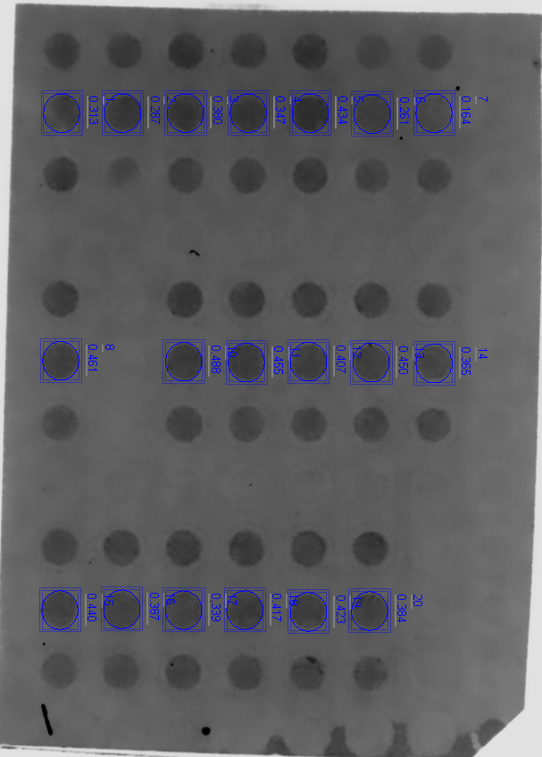
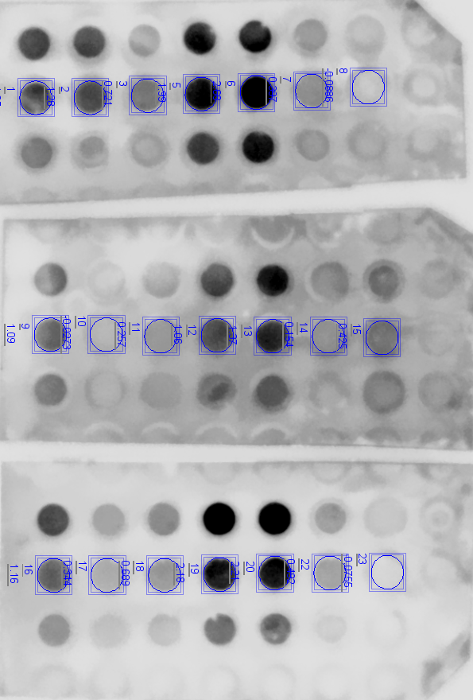
20200210_DotBlot_media_70dDiff_protein1
Ponceau
Syn total
WT 322
WT 232
WT 337
X3 367
X3 317
X2 340
X2 341
WT 322
WT 232
WT 337
X3 367
X3 317
X2 340
X2 341
Passage 10
Passage 11
Passage 12

Slide 6
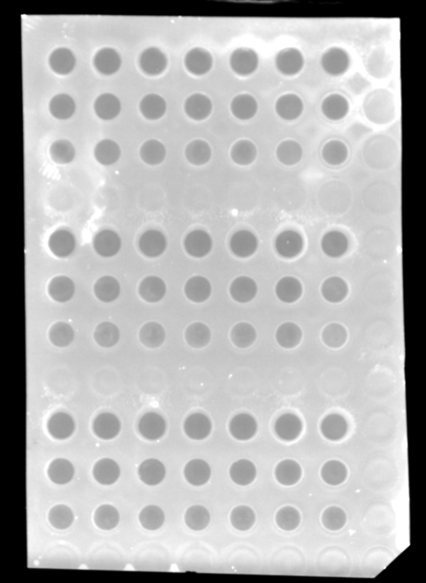
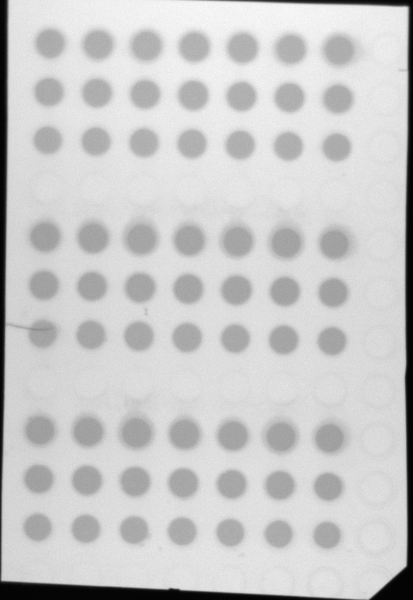
20200220_15Ddiff_hMO_prot2
Problems during the acquisition of ponceau in Odyssey**
Ponceau
Ponceau
Synuclein 230
600 odyssey inverted
Stella
CHEMI odyssey
WT 322
WT 232
WT 337
X3 367
X3 317
X2 340
X2 341
Passage 10
Passage 12
Passage 11

Slide 7
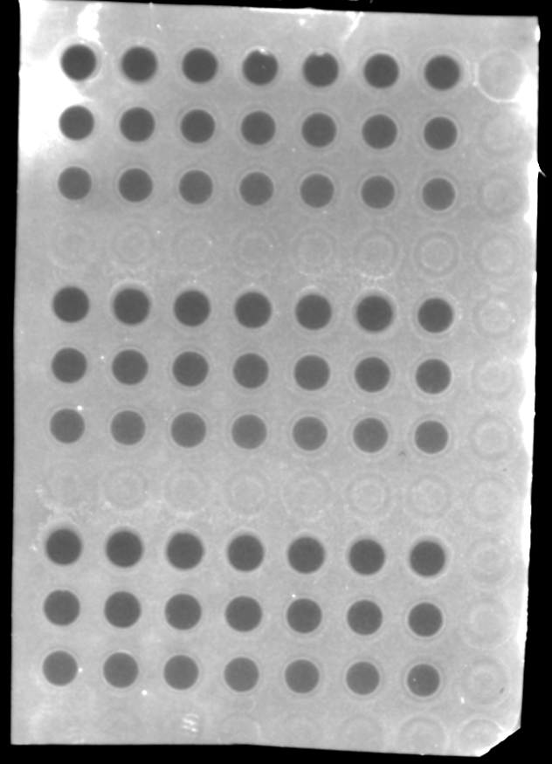
20200220_30Ddiff_hMO_prot2
Problems during the acquisition of ponceau in Odyssey**
Ponceau
Synuclein 230
600 odyssey inverted
CHEMI odyssey
WT 322
WT 232
WT 337
X3 367
X3 317
X2 340
X2 341
Passage 10
Passage 11
Passage 12

Slide 8
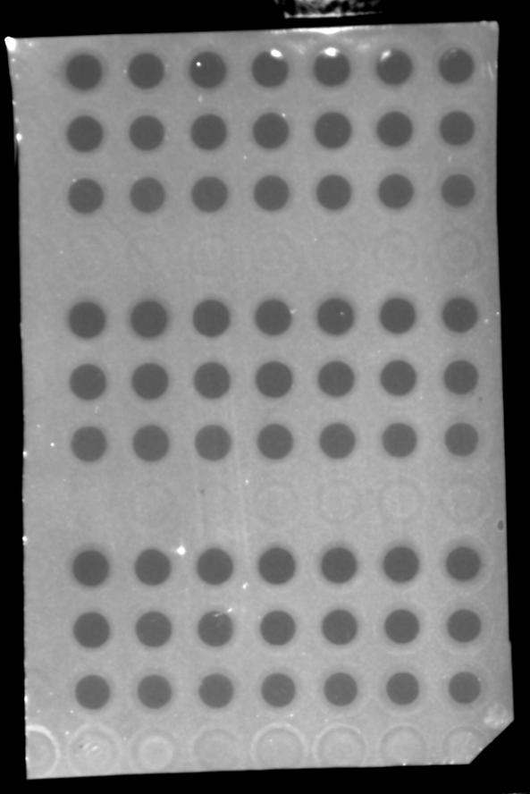
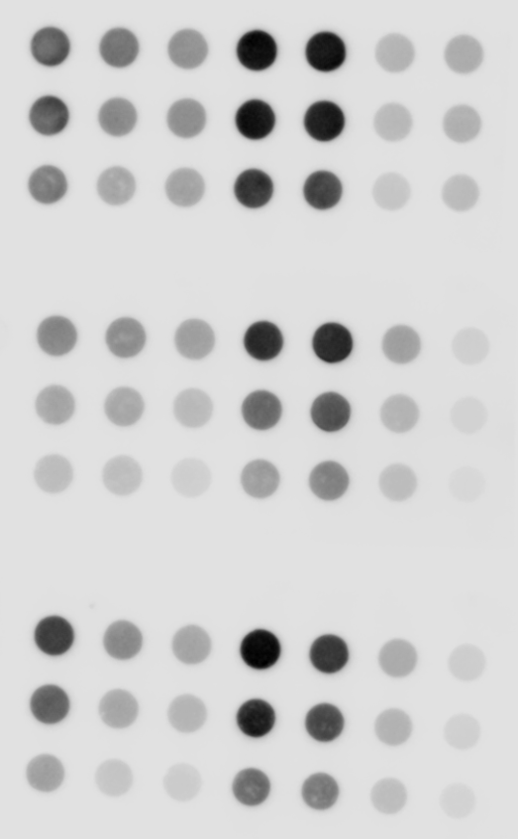
20200220_50Ddiff_hMO_prot2
Problems during the acquisition of ponceau in Odyssey**
Ponceau
600 odyssey inverted
Synuclein 230
WT 322
WT 232
WT 337
X3 367
X3 317
X2 340
X2 341
CHEMI odyssey
Passage 10
Passage 11
Passage 12

Slide 9
20200210_DotBlot_media_70dDiff_protein2
Ponceau
Syn total
WT 322
WT 232
X3 367
X3 317
WT 337
WT 322
WT 232
X3 367
X3 317
WT 337
Passage 10
Passage 11
Passage 12

Slide 10
20200210_DotBlot_media_90dDiff_protein2
Ponceau
Syn total
WT 322
WT 232
X3 367
X3 317
WT 337
WT 322
WT 232
X3 367
X3 317
WT 337
Passage 10
Passage 11
Passage 12

Slide 11
N = 6
Problems normalizing to ponceau. No differences between lines although the media seems clearly different.
Re-check results normalizing to total protein?

Slide 14
n = 3 passages ( media from 8 - 12 hMO)
n = 12 technical replicates (media from 2-3 hMO)

Slide 15
Media characterization: a-synuclein over time experiments 5,6,7 passage 9,10,11

Slide 16
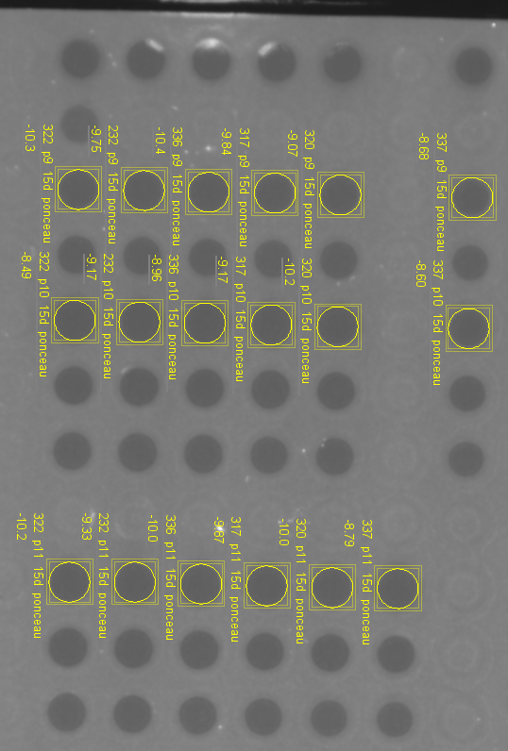
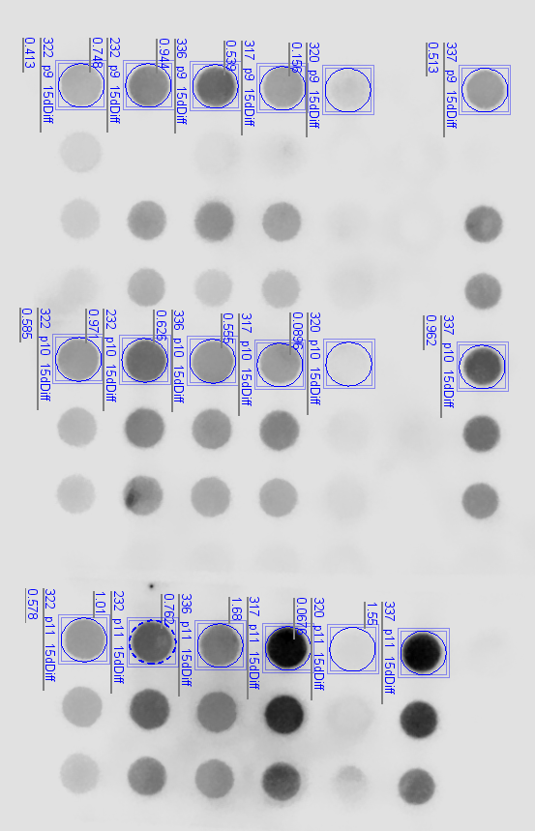
20200427_DotBlot_media_15dDiff_protein1
Ponceau
600 odyssey inverted
Synuclein 230
WT 322
WT 232
X3 367
X3 317
KO 320
337
CHEMI odyssey
Passage 09
Passage 10
\\atlas.uni.lux\users\jennifer.modamio\DVB_group\2020\Dotblot Media\20200427 characterisation media p9 p10 p11\15d Diff hMO media
Passage 11

Slide 17
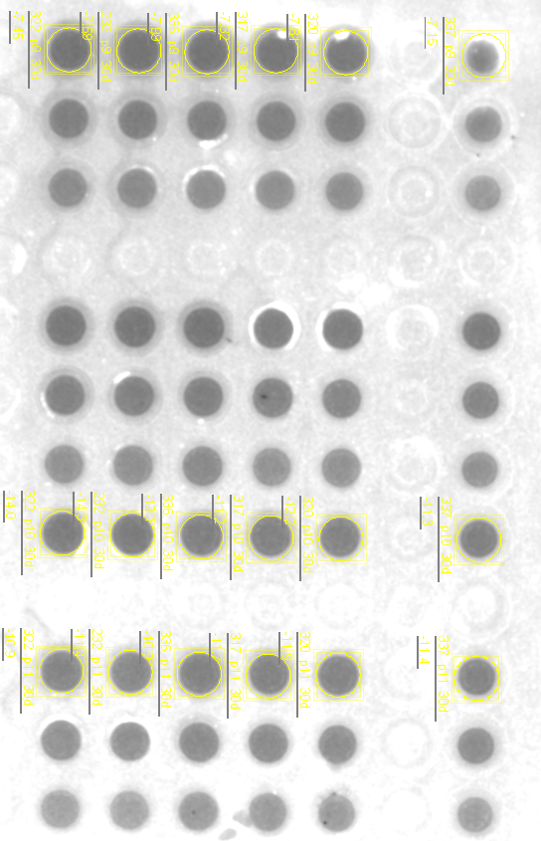
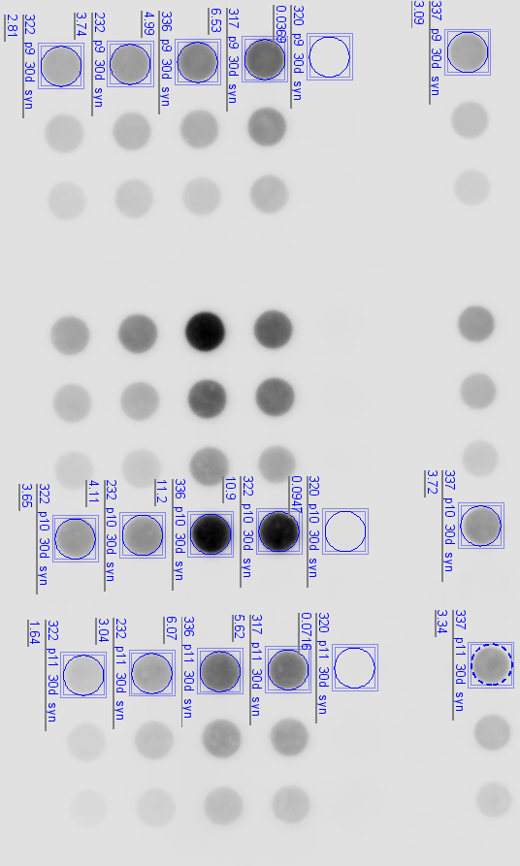
20200427_DotBlot_media_30dDiff_protein1
Ponceau
600 odyssey inverted
Synuclein 230
X3 367
CHEMI odyssey
WT 322
WT 232
X3 317
KO 320
337
Passage 09
Passage 10
Passage 11
\\atlas.uni.lux\users\jennifer.modamio\DVB_group\2020\Dotblot Media\20200427 characterisation media p9 p10 p11\30d Diff hMO media

Slide 18
20200427_DotBlot_media_50dDiff_protein1
Ponceau
600 odyssey inverted
Synuclein 230
X3 367
CHEMI odyssey
WT 322
WT 232
X3 317
KO 320
337
Passage 09
Passage 10
Passage 11
\\atlas.uni.lux\users\jennifer.modamio\DVB_group\2020\Dotblot Media\20200427 characterisation media p9 p10 p11\50d Diff hMO media

Slide 19
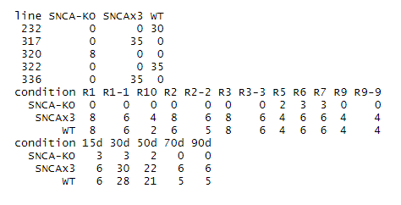
Analysis

Slide 20
