Slide 1
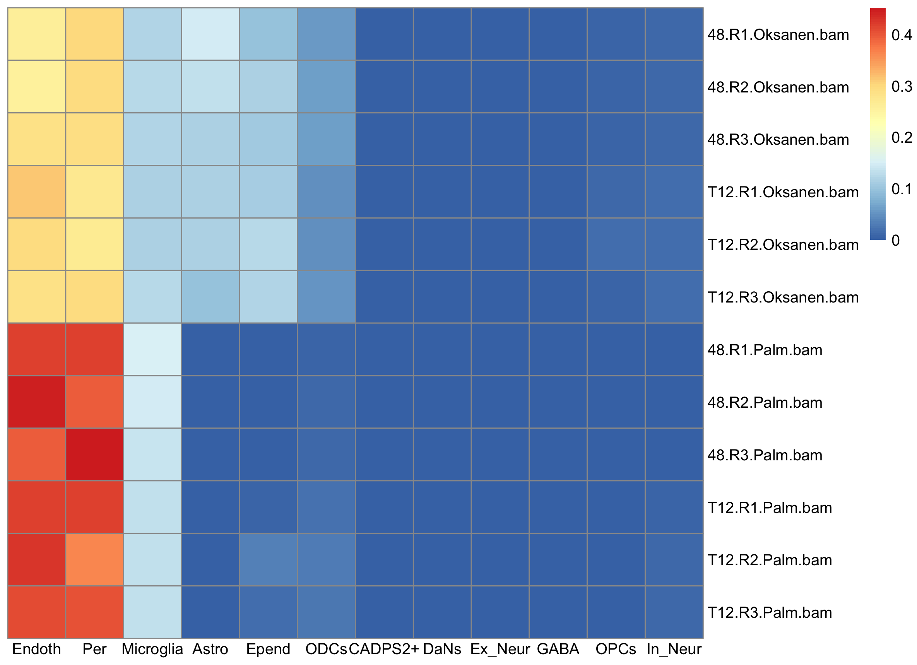
RNA seq reference : Smajic et al 2022 PD+CTRL
#48
T12
#48
T12

Slide 2
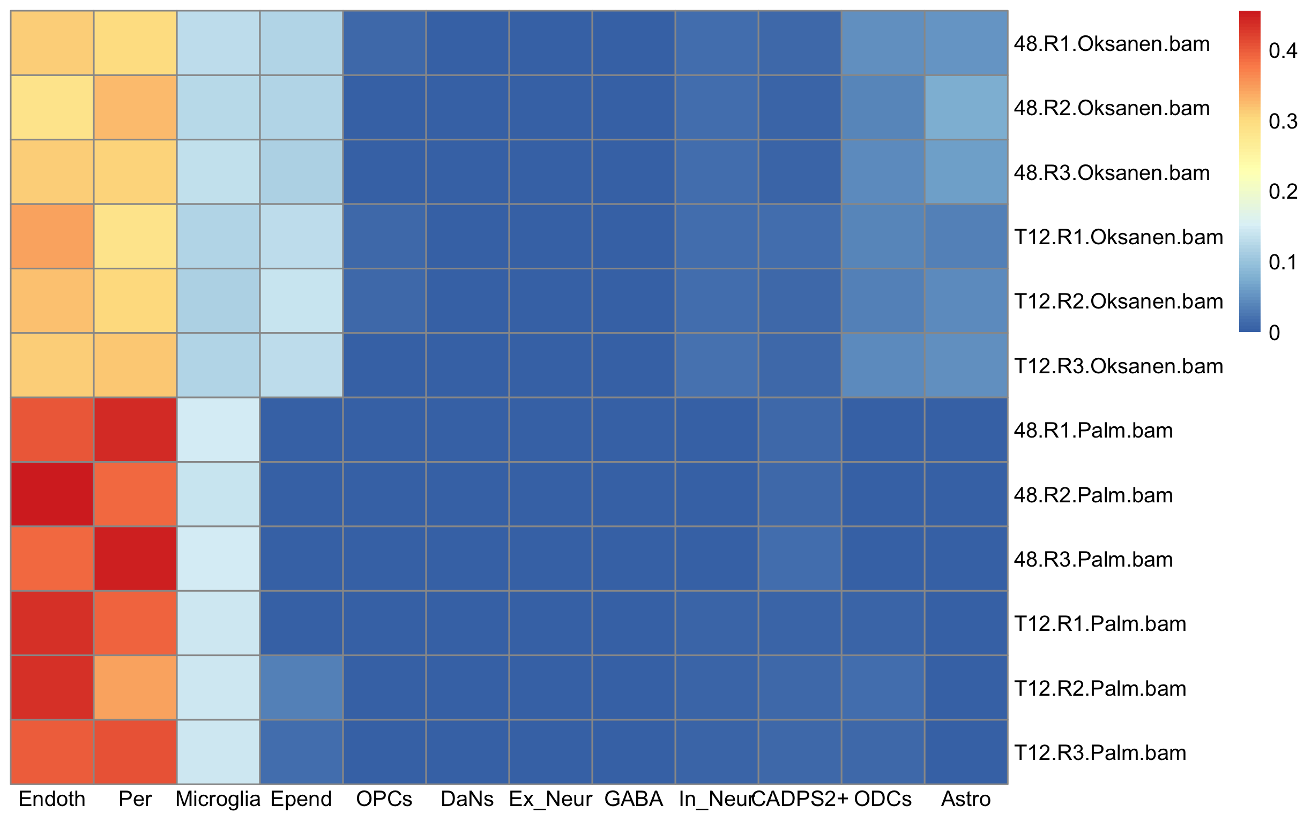
RNA seq reference : Smajic et al 2022
CONTROL

Slide 3
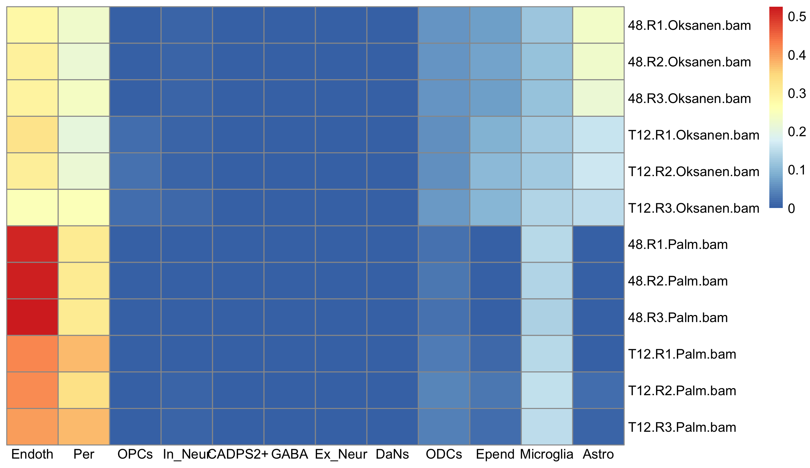
RNA seq reference : Smajic et al 2022
PD

Slide 4
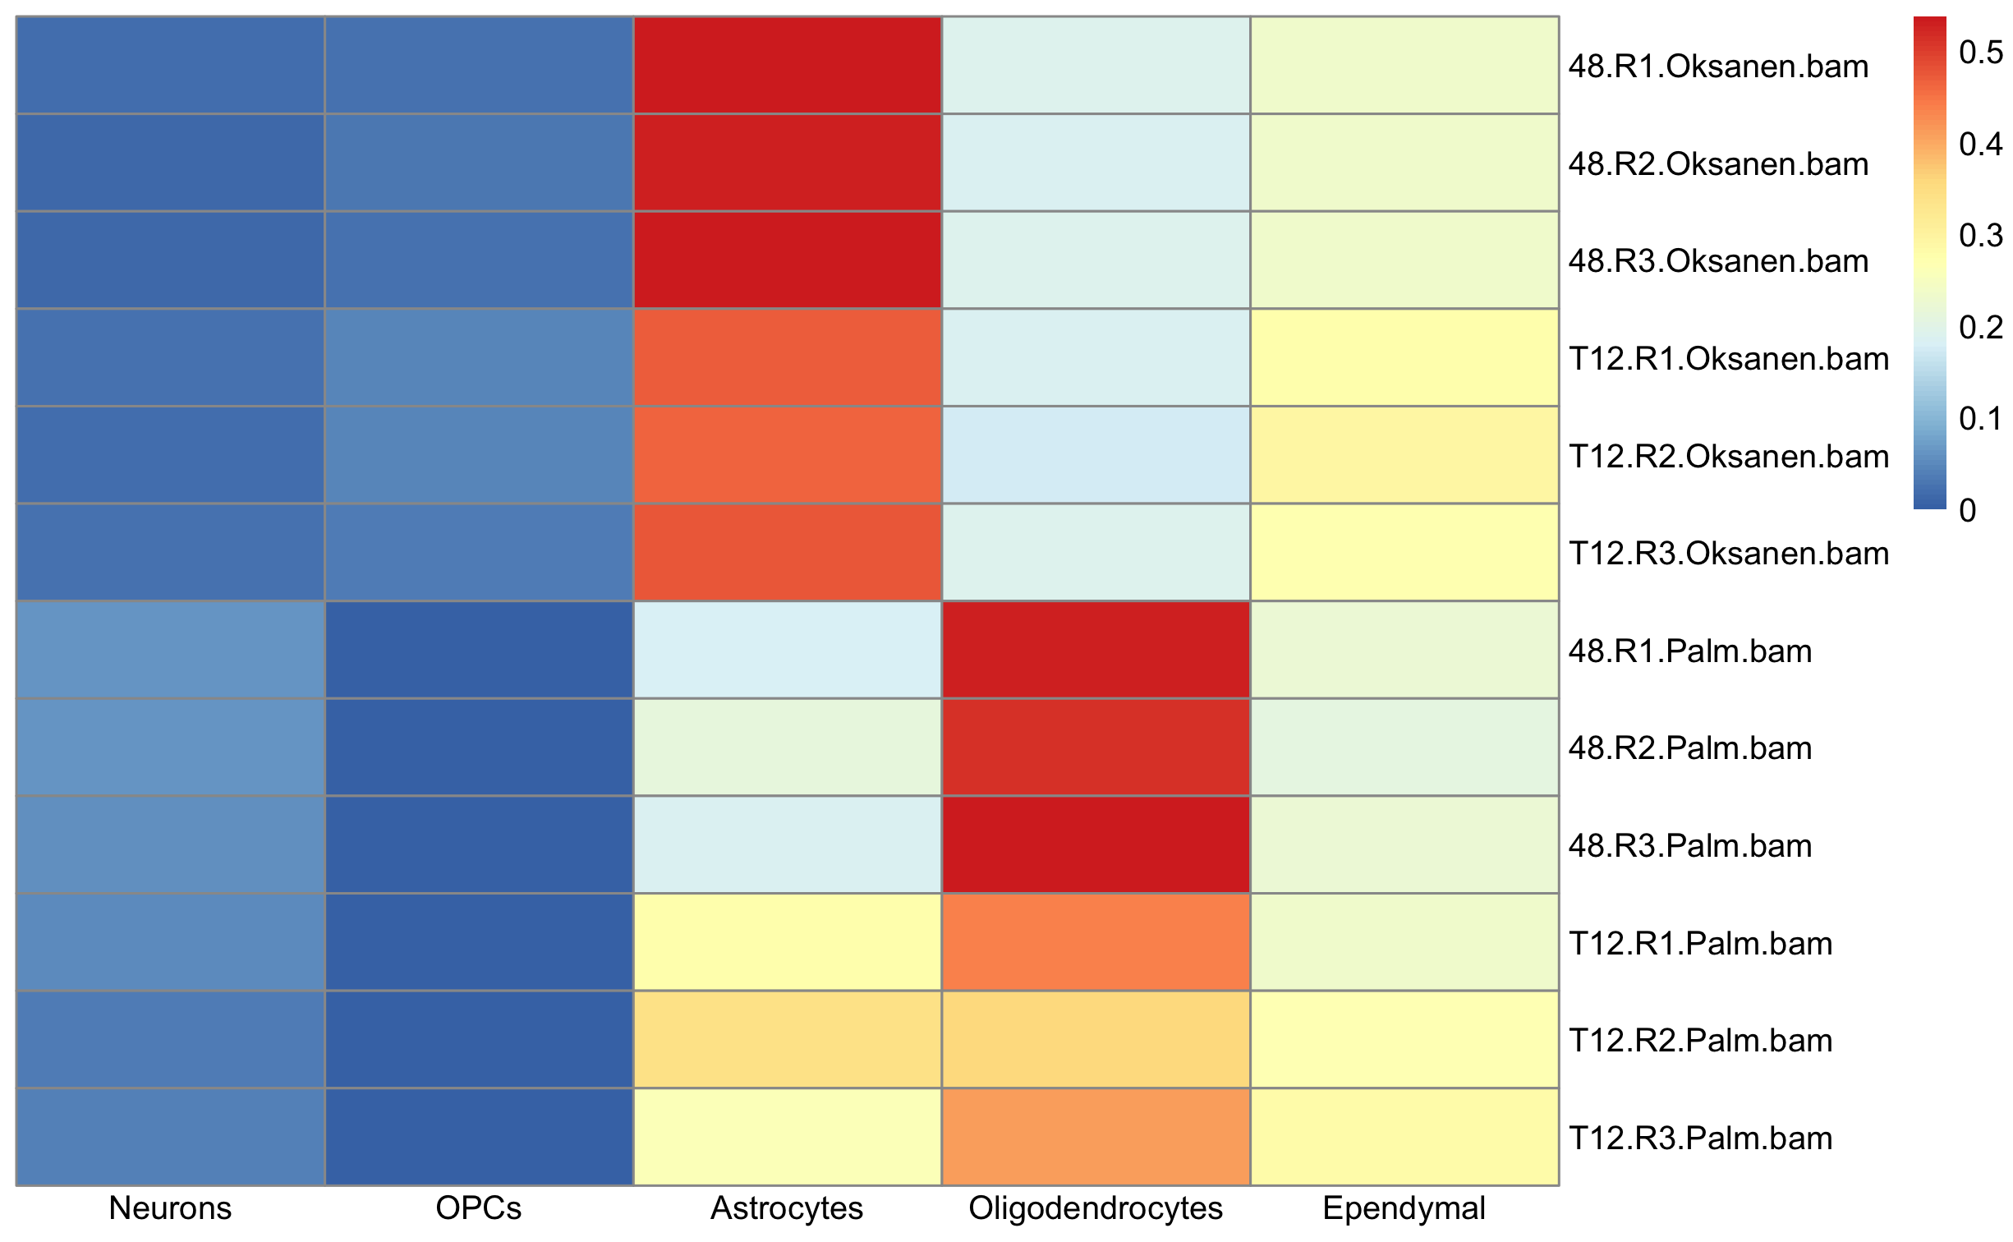
RNA seq reference : Smajic et al 2022 modified
PD+CTRL
Neurons = CADPS2+DaNs+Excitatory+Inhibitory+GABA
Endothelials+Pericytes+Microglia were removed

Slide 5
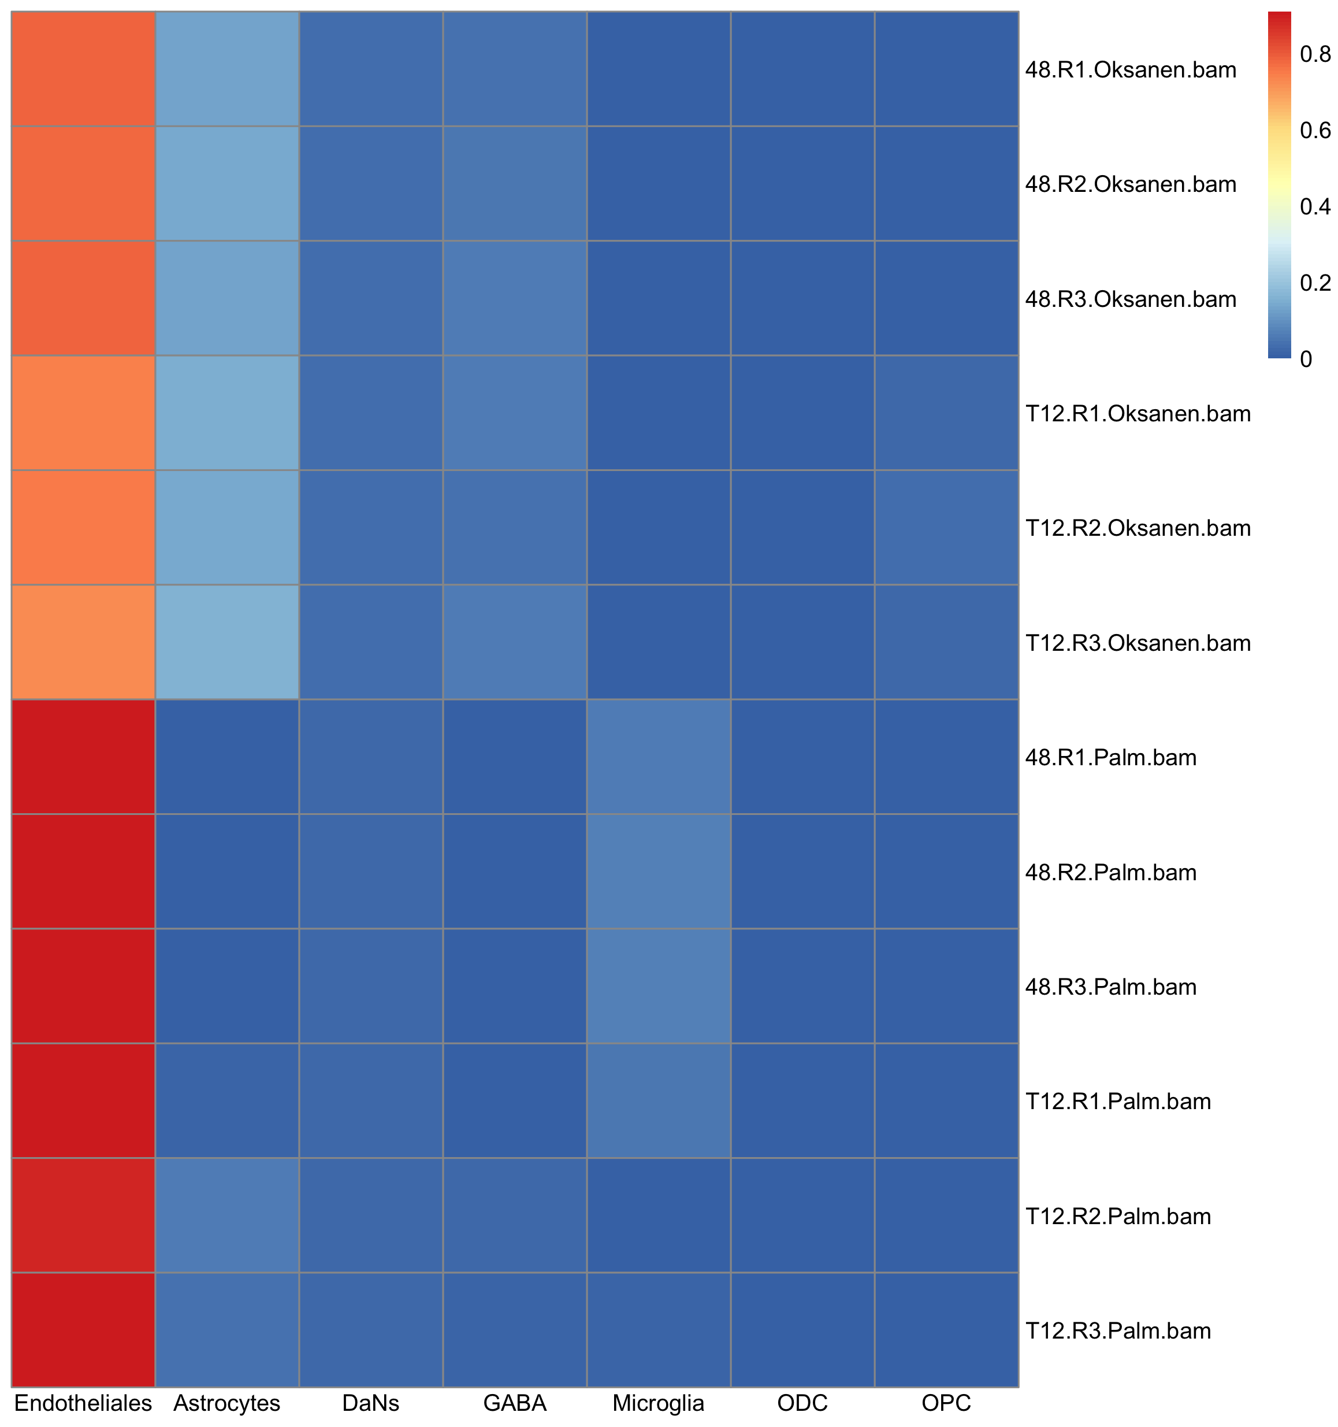
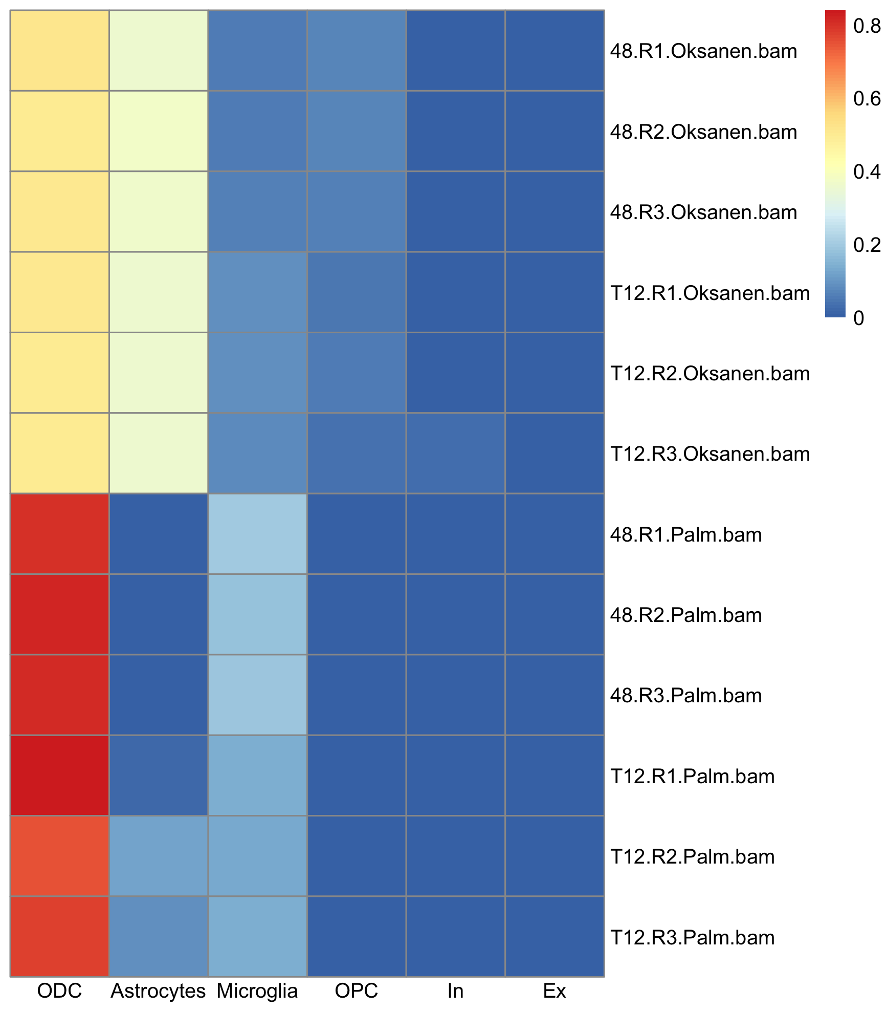
RNA seq reference : Agarwal et al 2020
Reference SN samples
Reference Cortex samples

Slide 6
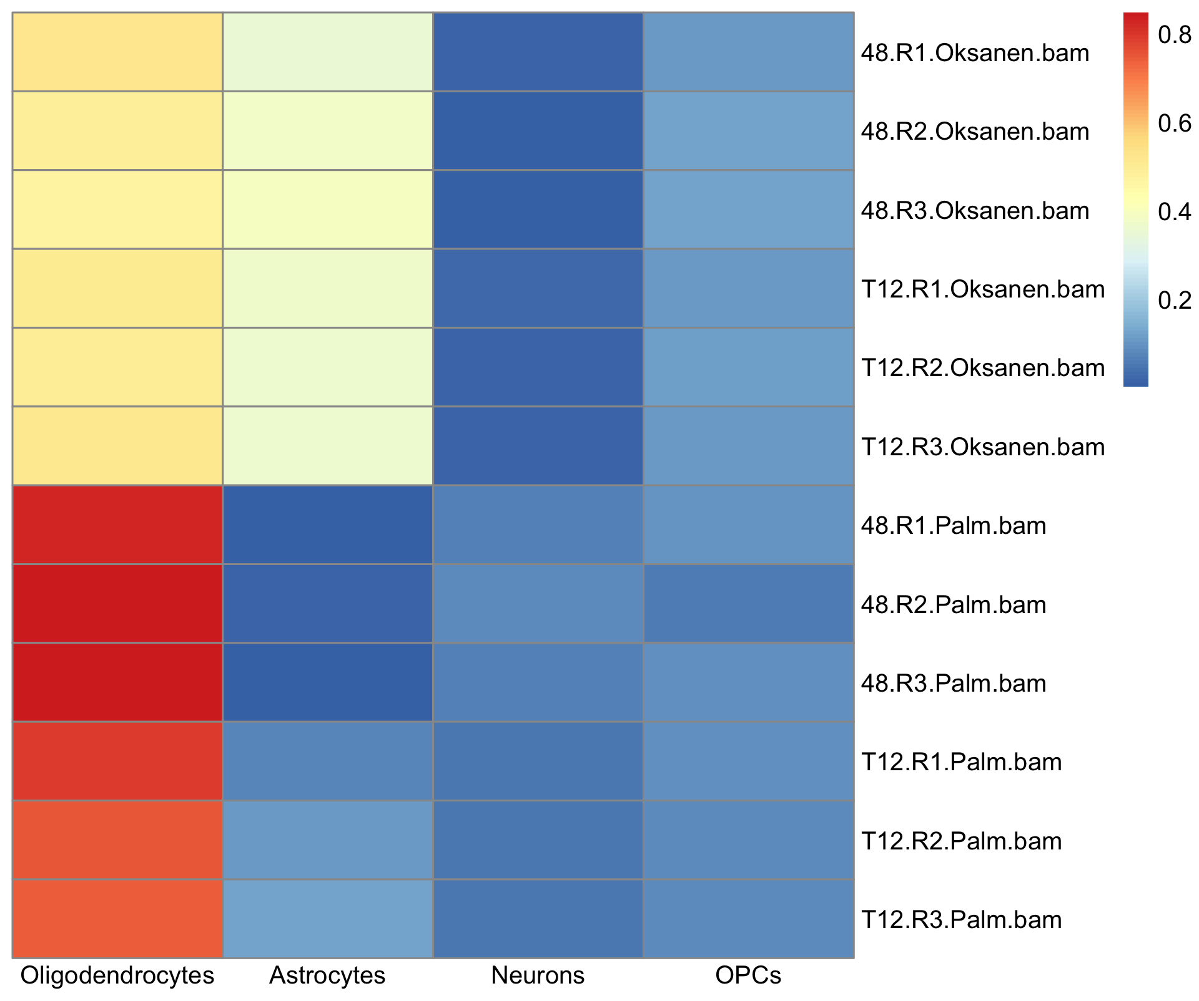
RNA seq reference : Agarwal et al 2020 modified
Cortex
Neurons = Excitatory+Inhibitory
Microglia was removed

Slide 7
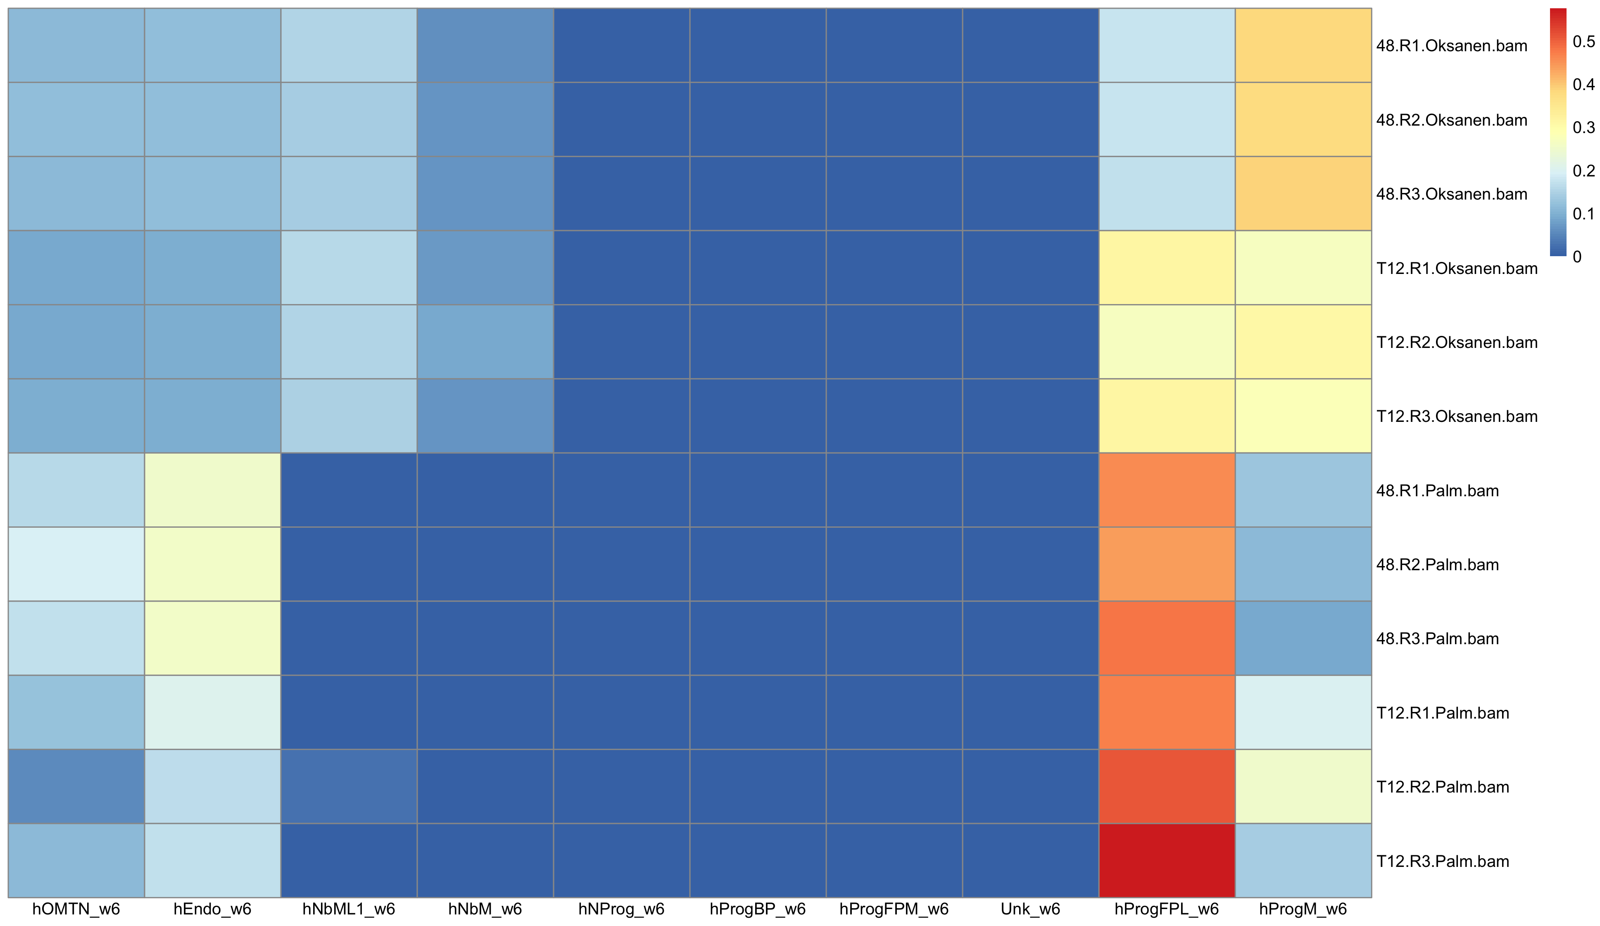
RNA seq reference : La Manno et al 2016
hEmbryo_Week6

Slide 8
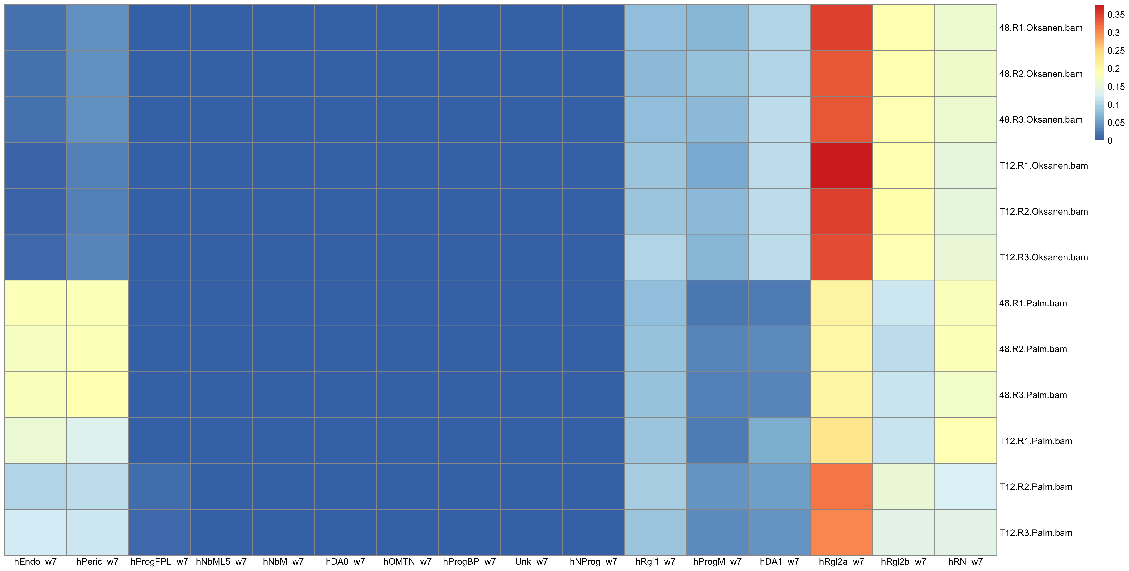
RNA seq reference : La Manno et al 2016
hEmbryo_Week7

Slide 9
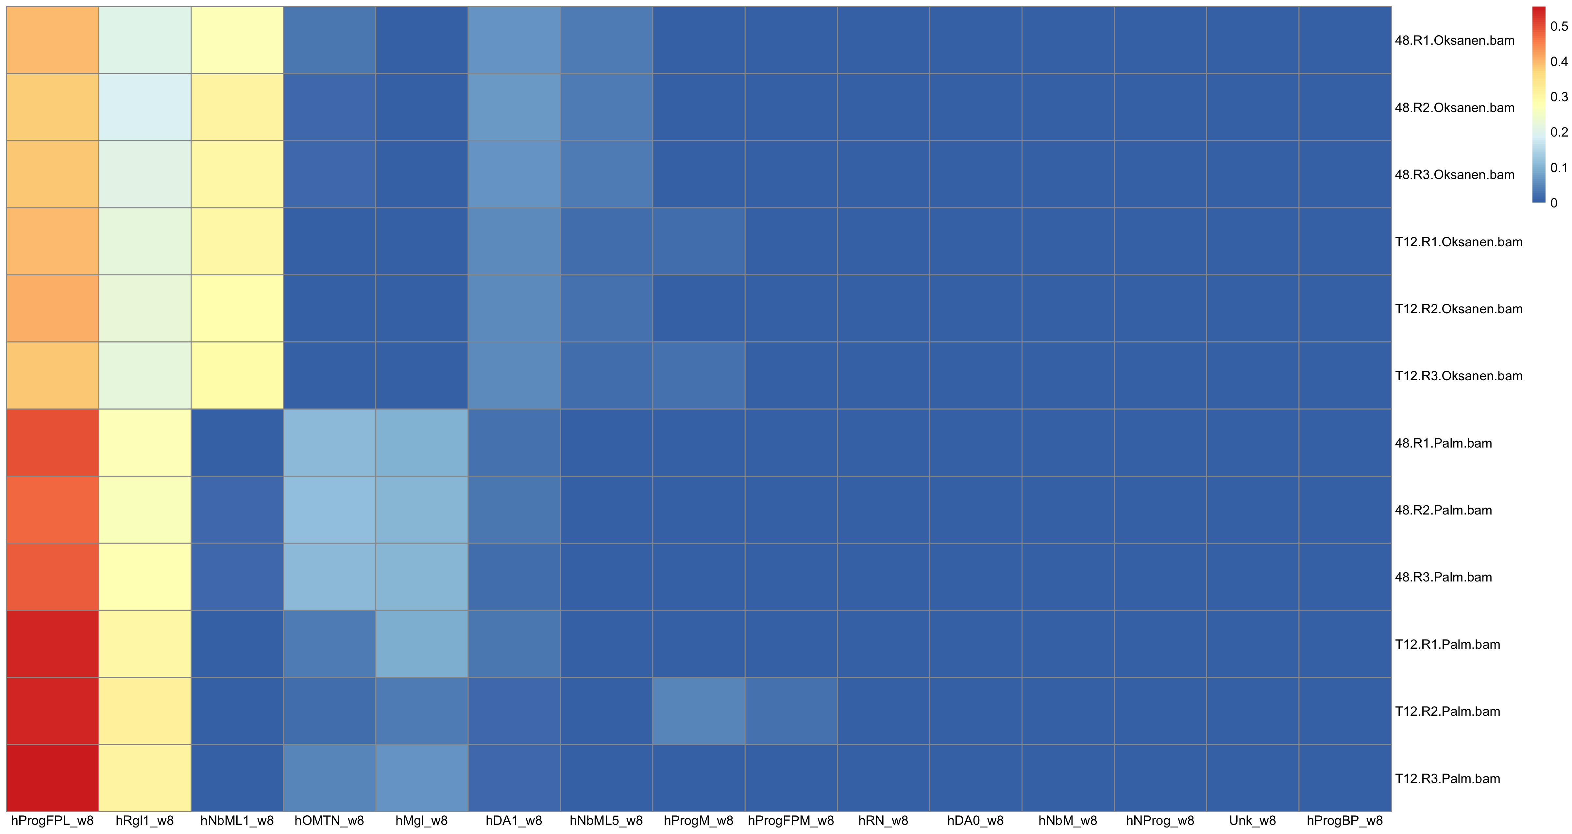
RNA seq reference : La Manno et al 2016
hEmbryo_Week8

Slide 10
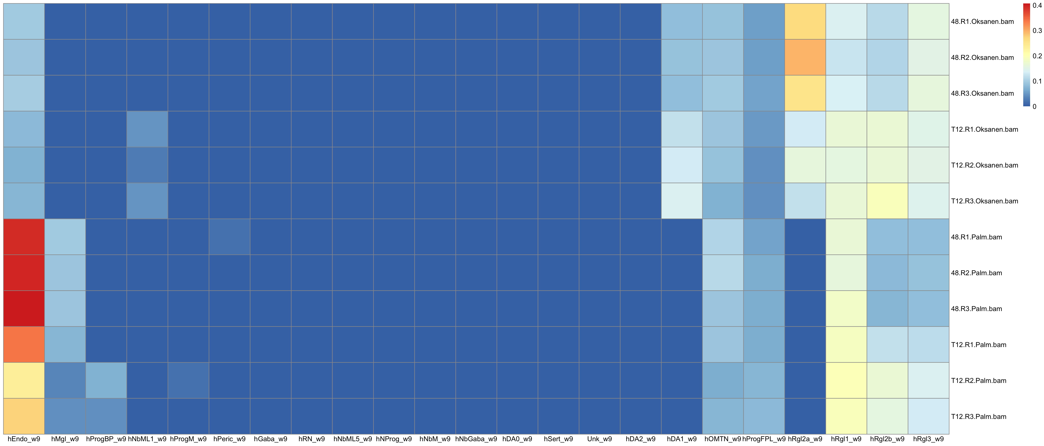
RNA seq reference : La Manno et al 2016
hEmbryo_Week9

Slide 11
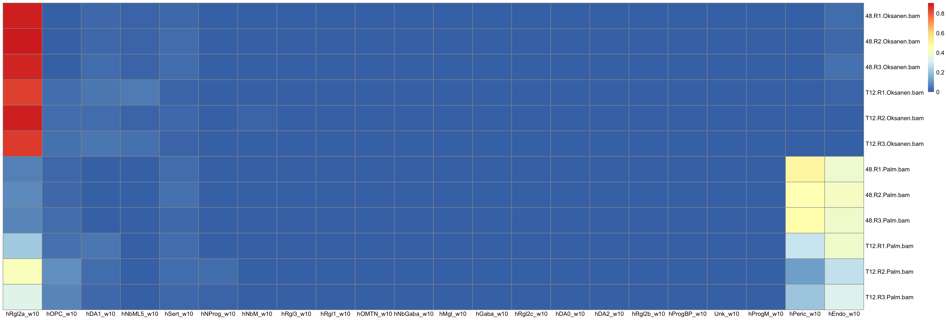
RNA seq reference : La Manno et al 2016
hEmbryo_Week10

Slide 12
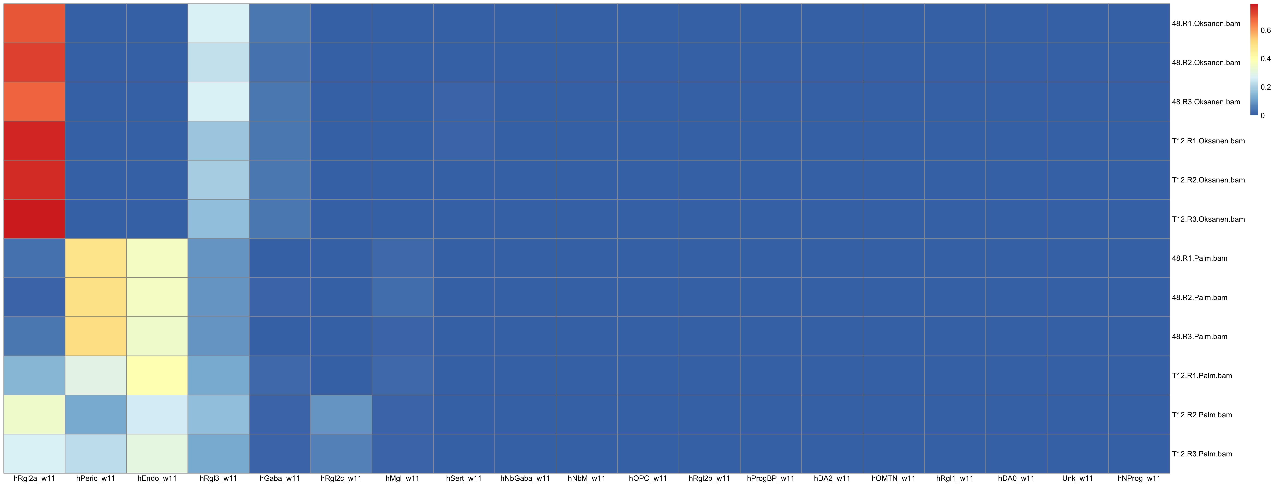
RNA seq reference : La Manno et al 2016
hEmbryo_Week11

