Slide 1
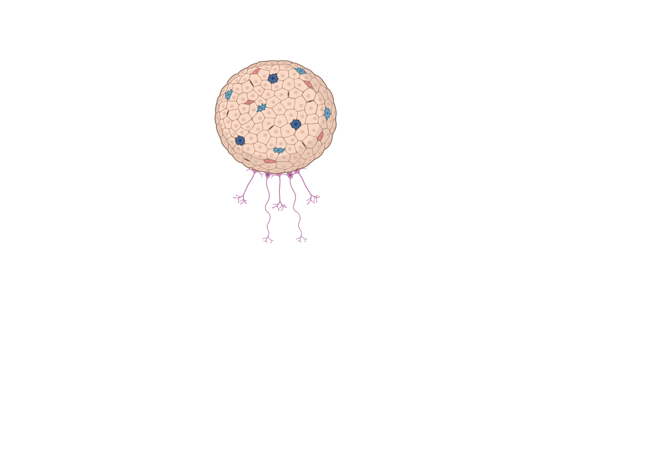
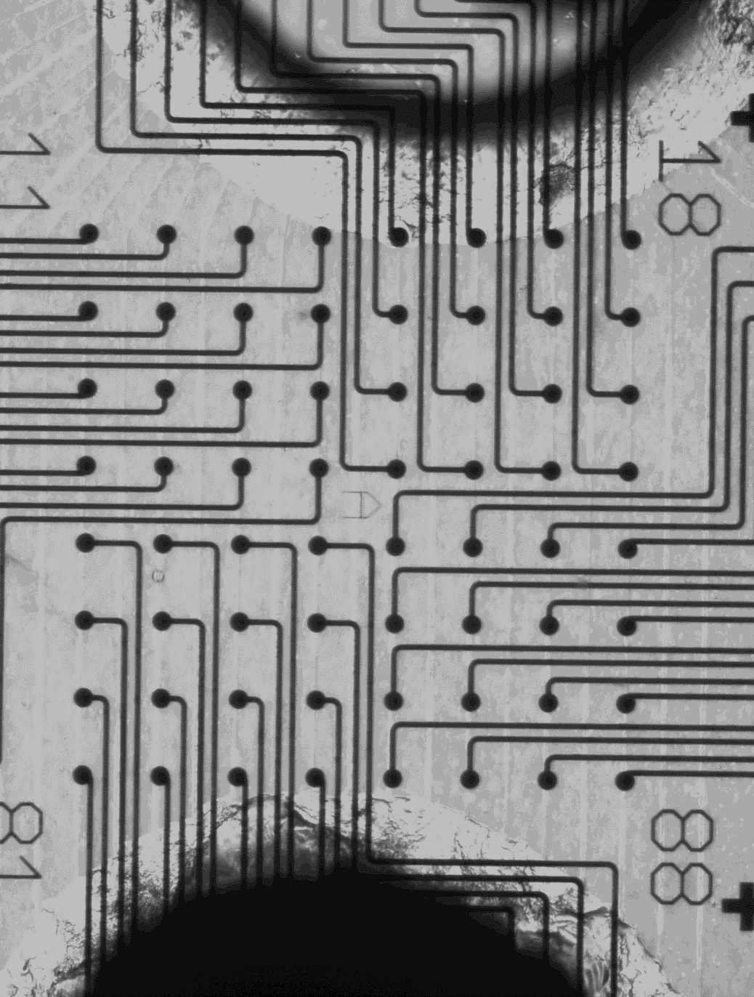

a)
MO
b)
200 µm
10 µm
StrO
c)
2Δt
e1
e2
e)
0
Time (s)
T
d)
A
C
E
Δr
D
$$V=\frac{Δr}{Δt}=0.32 m/s$$
B
F
Δt
0.2
V_{ab} = 0.32 m/s
Probability
Electrode row #
0.1
0
-0.015
-0.01
-0.005
0
0.005
0.01
0.015
0.4
Probability
V_{cd} = 0.18 m/s
0.2
x
0
-0.015
-0.01
-0.005
0
0.005
0.01
0.015
y
0.04
Probability
V_{ef} = 0.49 m/s
0.02
0
-0.015
-0.01
-0.005
0
0.005
0.01
0.015
Electrode column #
Time offset (s)
f)
g)
**
h)
100
5
70
***
92
4
75
3
60
***
2
50
Connected organoids (%)
Lateral directionality (|x|)
Vertical directionality (y)
40
50
1
0
30
25
-1
20
-2
10
20
40
60
80
-3
Time (days in vitro)
-4
DIV<40
DIV40-80
DIV>80
0
DIV<40
DIV40-80
DIV>80

