Slide 1
Blots for all replicates - All lines (no GC):

Slide 2
extra_JM_R1_allLines
P62
b-actin
P62
LC3-I
LC3-II
b-actin
K7
T12
KOLF
68
2122
4C1
826
825
WT Healthy control
∆PINK1
LC3-I
LC3-II
P62
b-actin
LC3-I
LC3-II

Slide 3
extra_JM_R2_allLines
P62
b-actin
LC3-I
LC3-II
K7
T12
KOLF
68
2122
4C1
826
825
WT Healthy control
∆PINK1

Slide 4
P62
extra_JM_R3_allLines
b-actin
LC3-I
LC3-II
K7
T12
KOLF
68
2122
4C1
826
825
WT Healthy control
∆PINK1

Slide 5
Blots for all replicates - All lines (no GC): RESULTS
\\atlas\LCSB_Cellular_Biology\09-Sharing of Data\for Javi\from_JM_CL_SSS_pink1\JJ_PINK1paper_JM\all lines blots\Results

Slide 6
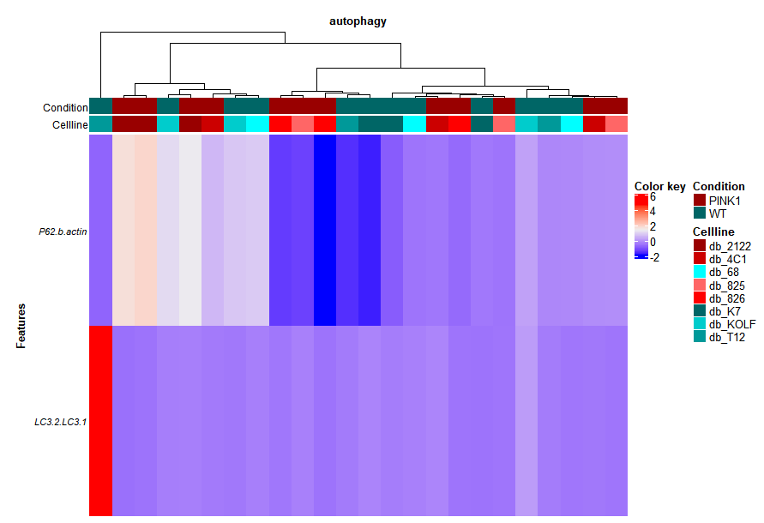
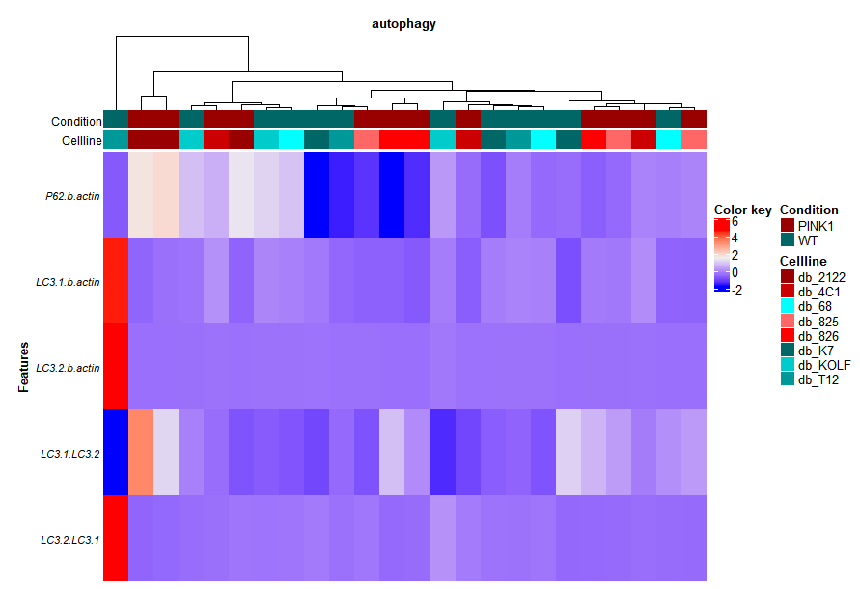

Slide 7
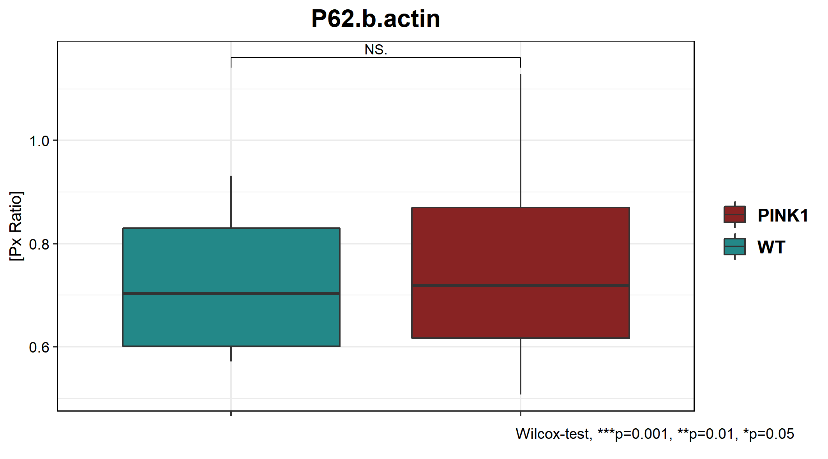
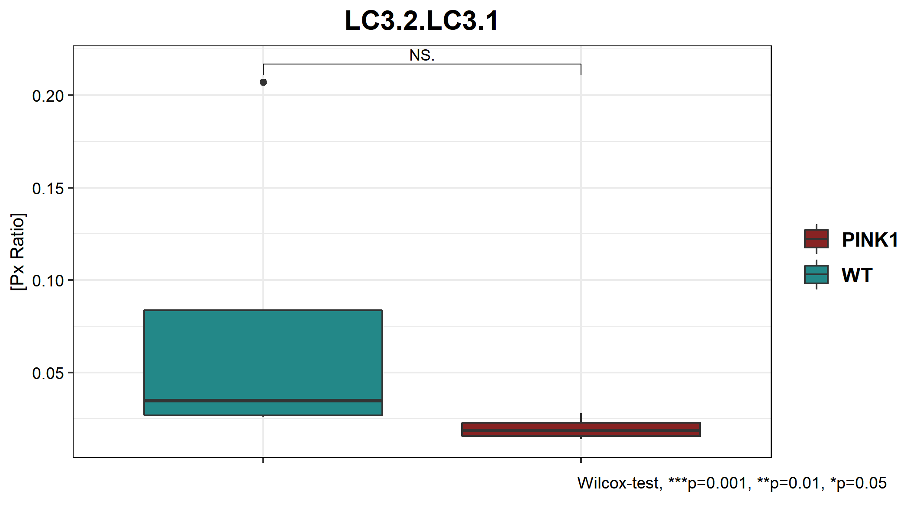
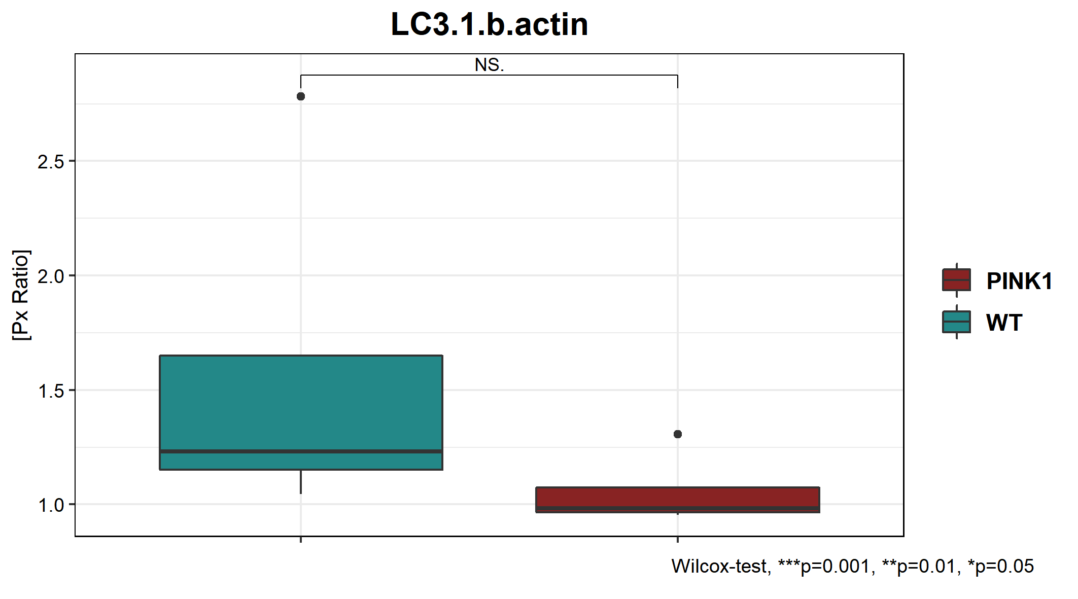
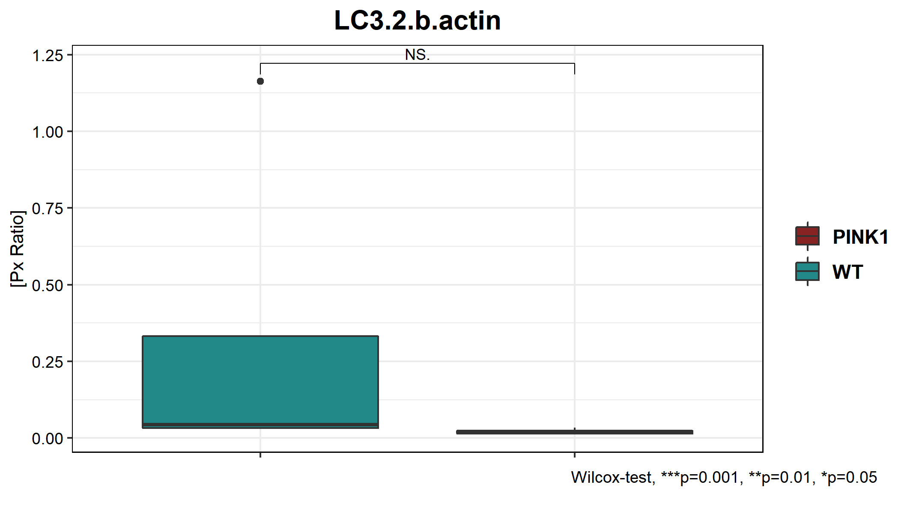
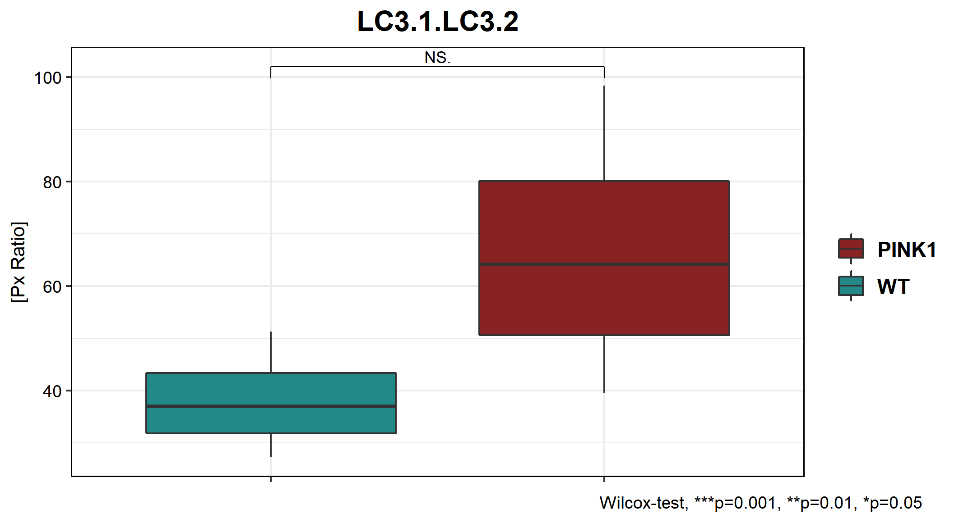
\\atlas\LCSB_Cellular_Biology\09-Sharing of Data\for Javi\from_JM_CL_SSS_pink1\JJ_PINK1paper_JM\all lines blots\Results\results_perCondition_averageReplicate
Note: plotting a single value per line (average of replicates)

Slide 8
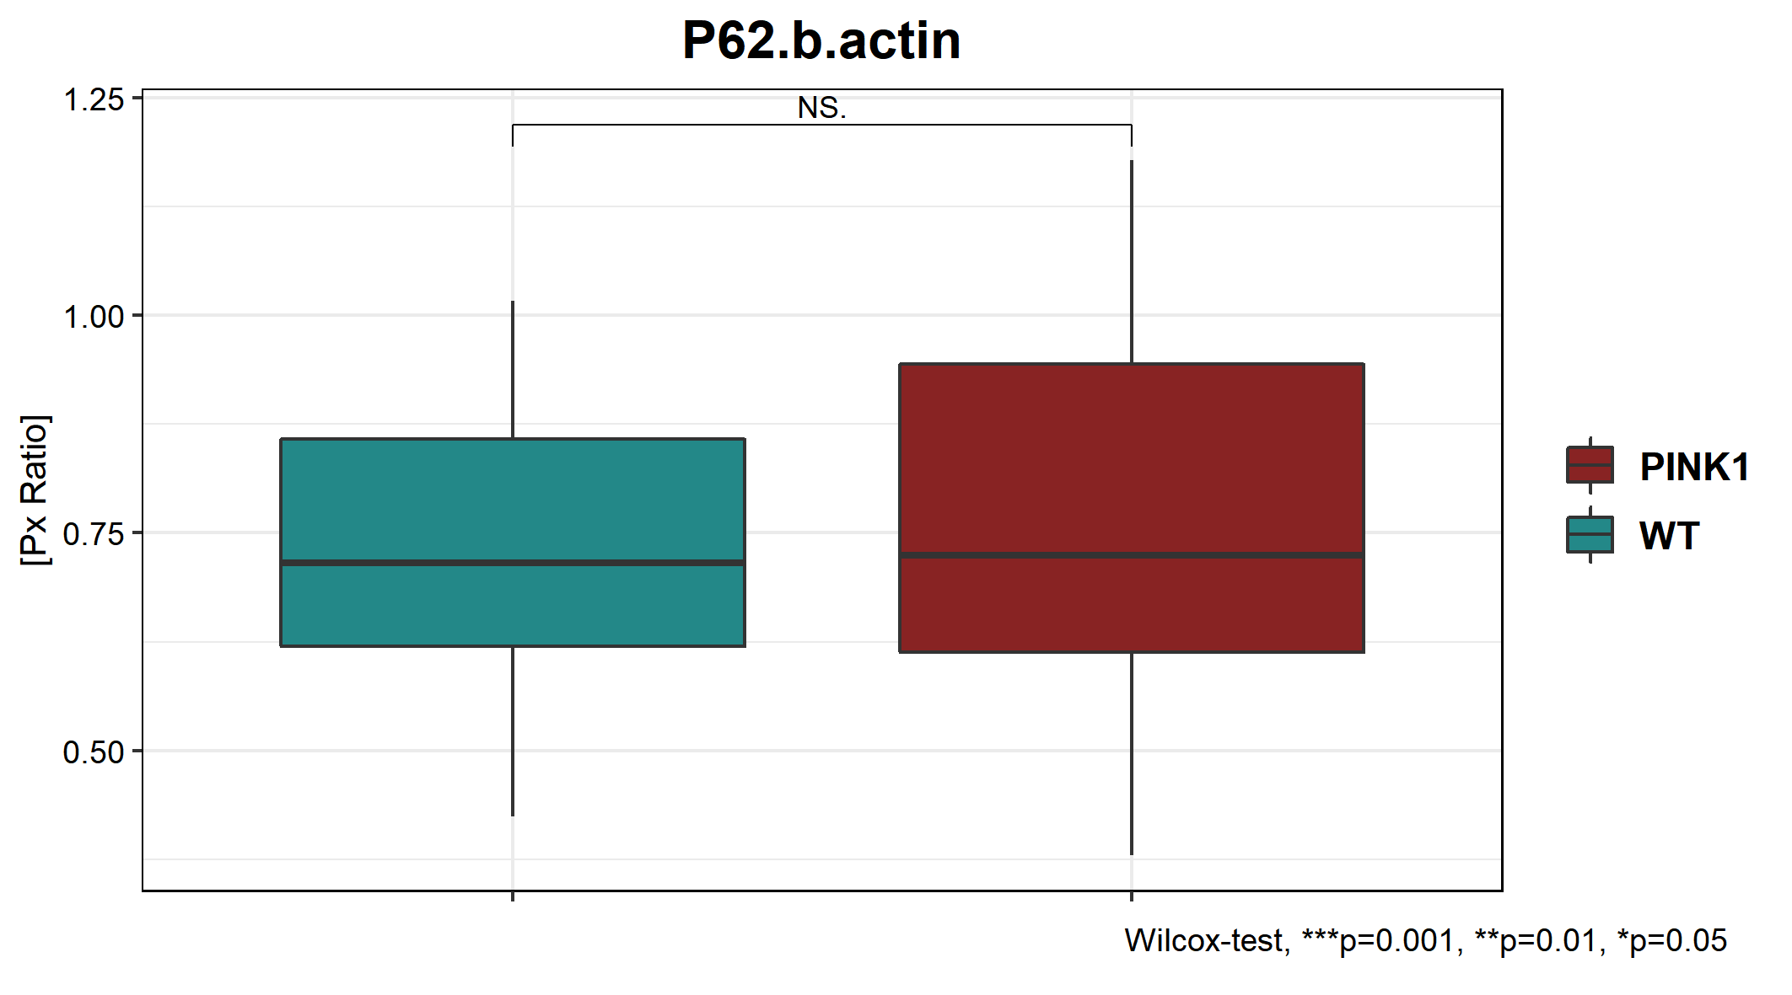
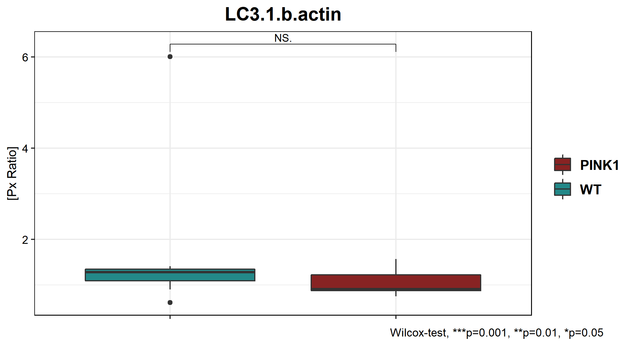
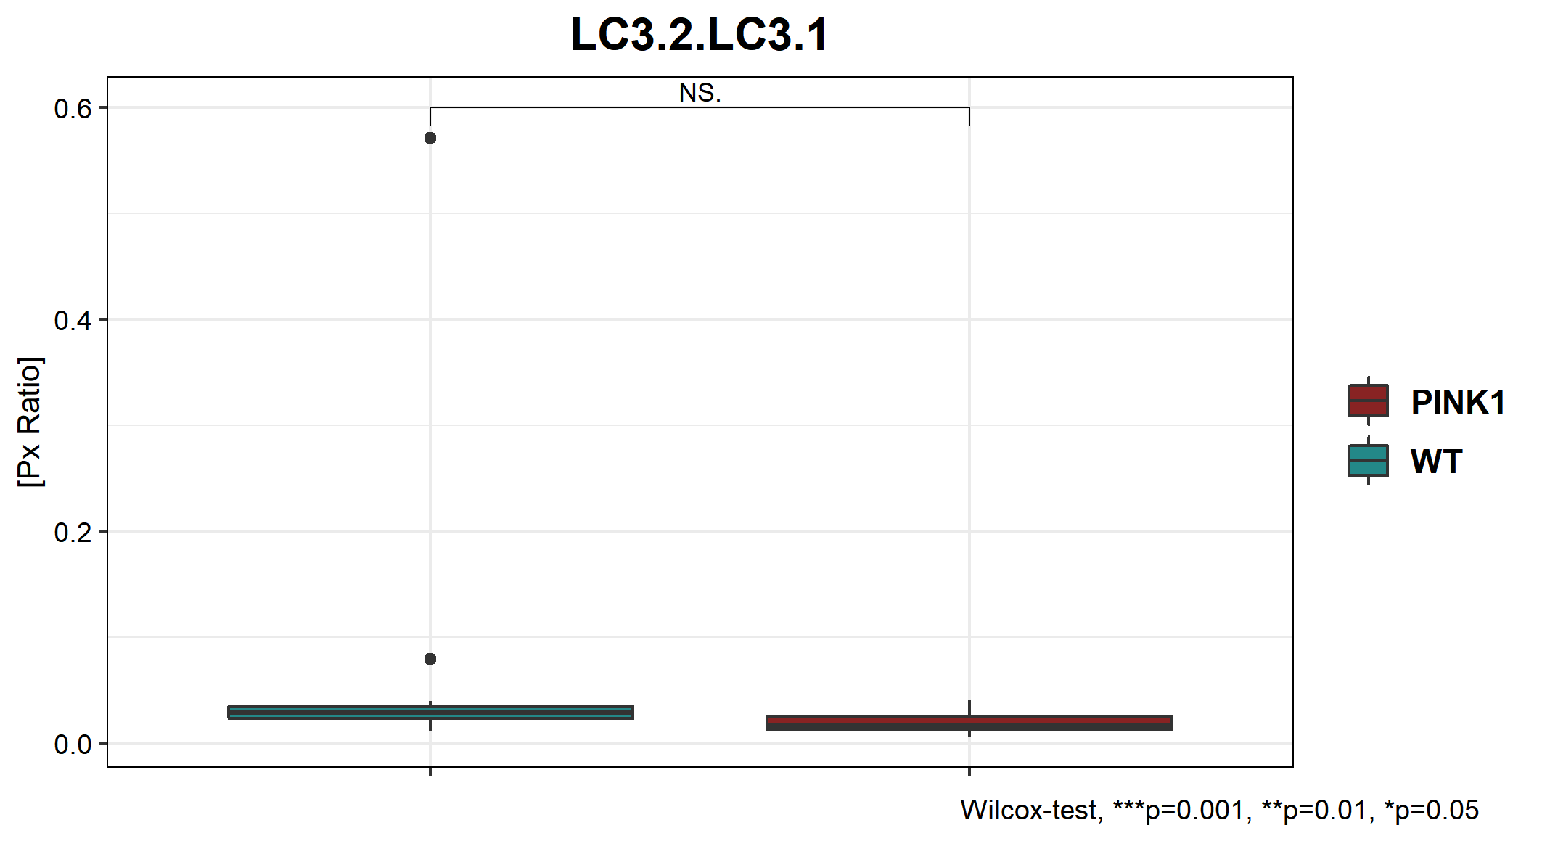
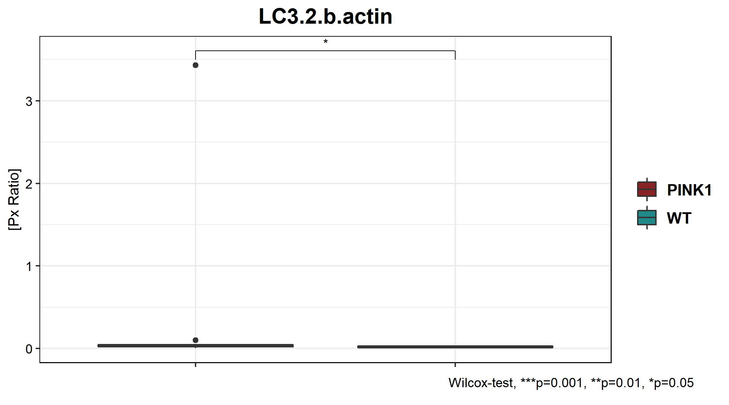
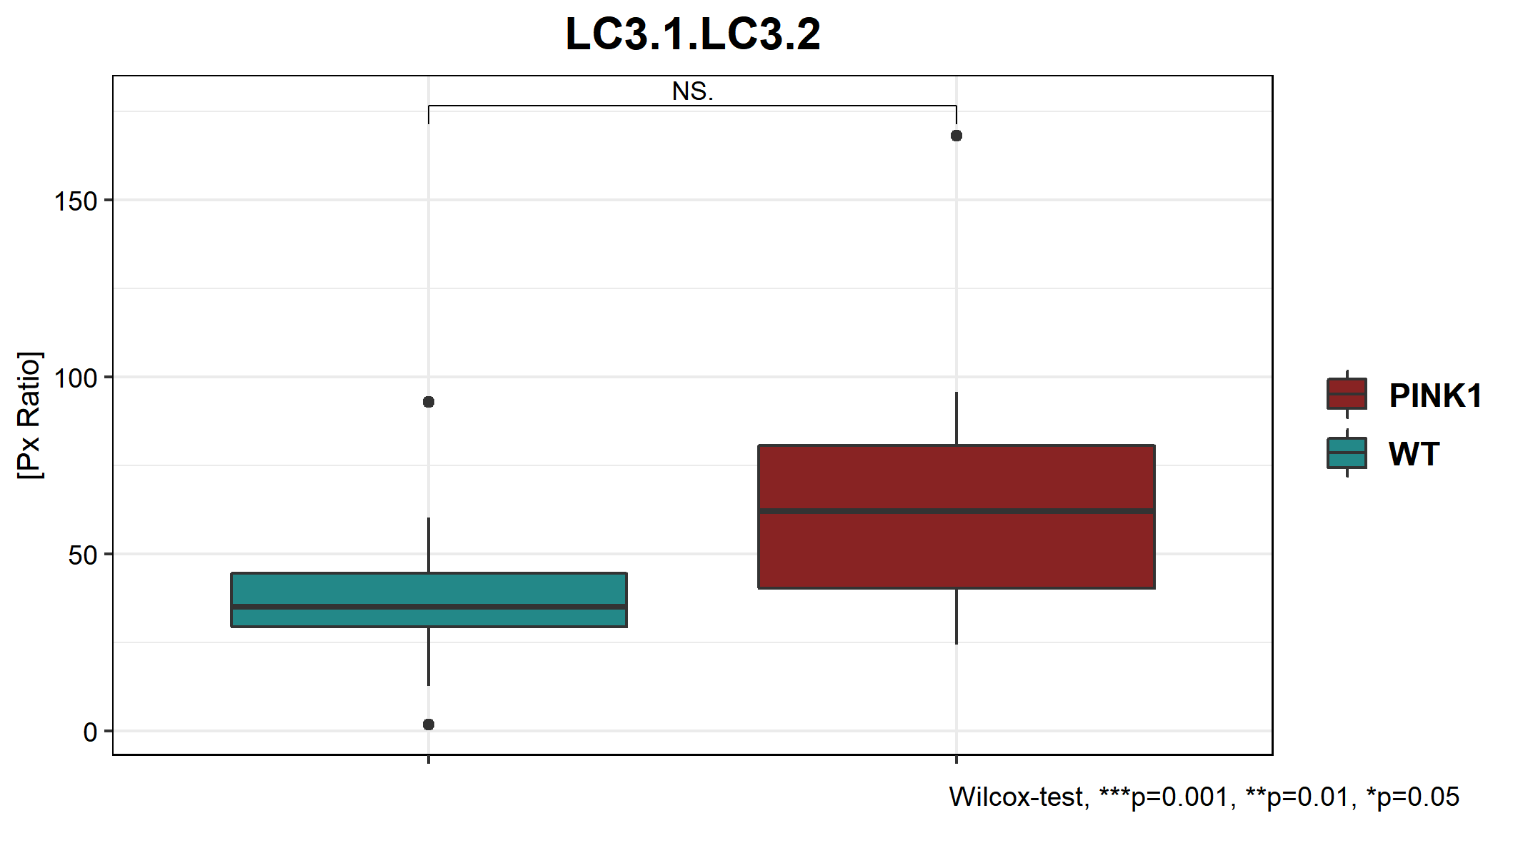
\\atlas\LCSB_Cellular_Biology\09-Sharing of Data\for Javi\from_JM_CL_SSS_pink1\JJ_PINK1paper_JM\all lines blots\Results\results_perCondition_NOaverageReplicate
Note: plotting 3 values per line (NO average of replicates)
significant

Slide 9
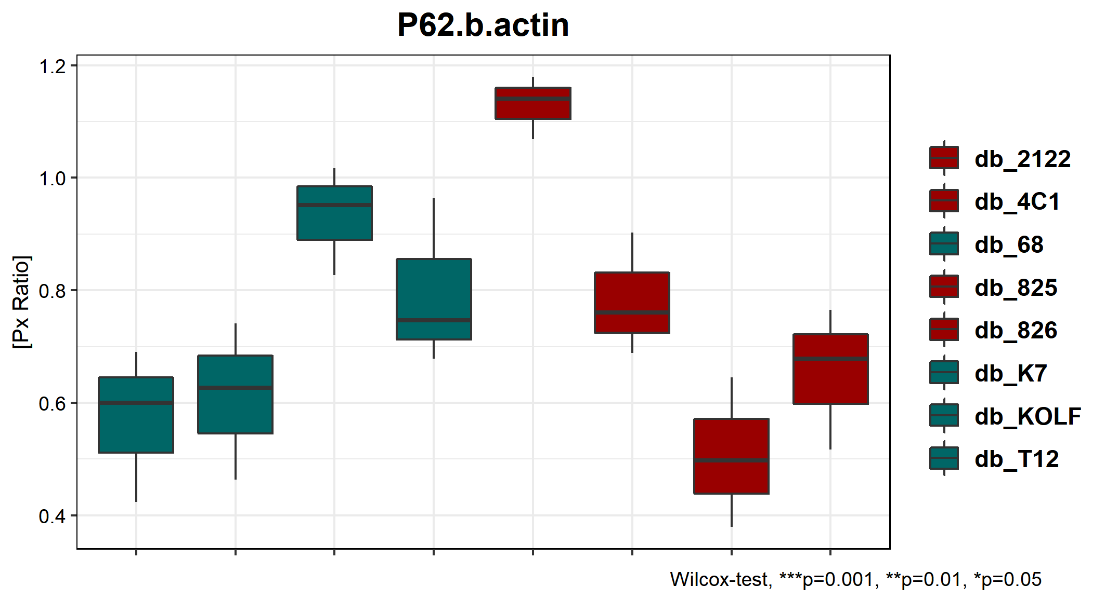
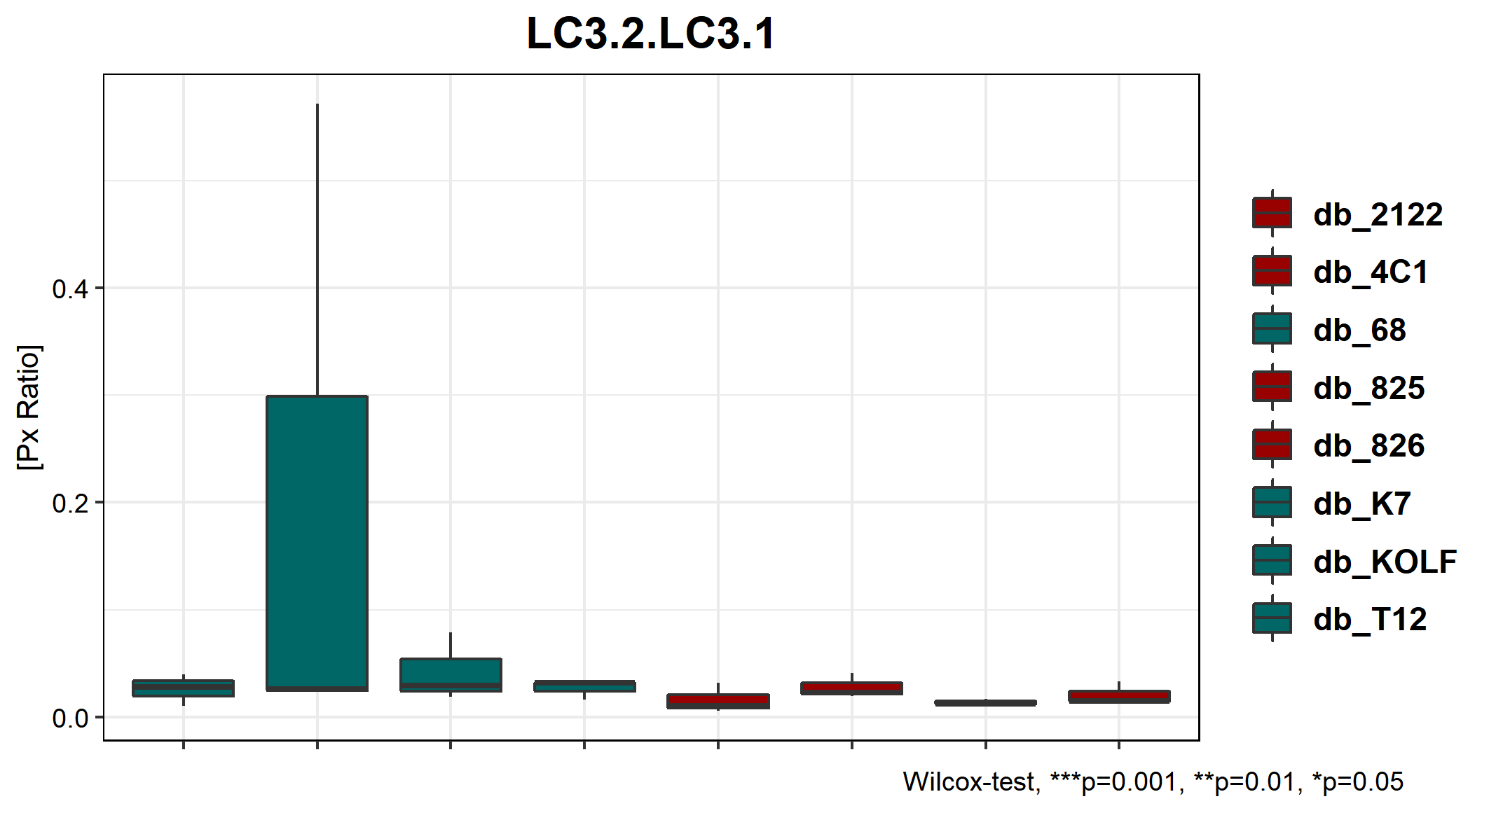
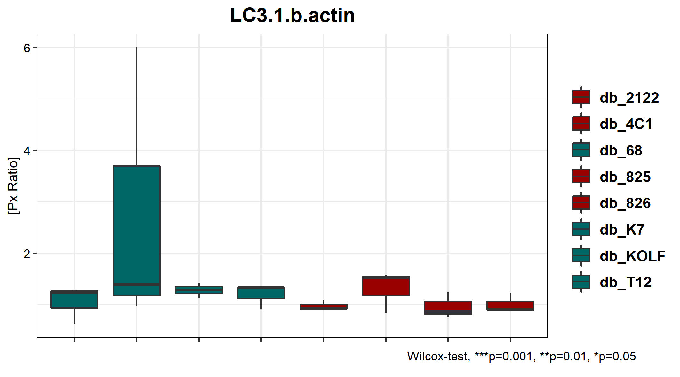
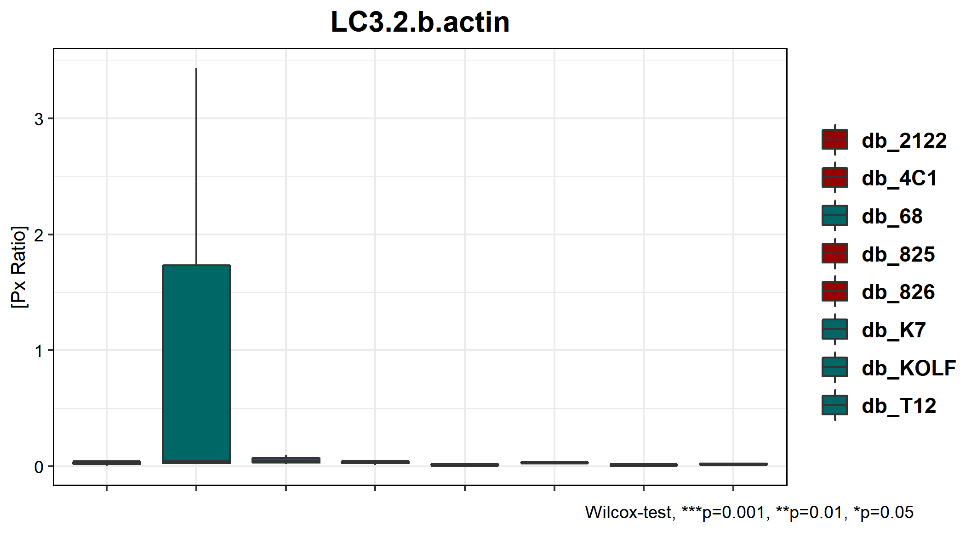
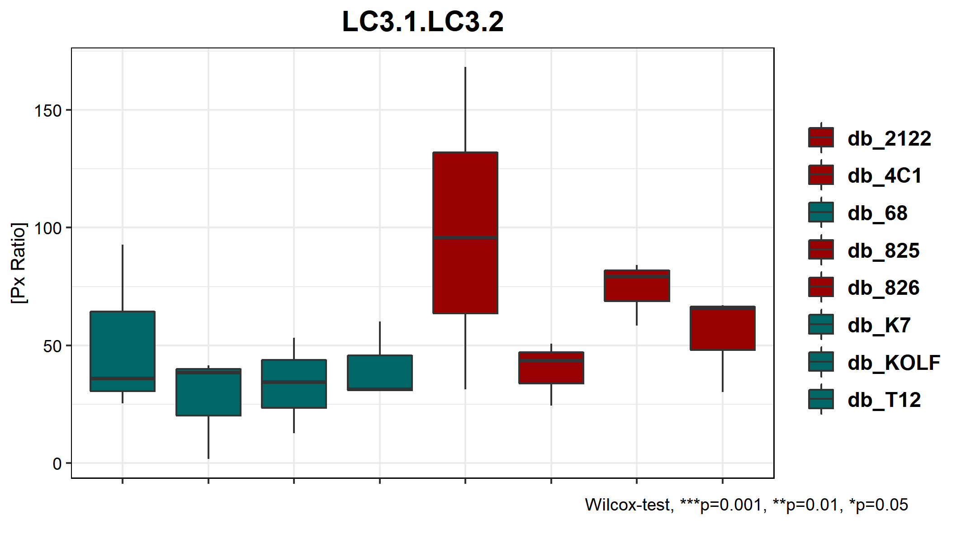
\\atlas\LCSB_Cellular_Biology\09-Sharing of Data\for Javi\from_JM_CL_SSS_pink1\JJ_PINK1paper_JM\all lines blots\Results\results_perLine

Slide 10
Blots for treatments (*partial data – rest of samples from Claudia):

Slide 11
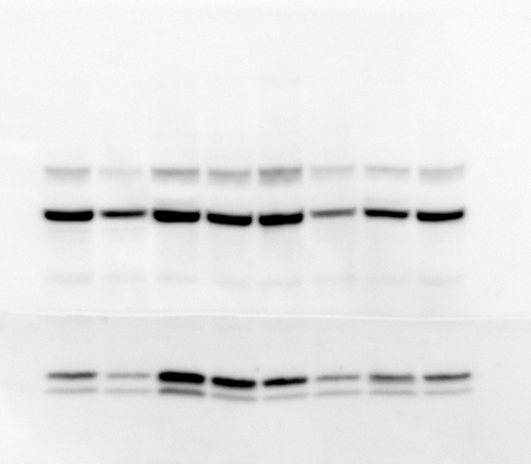
REPETITION BY SÒNIA
P62
b-actin
LC3-I
LC3-II

Slide 12
R1
P62
b-actin
LC3-I
LC3-II
K7
T12
KOLF
68
2122
4C1
826
825
WT Healthy control
∆PINK1
R2
P62
b-actin
LC3-I
LC3-II
K7
T12
KOLF
68
2122
4C1
826
825
WT Healthy control
∆PINK1
P62
b-actin
LC3-I
LC3-II
K7
T12
KOLF
68
2122
4C1
826
825
WT Healthy control
∆PINK1

