Slide 1
Fibroblasts

Slide 2
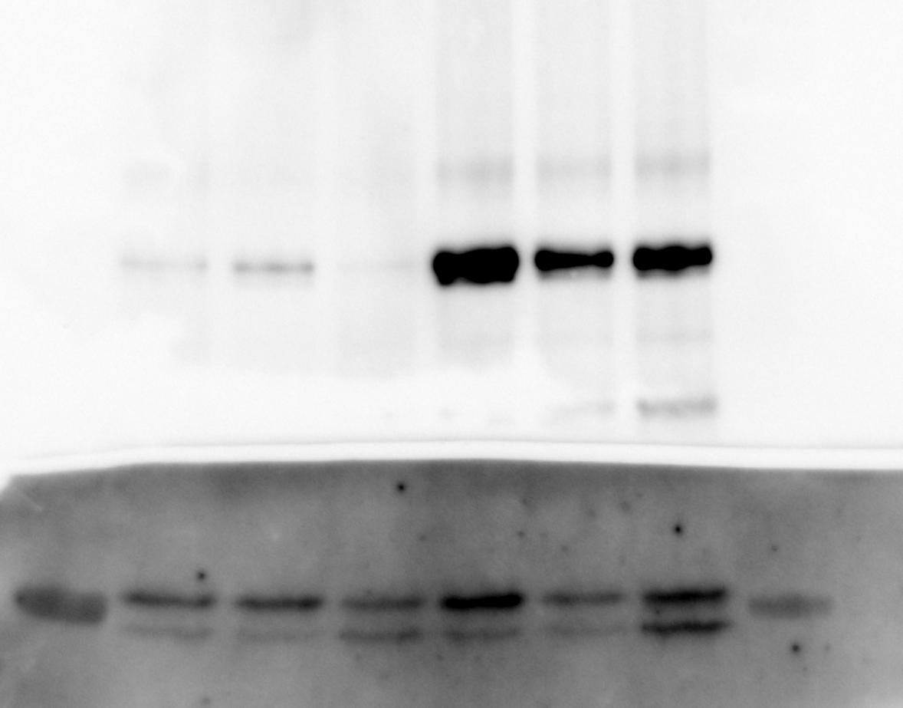
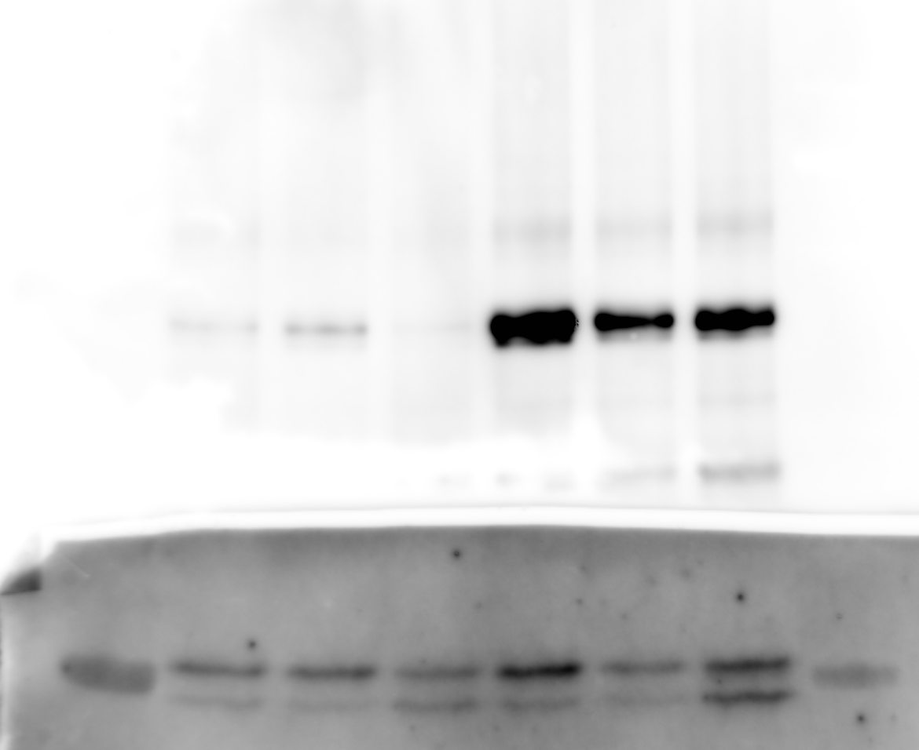
Fib R1 – 6 samples
B-actin
P62
Couldn’t see it
LC3 I & II

Slide 3
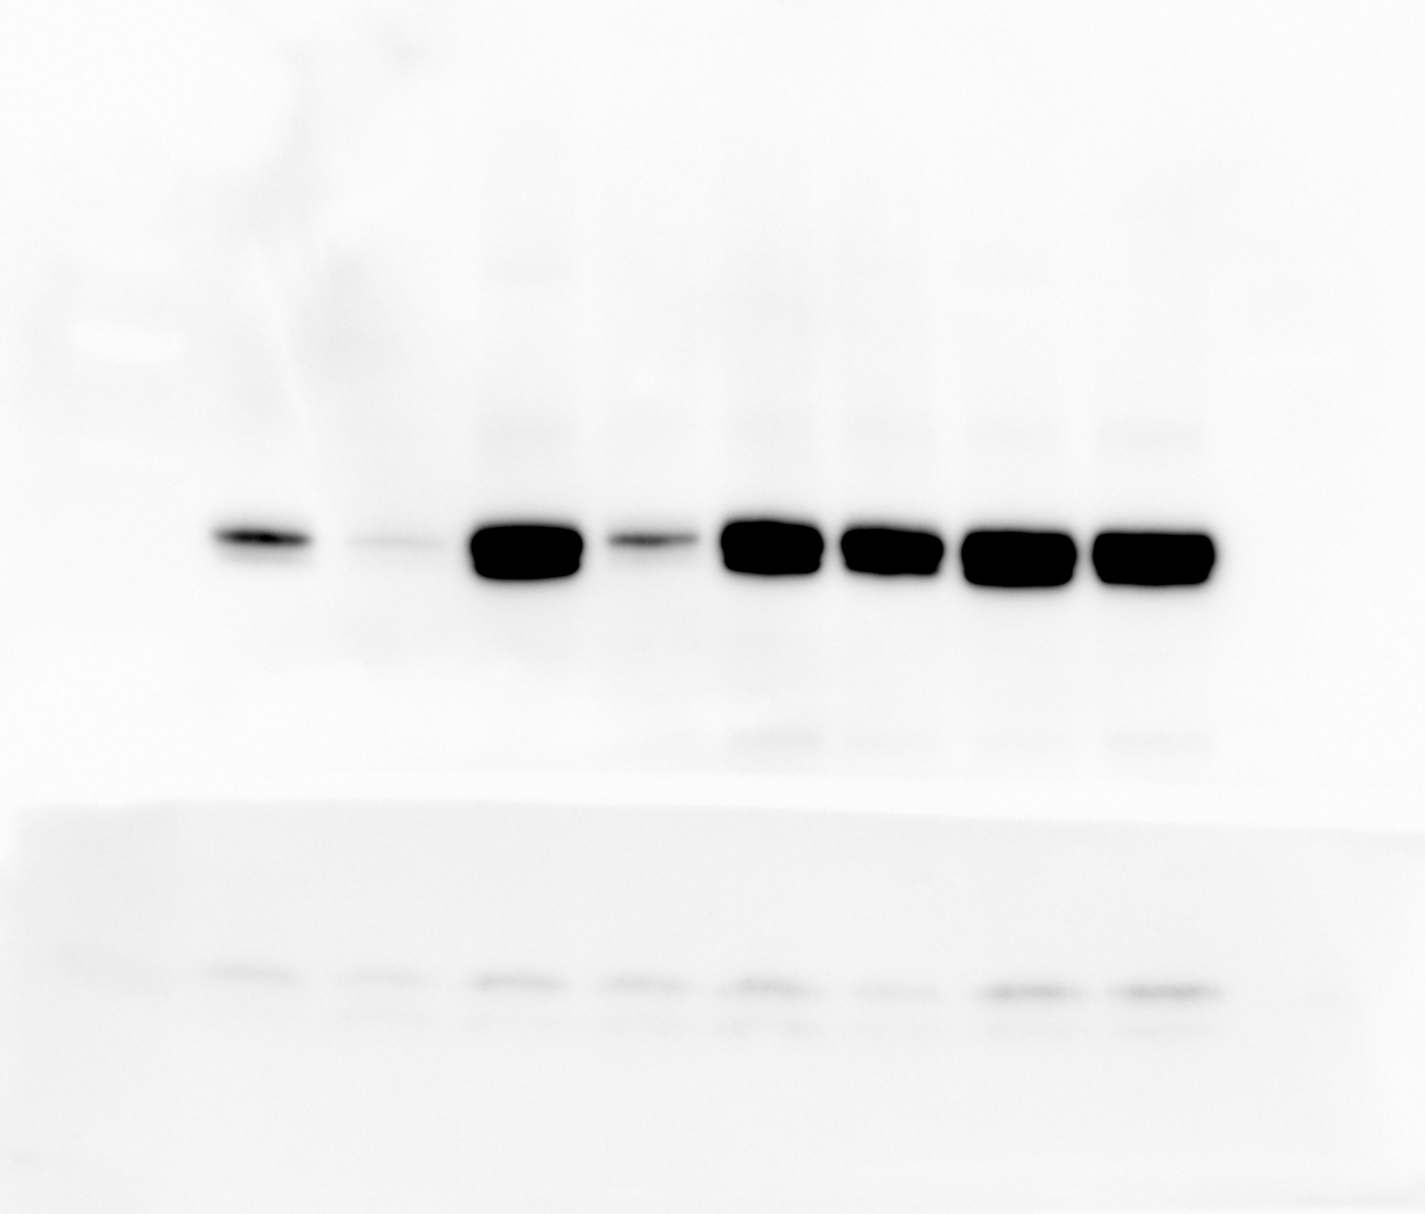
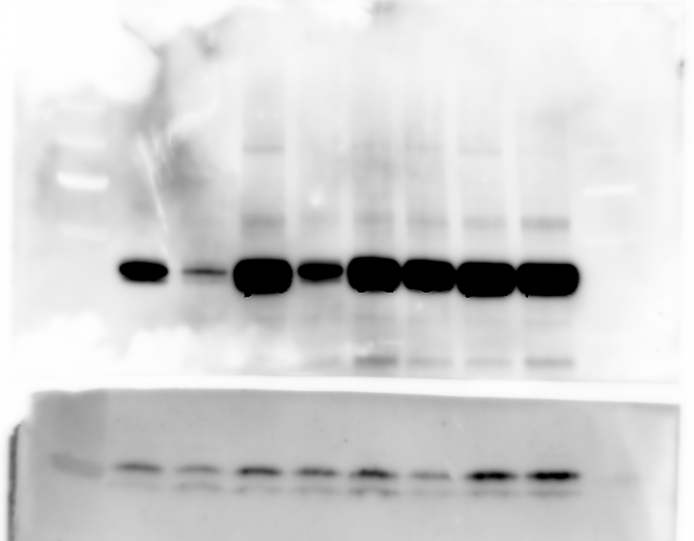
Fib R1 – 8 samples
B-actin
P62
Couldn’t see it
LC3 I & II

Slide 4
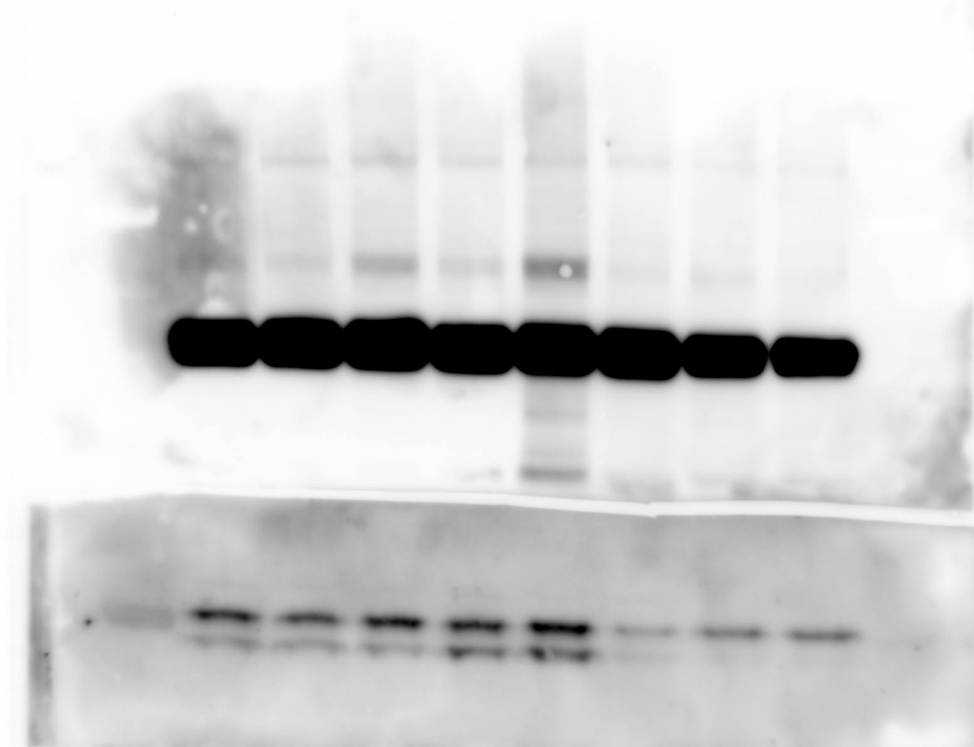
Fib R2 – 8 samples
B-actin
P62
Couldn’t see it
LC3 I & II

Slide 5
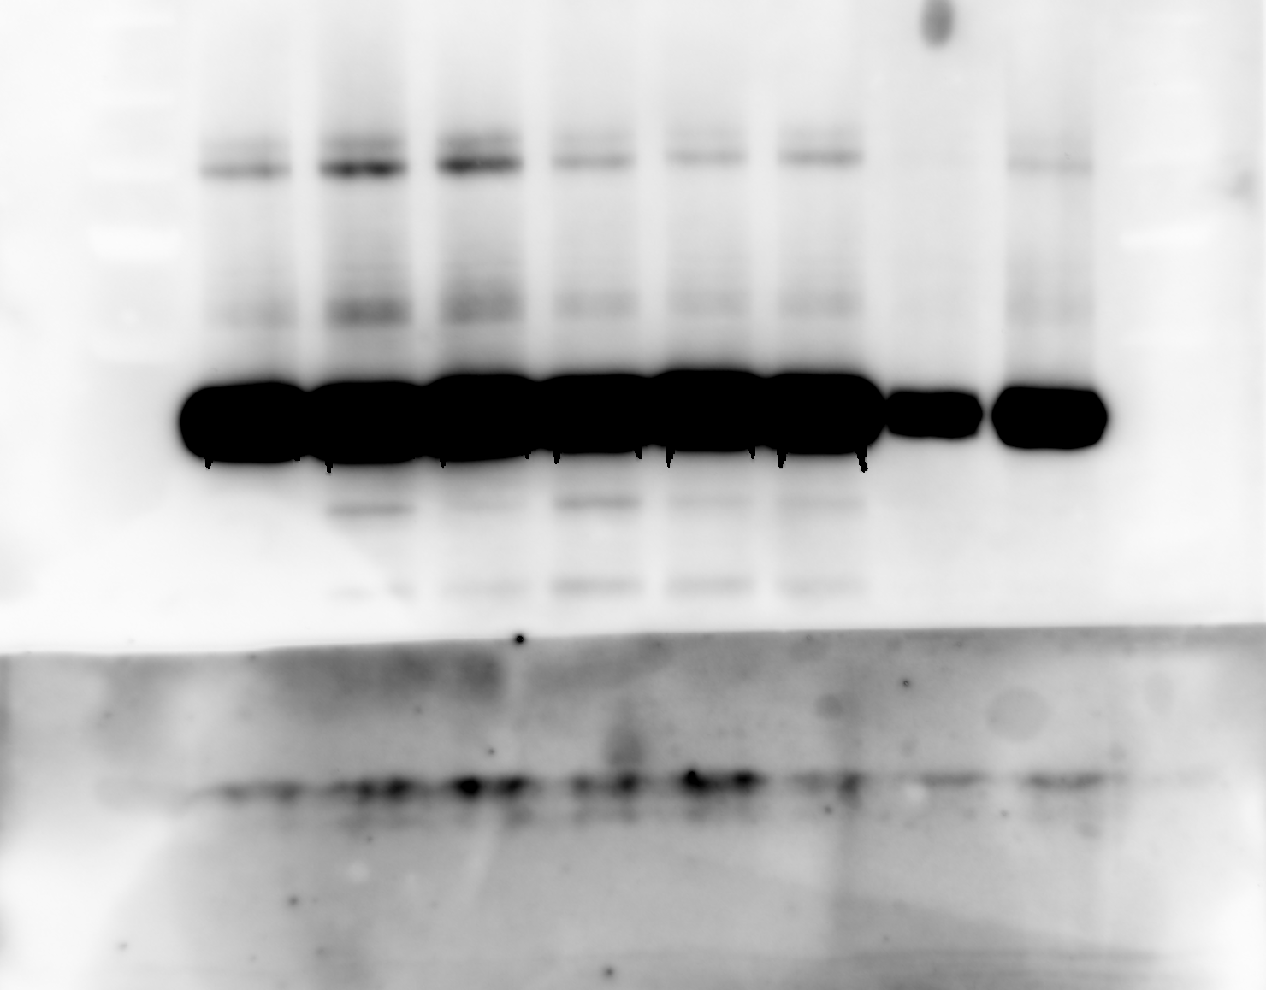
Fib R3 – 8 samples
B-actin
Decrease ab dilution to 1:500
P62
We still have the 2 bands but maybe with this dilution we can quantified it
LC3 I & II
LC3 didn’t arrived, had to used a reused one from 3mL with less than 3ul

