Slide 1
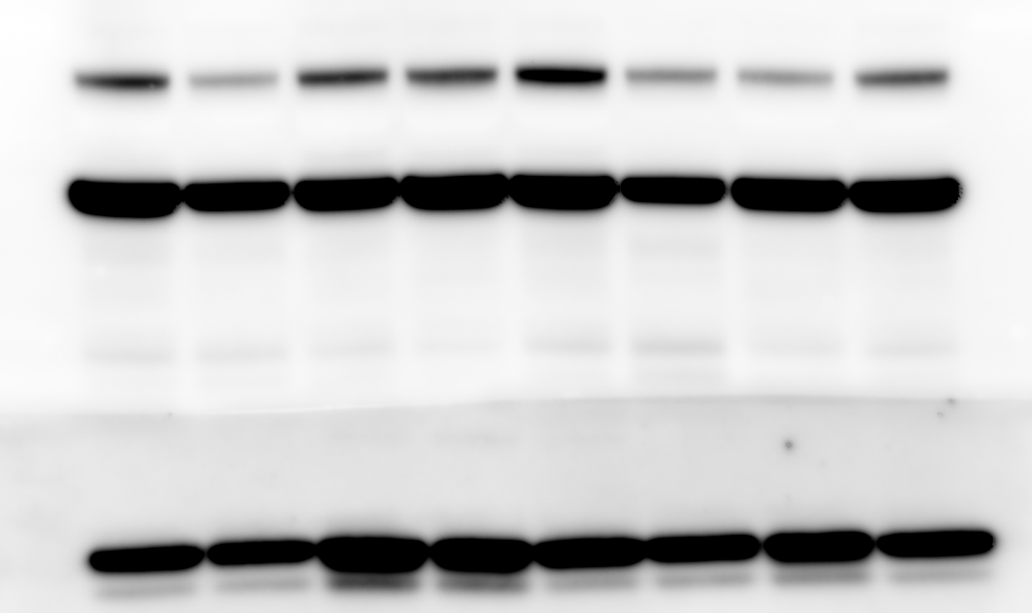
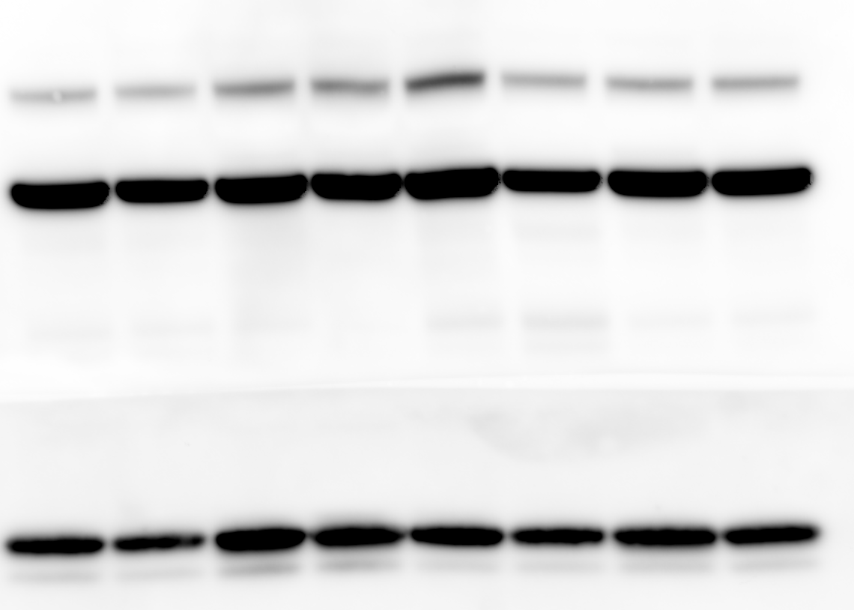
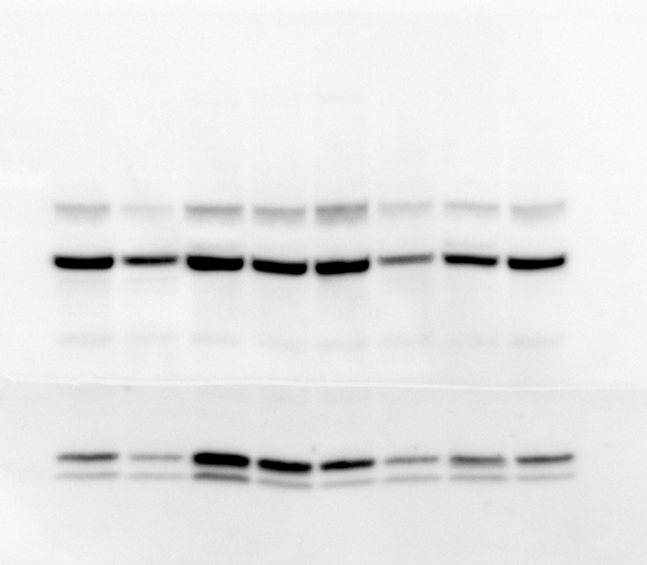
R1
P62
b-actin
LC3-I
LC3-II
K7
T12
KOLF
68
2122
4C1
826
825
WT Healthy control
∆PINK1
R2
P62
b-actin
LC3-I
LC3-II
K7
T12
KOLF
68
2122
4C1
826
825
WT Healthy control
∆PINK1
P62
b-actin
LC3-I
LC3-II
K7
T12
KOLF
68
2122
4C1
826
825
WT Healthy control
∆PINK1

