Slide 1
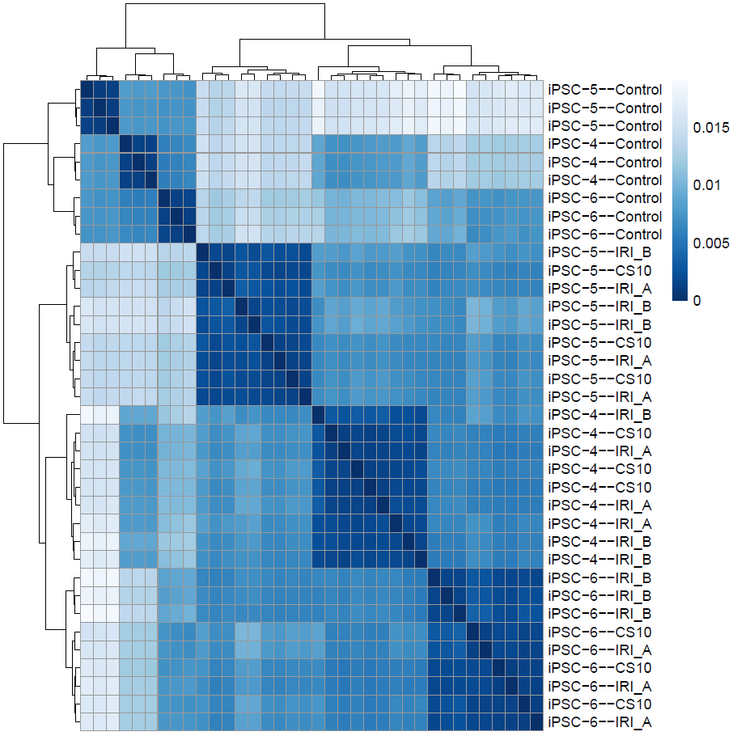
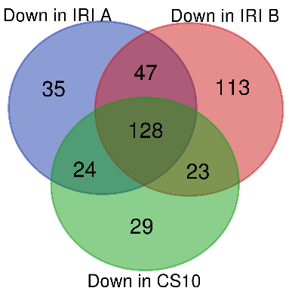
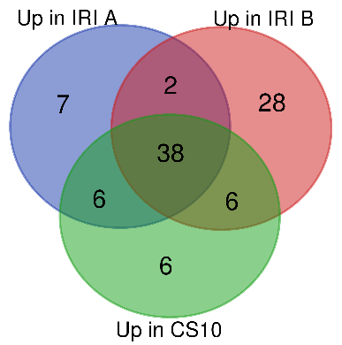
A
B
C
Number of DEGs | CS10 | IRI-A | IRI-B
Down-regulated | 204 | 234 | 311
Up-regulated | 56 | 53 | 74
De-regulated | 260 | 287 | 385
D
Number of selected pathways | CS10 | IRI-A | IRI-B
Down-regulated | 13 | 18 | 28
Up-regulated | 1 | 0 | 9
De-regulated | 14 | 18 | 37
E
Pathways deregulation | Cryoprotectants | Pathway name
Up-regulated | Common CS10 and IRI-B | HALLMARK_HYPOXIA
 | IRI-B | CONCANNON_APOPTOSIS_BY_EPOXOMICIN_UP
 |  | HALLMARK_HYPOXIA
 |  | GO_RESPONSE_TO_OXIDATIVE_STRESS
 |  | WINTER_HYPOXIA_METAGENE
 |  | GO_CELLULAR_RESPONSE_TO_STRESS
 |  | GO_EMBRYONIC_MORPHOGENESIS
 |  | GO_REGULATION_OF_RESPONSE_TO_STRESS
 |  | GO_REGULATION_OF_CELLULAR_RESPONSE_TO_STRESS
 |  | BUYTAERT_PHOTODYNAMIC_THERAPY_STRESS_UP
Down-regulated | Common all cryoprotectants | GO_PASSIVE_TRANSMEMBRANE_TRANSPORTER_ACTIVITY
 |  | GO_INORGANIC_ION_TRANSMEMBRANE_TRANSPORT
 |  | GO_ION_TRANSMEMBRANE_TRANSPORT
 |  | GO_METAL_ION_TRANSMEMBRANE_TRANSPORTER_ACTIVITY
 |  | GO_INORGANIC_CATION_TRANSMEMBRANE_TRANSPORTER_ACTIVITY
 |  | GO_REGULATION_OF_TRANSMEMBRANE_TRANSPORT
 |  | GO_TRANSMEMBRANE_TRANSPORT
 |  | GO_CATION_TRANSMEMBRANE_TRANSPORTER_ACTIVITY
 |  | GO_TRANSMEMBRANE_TRANSPORTER_ACTIVITY
 |  | GO_MONOVALENT_INORGANIC_CATION_TRANSMEMBRANE_TRANSPORTER_ACTIVITY

