Slide 1




















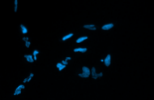
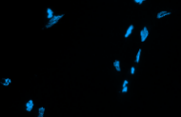
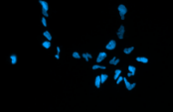
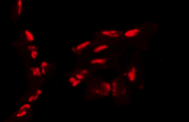
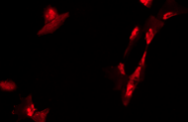
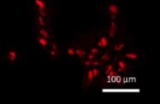
A
Colony
SSEA4 Nanog TRA-1-60 Oct4 TRA-1-81 SOX2
B
 | Undifferentiated cells
 | Self-renew | Ecto | Meso | Endo
iPSC-4
iPSC-5
iPSC-6
iPSC-4
iPSC-5
iPSC-6
D
C
iPSC-4 iPSC-5 iPSC-6
 | Differentiated cells
 | Self-renew | Ecto | Meso | Endo
iPSC-4
iPSC-5
iPSC-6
SOX17 Hoechst

