Slide 1
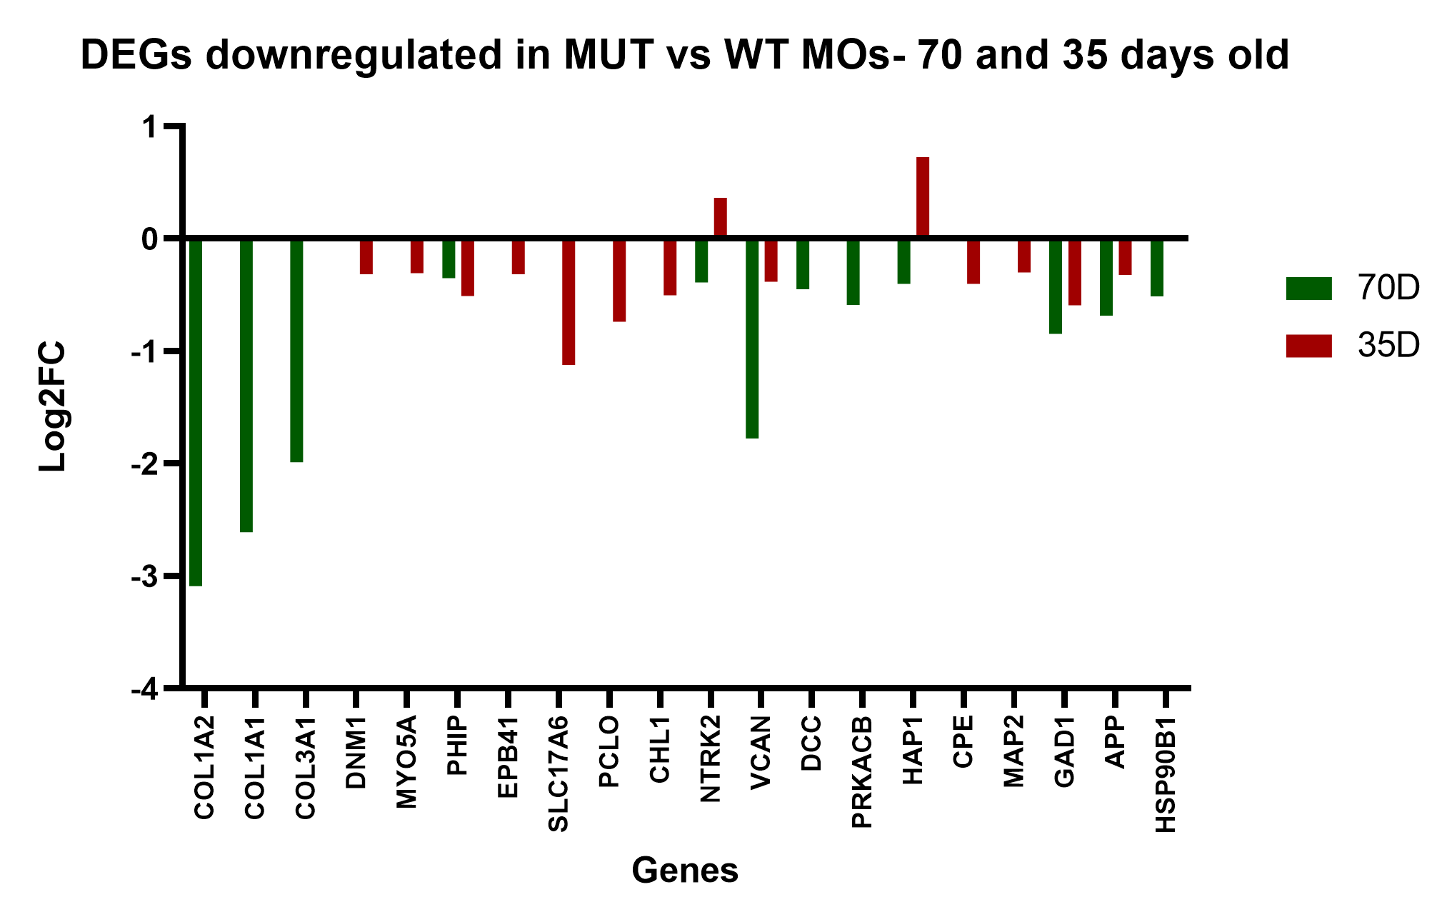
Cytoskeleton
Synapses
Neuronal development

