Slide 1
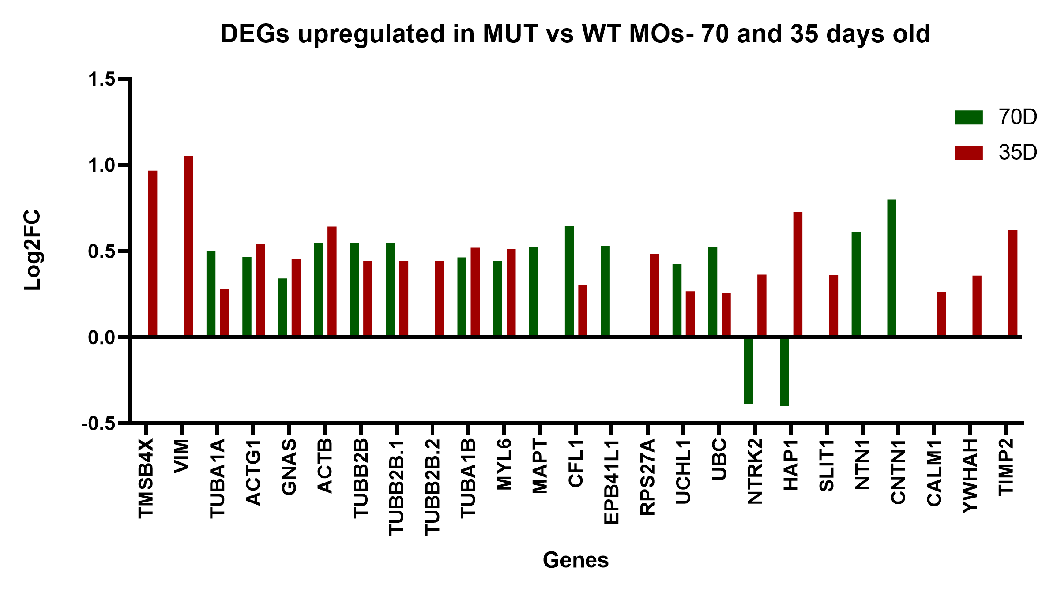
Cytoskeleton
Proteins regulation
Neuronal development
Migration – Axonal
guidance

