Slide 1
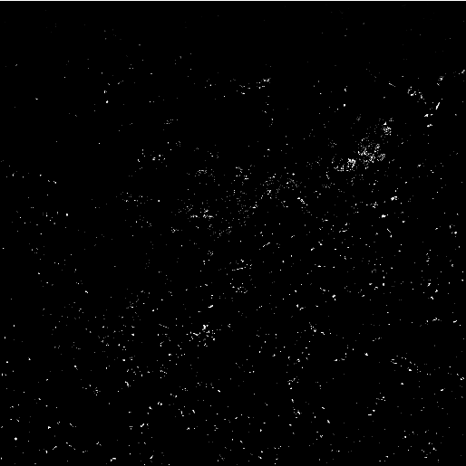

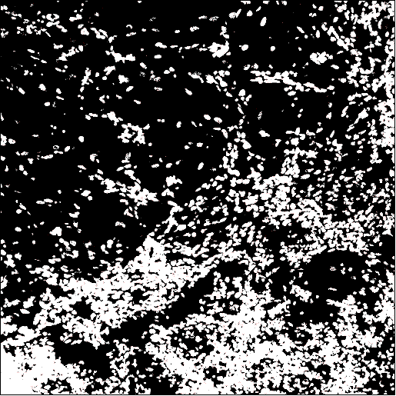
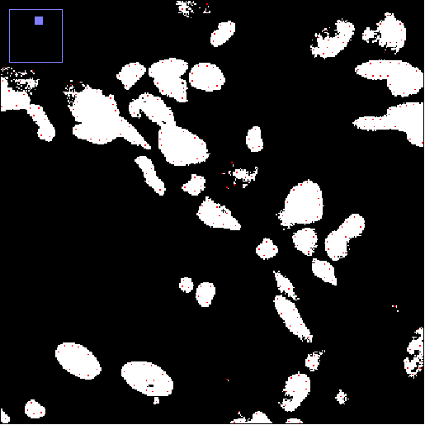
PSD95
Synaptophysin
Nuclei
WT Section 1_ROI1
MaxEntropy threshold
Mean threshold
Particle analysis count mask
ITCN nuclear count mask

Slide 2
Ch1= PSD95
Ch2= Synaptophysin
Ch3 = Nuclei
WT Section 1_ROI1
Particle analysis count mask
ITCN nuclear count mask

