Slide 1
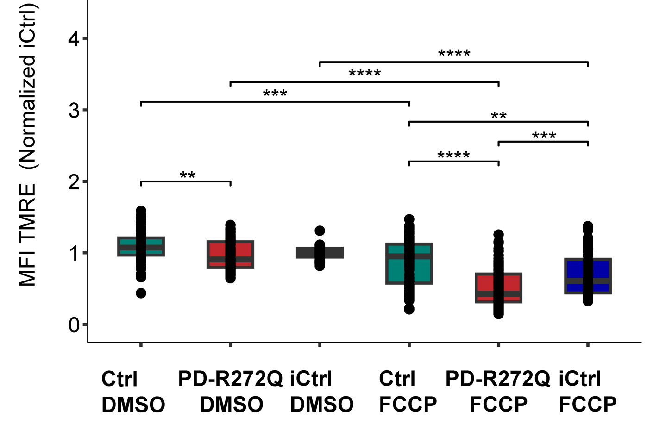
Ctrl dmso
PD-R272Q dmso
iCtrl dmso
Ctrl fccp
PD-R272Q fccp
iCtrl fccp

