Slide 1
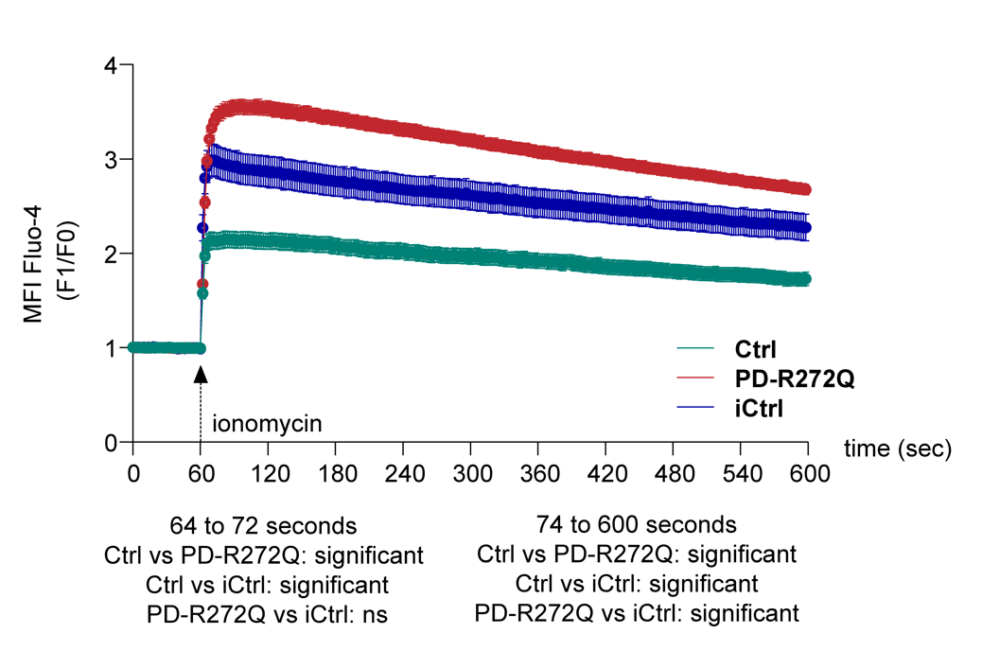
T001
T120
Ctrl
PD-R272Q
iCtrl
Fluo4
Hoechst
Merged
Fluo4
Hoechst
Merged

