Slide 1
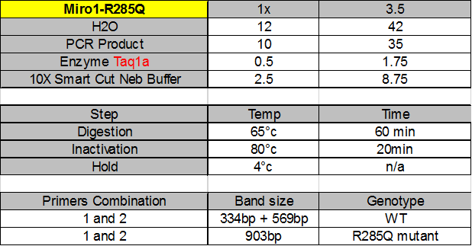
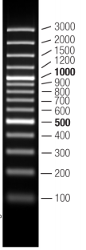
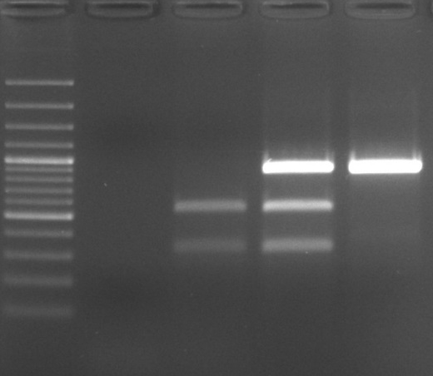
08/09/2017
Genotyping Mouse Tail
Miro1 R285Q
(Digestion with Restriction Enzyme from NEB for Sequencing)
(PCR Promega Go Taq Flexi DNA Polymerase)
(Digestion with Restriction Enzyme from NEB – Taq1a)
R0031 – BRK17 – WT
R0028 – BRK17 – Hétérozygote
R0034 – BRK17 – Homozygote
100bp Ladder
H2O
R0031 (WT)
R0028 (Hétéro)
R0034 (Homo)
Digested band → R285Q (WT)
Digested band & no digested band → R285Q mutant (Hétéro)
No digested band → R285Q mutant (Homo)

