Slide 1
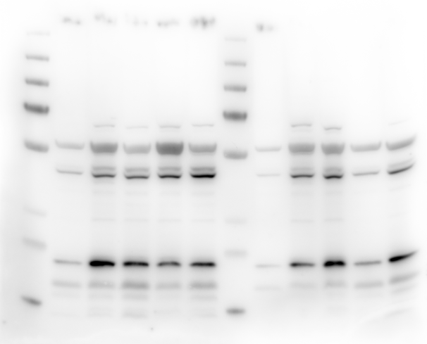
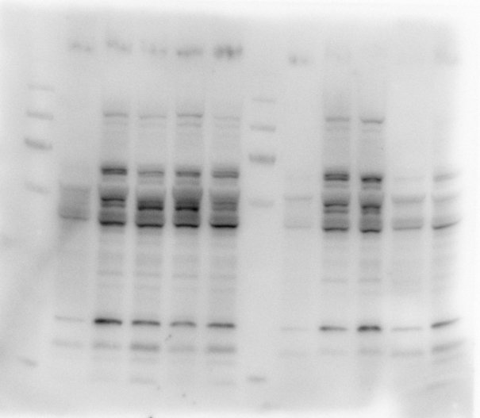
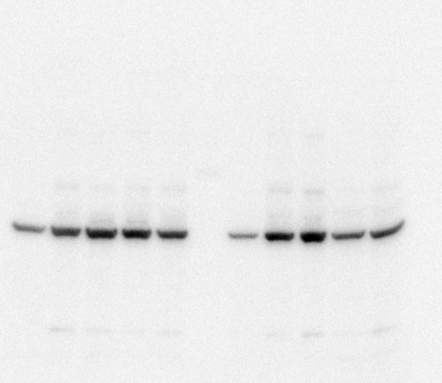
Membrane 1
B12
B13
B12
B13
WT18075 WT580 WT581 PD GC
WT18075 WT580 WT581 PD GC
WT18075 WT580 WT581 PD GC
WT18075 WT580 WT581 PD GC
JNK/MAPK8
55kDA
FTL
19kDA
actin
actin
Because of the actin in the WT18075, I am redoing this

Slide 2
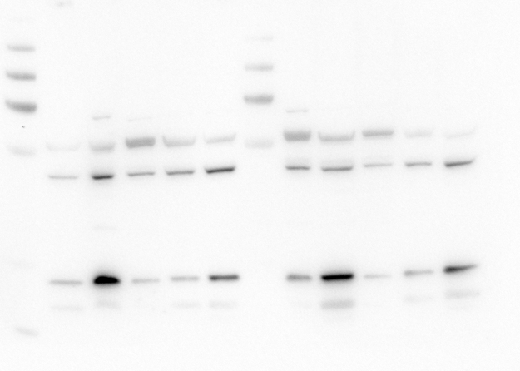
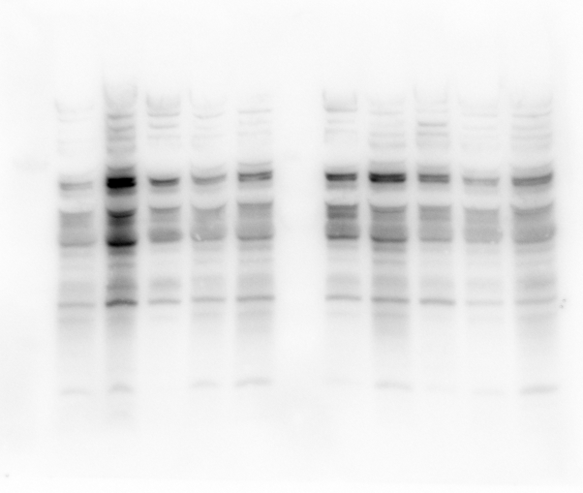

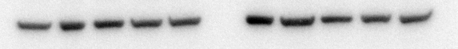
Membrane 1
Membrane 2
B14
B15
B14
B15
WT18075 WT580 WT581 PD GC
WT18075 WT580 WT581 PD GC
WT18075 WT580 WT581 PD GC
WT18075 WT580 WT581 PD GC
JNK/MAPK8
55kDA
FTL
19kDA
actin
actin

Slide 3
Antibody information
Ferritin light chain (FTL) Polyclonal Antibody | Rabbit | IgG | Proteintech | 10727-1-AP
PRKCB Monoclonal antibody | Mouse | IgG1 | Proteintech | 68620-1-Ig
JNK Monoclonal antibody (MAPK8;JNK1) | Mouse | IgG1 | Proteintech | 66210-1-Ig

