Slide 1
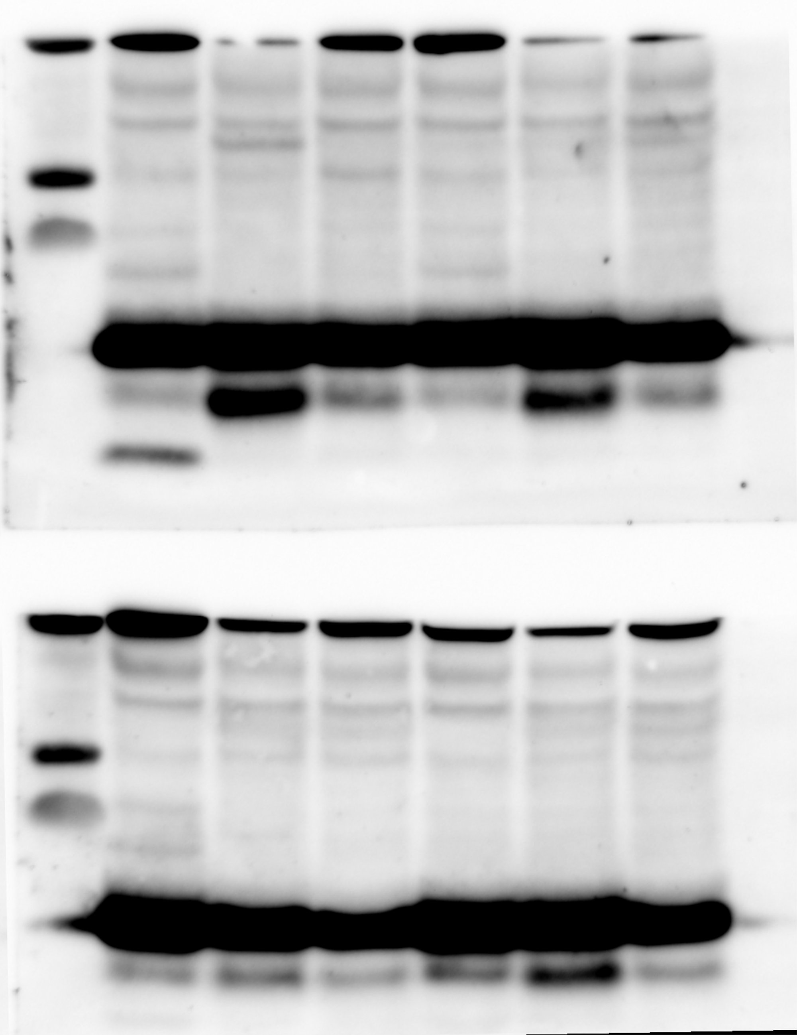
Normal exposure
Ctrl1
PD-R272Q
iCtrl
Ctrl1
PD-R272Q
iCtrl
Ctrl1
PD-R272Q
iCtrl
Ctrl1
PD-R272Q
iCtrl
β-actin 42 kDa
α-syn 15 kDa
High exposure
Ctrl1
PD-R272Q
iCtrl
Ctrl1
PD-R272Q
iCtrl
α-syn 15 kDa

Slide 2
3x
SNCA
PD-R272Q
iCtrl
Ctrl1
3x
SNCA
PD-R272Q
iCtrl
Ctrl1
α-syn 60 kDa
Vinculin 130 kDa
α-syn 15 kDa

Slide 3
Ctrl1
Ctrl2
PD-
R272Q
Ctrl3
iCtrl
PD-
R272Q
TH 60 kDa
Ctrl1
Ctrl2
Ctrl3
iCtrl
β-actin 42 kDa

Slide 4
wt/wt
R285Q/R285Q
β-actin 42 kDa
wt/wt
R285Q/R285Q
α-syn 15 kDa

Slide 5
wt/wt
R285Q/R285Q
β-actin 42 kDa
wt/wt
R285Q/R285Q
α-syn 19 kDa

Slide 6
Ctrl1
Ctrl2
PD-
R272Q
PD-
R272Q
Ctrl3
iCtrl
Ctrl1
Ctrl2
Ctrl3
iCtrl
Ctrl1
Ctrl2
PD-
R272Q
PD-
R272Q
Ctrl3
iCtrl
Ctrl1
Ctrl2
Ctrl3
iCtrl
VDAC 32 kDa
β-actin 42 kDa

Slide 7
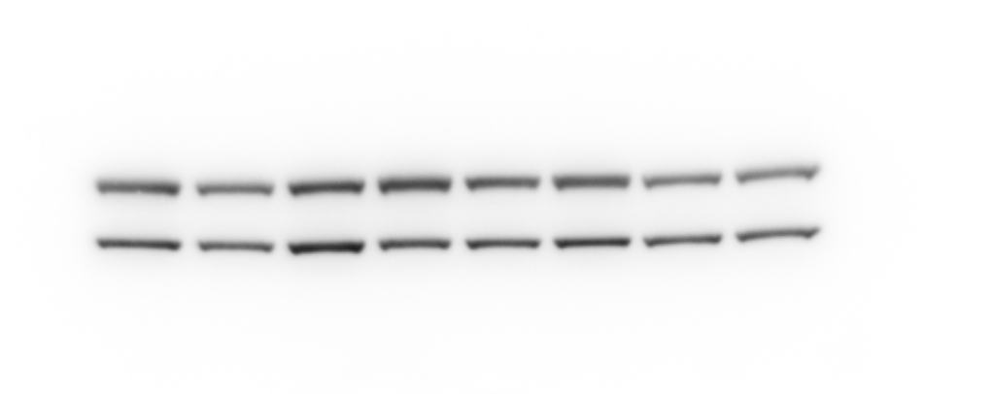
Ctrl1
Ctrl2
Ctrl3
PD-
R272Q
iCtrl
PD-
R272Q
Ctrl1
Ctrl2
Ctrl3
iCtrl
β-actin 42 kDa
TOM20 18 kDa

Slide 8
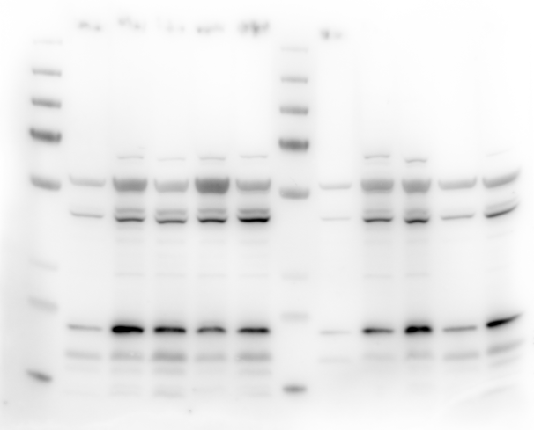
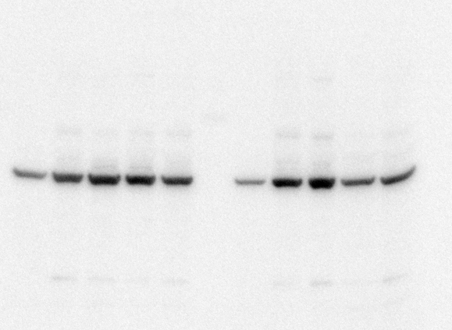
Ctrl1
Ctrl2
PD-
R272Q
PD-
R272Q
PD-
R272Q
PD-
R272Q
Ctrl3
iCtrl
Ctrl1
Ctrl2
Ctrl3
iCtrl
Ctrl1
Ctrl2
Ctrl3
iCtrl
Ctrl1
Ctrl2
Ctrl3
iCtrl
β-actin 42 kDa
FTL 19 kDa

Slide 9
iCtrl
PD-R272Q
iCtrl
PD-R272Q
α-syn 15 kDa
CDK5 30 kDa
iCtrl
PD-R272Q
Vinculin 130 kDa

Slide 10
wt/wt
R285Q/R285Q
wt/wt
R285Q/R285Q
β-actin 42 kDa
TOM20 18 kDa

Slide 11
wt/wt
R285Q/R285Q
wt/wt
R285Q/R285Q
β-actin 42 kDa
MnSOD 25 kDa

Slide 12
wt/wt
R285Q/R285Q
wt/wt
R285Q/R285Q
p62 62 kDa
β-actin 42 kDa

Slide 13
wt/wt
R285Q/R285Q
Vinculin 130 kDa
wt/wt
R285Q/R285Q
wt/wt
R285Q/R285Q
Complex V 55 kDa
Complex III 48 kDa
Complex IV 40 kDa
Complex II 30 kDa
Complex I 20 kDa

