Slide 1
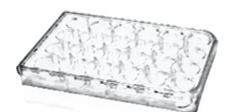
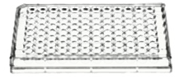
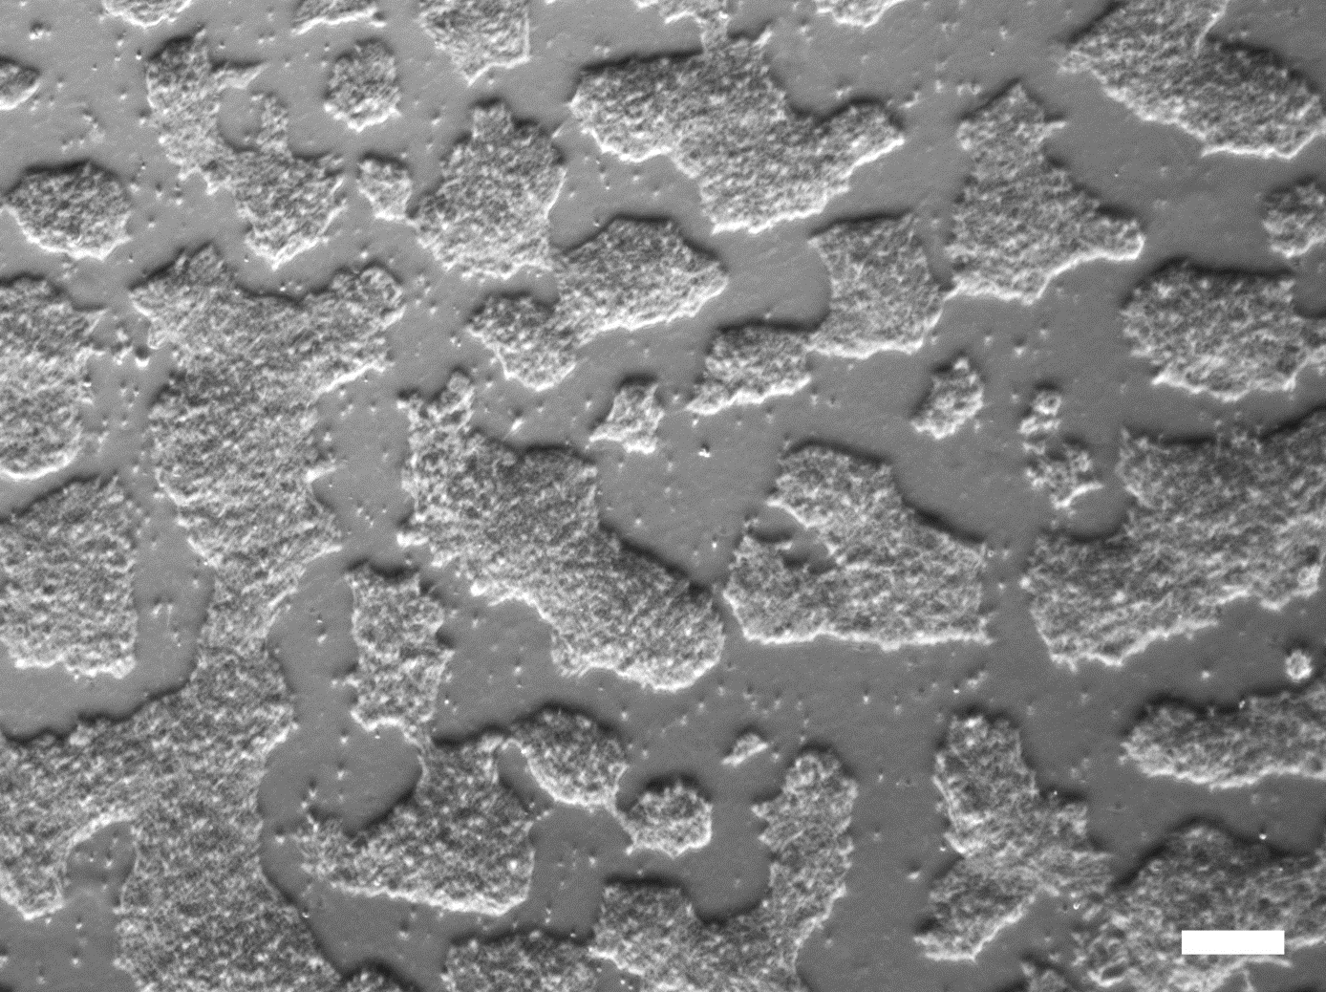
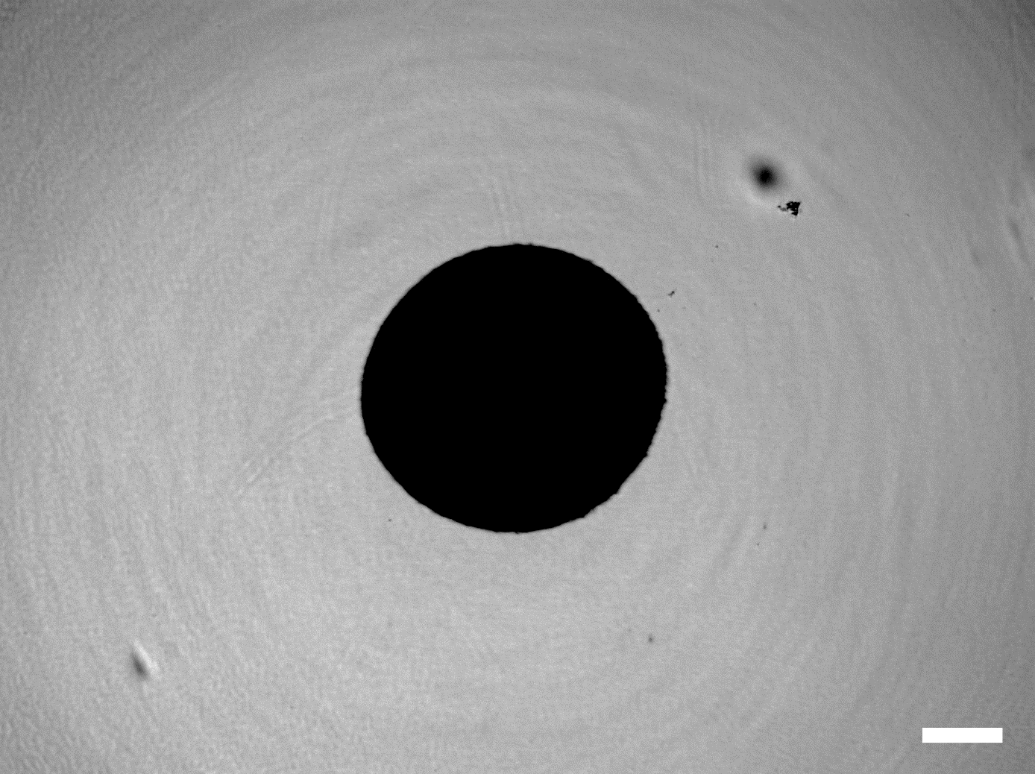
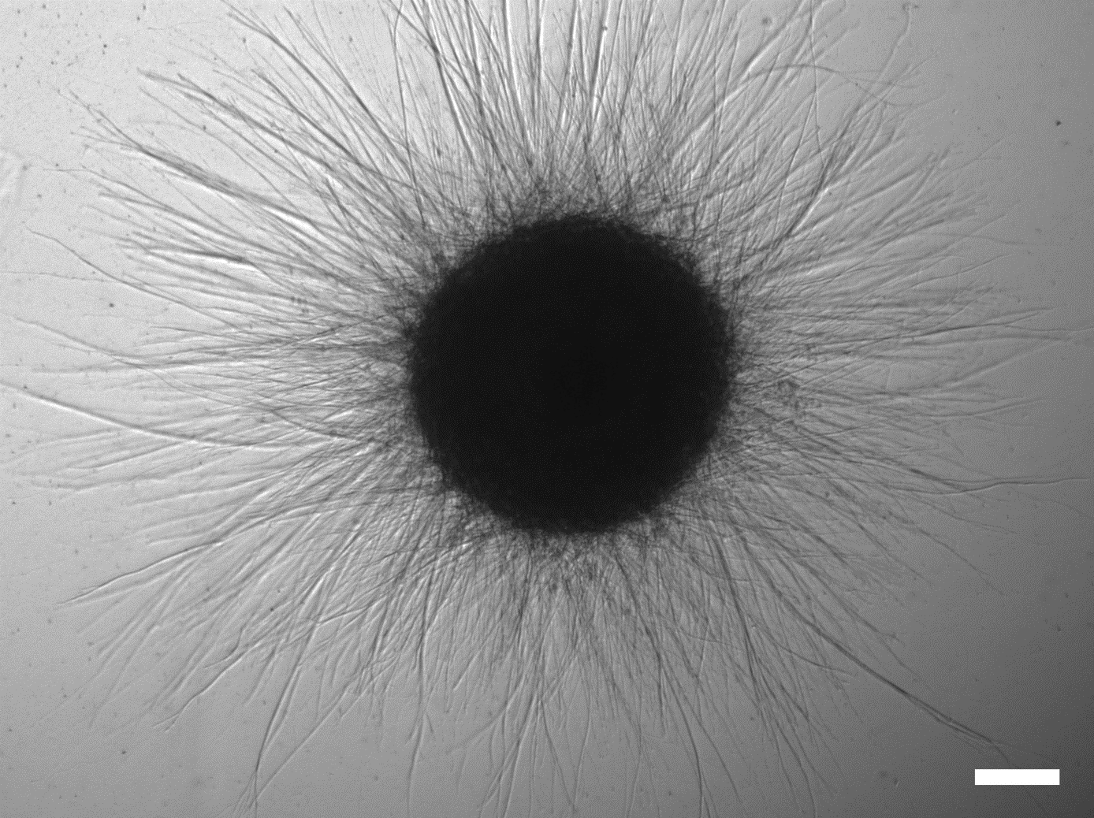
NESC maintenance
Spheroid formation
Embedding
Shaking
Days of
MO culture
2
8
30
60
0
MO
generation
Maintenance of NESCs
Seeding
Differentiation
Maturation
CHIR, PMA, AA
CHIR, PMA, AA
PMA, AA, GDNF, BDNF,
dcAMP, TGFbeta
AA, GDNF, BDNF, dcAMP, TGFbeta
Insulin
condition
Standard N2B27 media: Insulin resistance
Standard N2B27 media: Insulin resistance
Self-made N2 media: Insulin sensitivity

