Slide 1
Activation of AKT signaling pathway in iPSC-derived neurons (D30) treated with insulin
(after removal of N2 supplement for 12 days)
D1
Seed 6x10⁶ cells into 1 T25 flask (directly in Differentiation Medium I)
D3
Split (from 1 T25 to 1 T75)
D5
Change medium (15ml Differentiation medium I)
Split (from 1 T75 to 2 T75)
D8
Switch to Differentiation medium II
No insulin in the medium
D9
Switch to Maturation medium
D11
D12
Change medium
Split into 6-well plates (2.5x10⁶ cells/well)
D15
Activation of AKT signaling already at 10nM insulin
Change medium (1.5ml/well)
D17
Switch to « -N2 » medium, without insulin
D19
Change medium (1.5ml/well)
D22
Change medium (1.5ml/well)
D24
Change medium (3ml/well)
D26
Change medium (1.5ml/well)
D29
From day 19, B27 without insulin was used (but with Vitamine A),
which means NO insulin at all for 12 days
Insulin treatment
D31

Slide 2
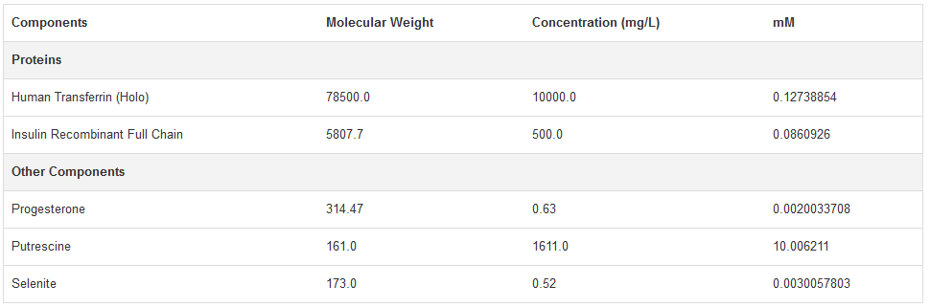
…..BUT, complete removal of N2 (and insulin) for 12 days seems deleterious for neurons → 30-40% less neurons at day 31
Home-made N2B27 medium (with physiological doses of insulin) is required
Commercial N2 supplement (100X, Gibco) → Used 1/200 (2,5ml in 500ml)
Final concentration into N2/B27 media
635nM
430nM
10nM
50µM
15nM
Commercial B27 supplement (100X, Gibco) → Used 1/100 (5ml in 500ml)
→ Insulin concentration in the B27 not provided my the manufacturer
→ Estimated at 58nM by Decourtye et al, but not clear if it refers to the commercial stock (100X) or to the final concentration in the media

Slide 3
ONGOING STRATEGY → Prepare DMEM/F12 + L-Glu + P/S + B27 supplement (58nM insulin?) = BASAL MEDIUM
→ Add « commercial » (Gibco, 430nM insulin) or « homemade » (HM_0, no insulin) N2 supplement,
but containing all the other components as the « commercial »
→ Include a third medium, by adding 430nM insulin to the « homemade » N2 supplement (HM_430)
→ Maintain (since thawing) and differentiate smNPCs either in the « commercial »
or in the « homemade » media
Commercial N2B27 (Gibco, Insulin 430nM + 58nM)
Homemade N2 (HM_0, Insulin 58nM)
Homemade N2 + Insulin (HM_430, Insulin 430nM + 58nM)
Basal conditions
smNPCs differentiation
2 control lines (17/6 wt and 18075)
Acute insulin
Stimulation
(from 10 to 200nM,
for 30 minutes)
B27 without insulin (but with Vitamine A) used only from day 29

Slide 4
Neuronal differentiation markers

Slide 5
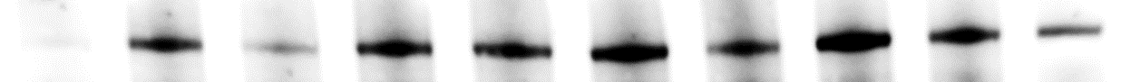
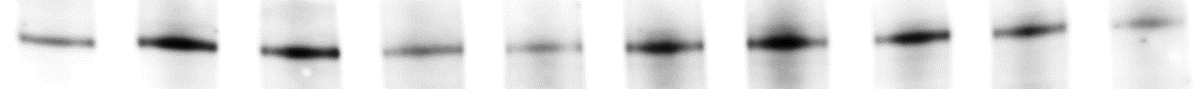
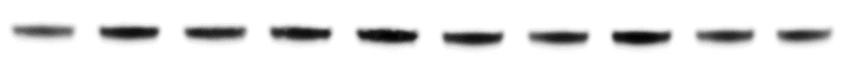
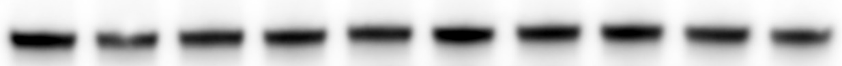
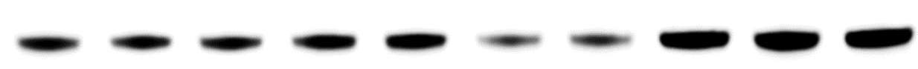
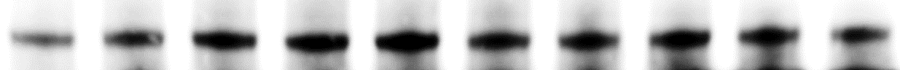
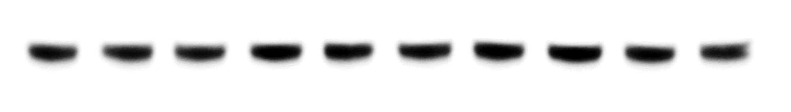
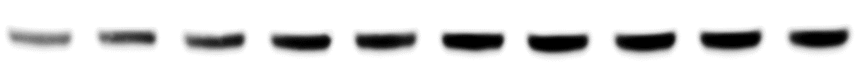
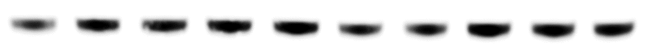
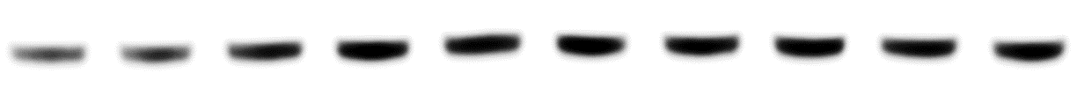
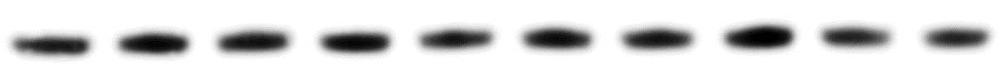
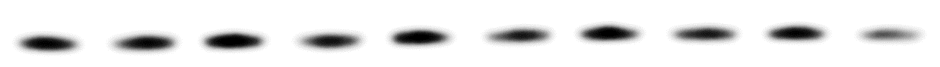
17/6 WT day 30
Gibco
HM_0
HM_10
HM_430
NT
10
50
100
200
NT
10
50
100
200
NT
10
50
100
200
NT
10
50
100
200
Insulin 30min
IRS-1
AKT
AKT pThr308
GSK3β
GSK3β pSer9
DJ-1
α-synuclein

Slide 6

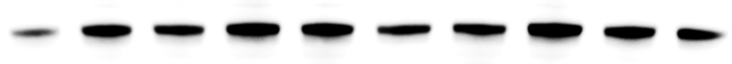
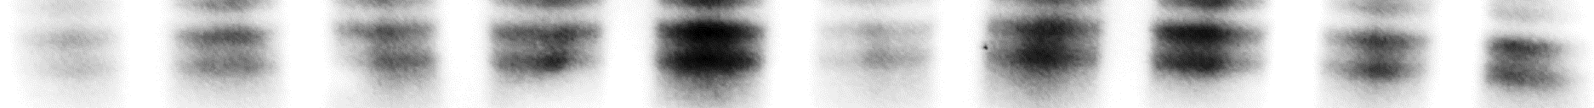
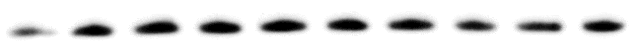
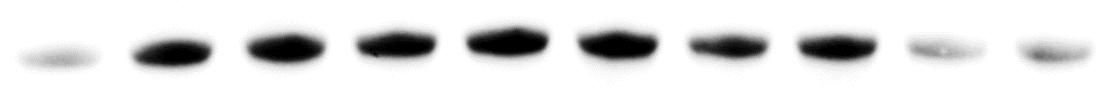
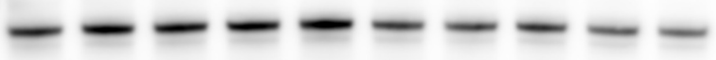
17/6 WT day 30
Gibco
HM_0
NT
10
50
100
200
NT
10
50
100
Insulin 30min
200
AKT
AKT pThr308
AKT pSer473
GSK3β
GSK3β pSer9
FoxO1 pThr24
FoxO3a pThr32
FoxO4 pThr28
Bad
p53
TH

Slide 7
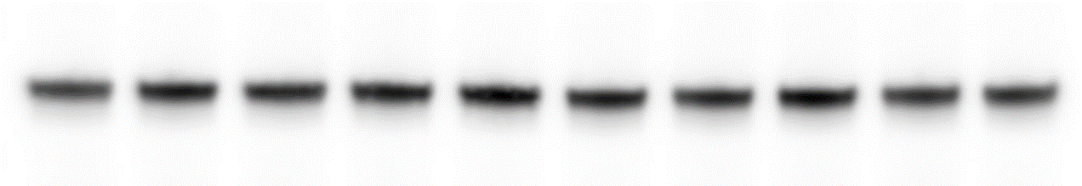
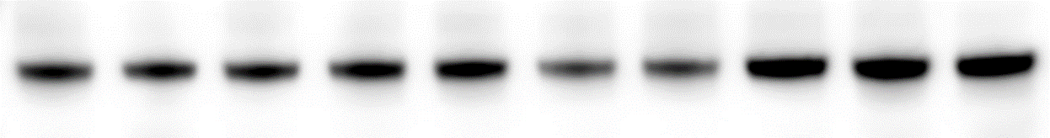
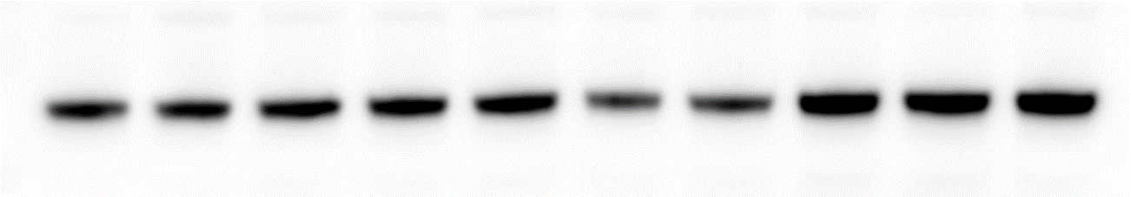
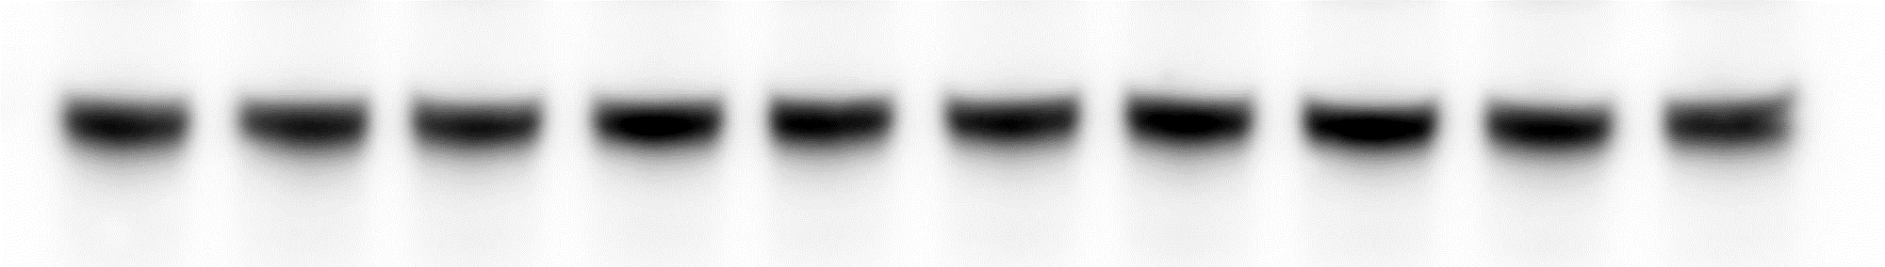
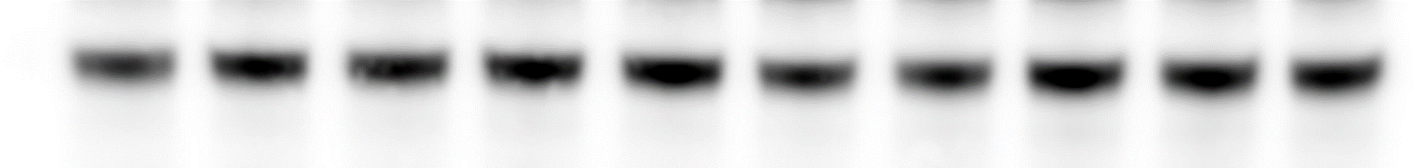
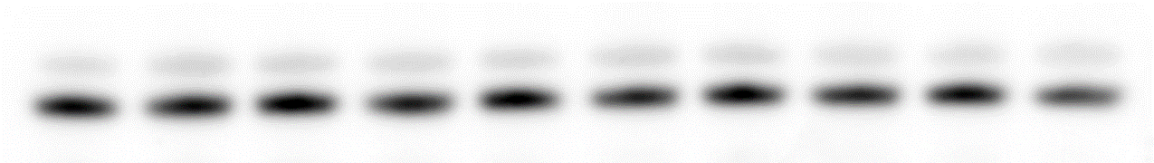
17/6 WT neurons_day 30
Gibco
Insulin 30min
NT
10
50
100
200
AKT
430 + 58 nM insulin in the medium
AKT pThr308
AKT pSer473
No activation of AKT signaling
even at 200nM insulin
GSK3β
GSK3β pSer9
DJ-1
α-synuclein

Slide 8
17/6 WT neurons_day 30
Gibco
HM_0
Insulin 30min
NT
10
50
100
200
NT
10
50
100
200
AKT
58 nM insulin in the medium
(from the B27)
AKT pThr308
AKT pSer473
Activation of AKT signaling
at 50nM insulin
GSK3β
GSK3β pSer9
DJ-1
α-synuclein

Slide 9
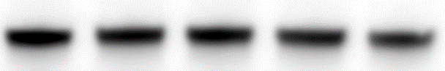
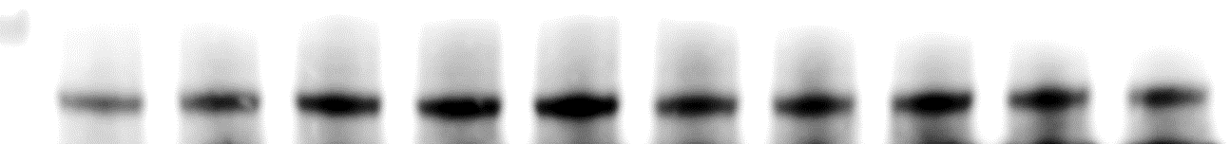
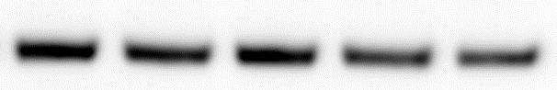
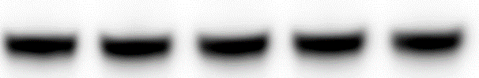
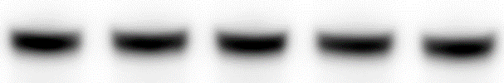
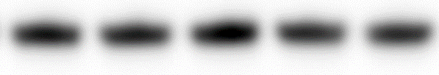
17/6 WT neurons_day 30
Gibco
HM_0
HM_430
Insulin 30min
NT
10
50
100
200
NT
10
50
100
200
NT
10
50
100
200
AKT
430 + 58 nM insulin
AKT pThr308
AKT pSer473
No activation of AKT signaling
even at 200nM insulin
GSK3β
GSK3β pSer9
DJ-1
α-synuclein
Standard culture conditions (about 500nM insulin) seem to trigger insulin resistance in neurons!

Slide 10
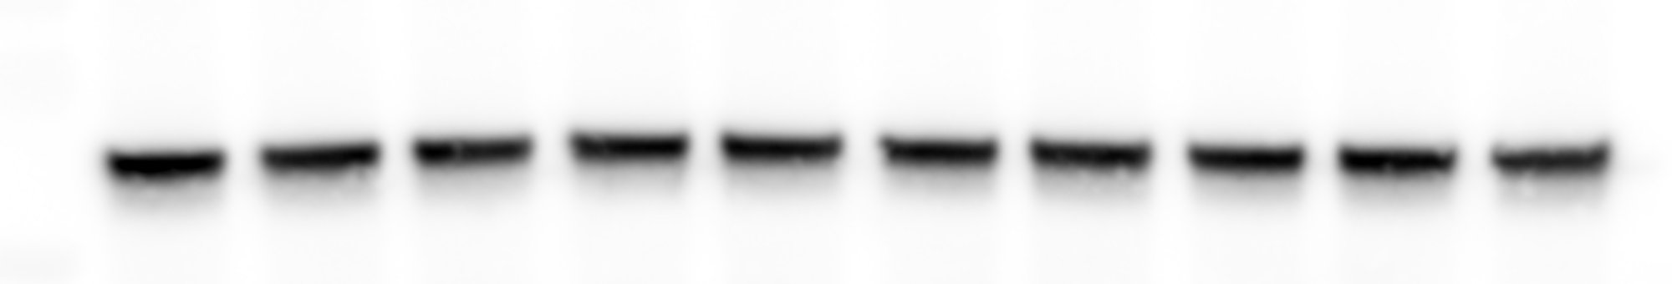
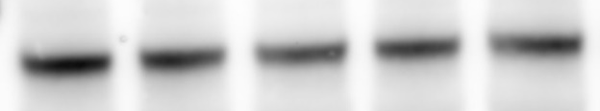

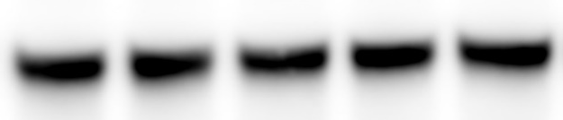
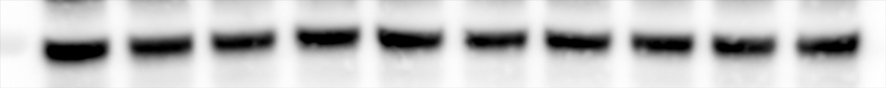
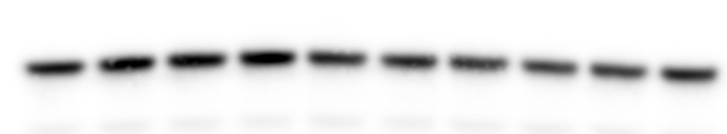
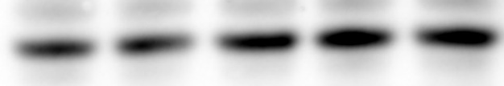
18075 WT neurons_day 30
Gibco
Insulin 30min
NT
10
50
100
200
AKT
430 + 58 nM insulin in the medium
AKT pThr308
AKT pSer473
No activation of AKT signaling
even at 200nM insulin
GSK3β
GSK3β pSer9
DJ-1
α-synuclein

Slide 11



18075 WT neurons_day 30
Gibco
HM_0
Insulin 30min
NT
10
50
100
200
NT
10
50
100
200
AKT
58 nM insulin in the medium
(from the B27)
AKT pThr308
AKT pSer473
Activation of AKT signaling
at 50nM insulin
GSK3β
GSK3β pSer9
DJ-1
α-synuclein

Slide 12

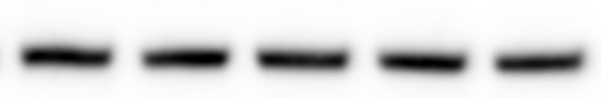
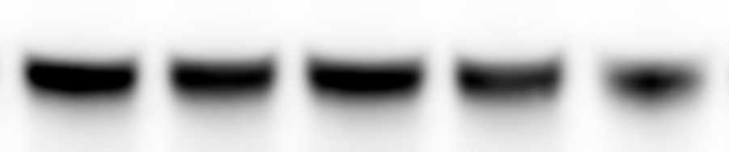
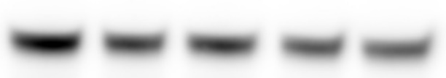
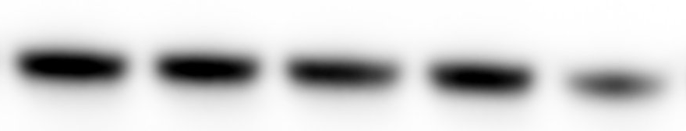
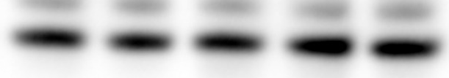
18075 WT neurons_day 30
Gibco
HM_0
HM_430
Insulin 30min
NT
10
50
100
200
NT
10
50
100
200
NT
10
50
100
200
AKT
430 + 58 nM insulin
AKT pThr308
AKT pSer473
No activation of AKT signaling
even at 200nM insulin
GSK3β
GSK3β pSer9
DJ-1
α-synuclein
Standard culture conditions (about 500nM insulin) seem to trigger insulin resistance in neurons!

