Slide 1
Data management, data stewardship, data data data
Roland Krause

Slide 2
Dr Bruce Banner aka The Incredible Hulk
Unrealistic depiction of a scientist
… can throw cars around and resist gun shots
… has 7 PhDs
…stores all research data in a database

Slide 3
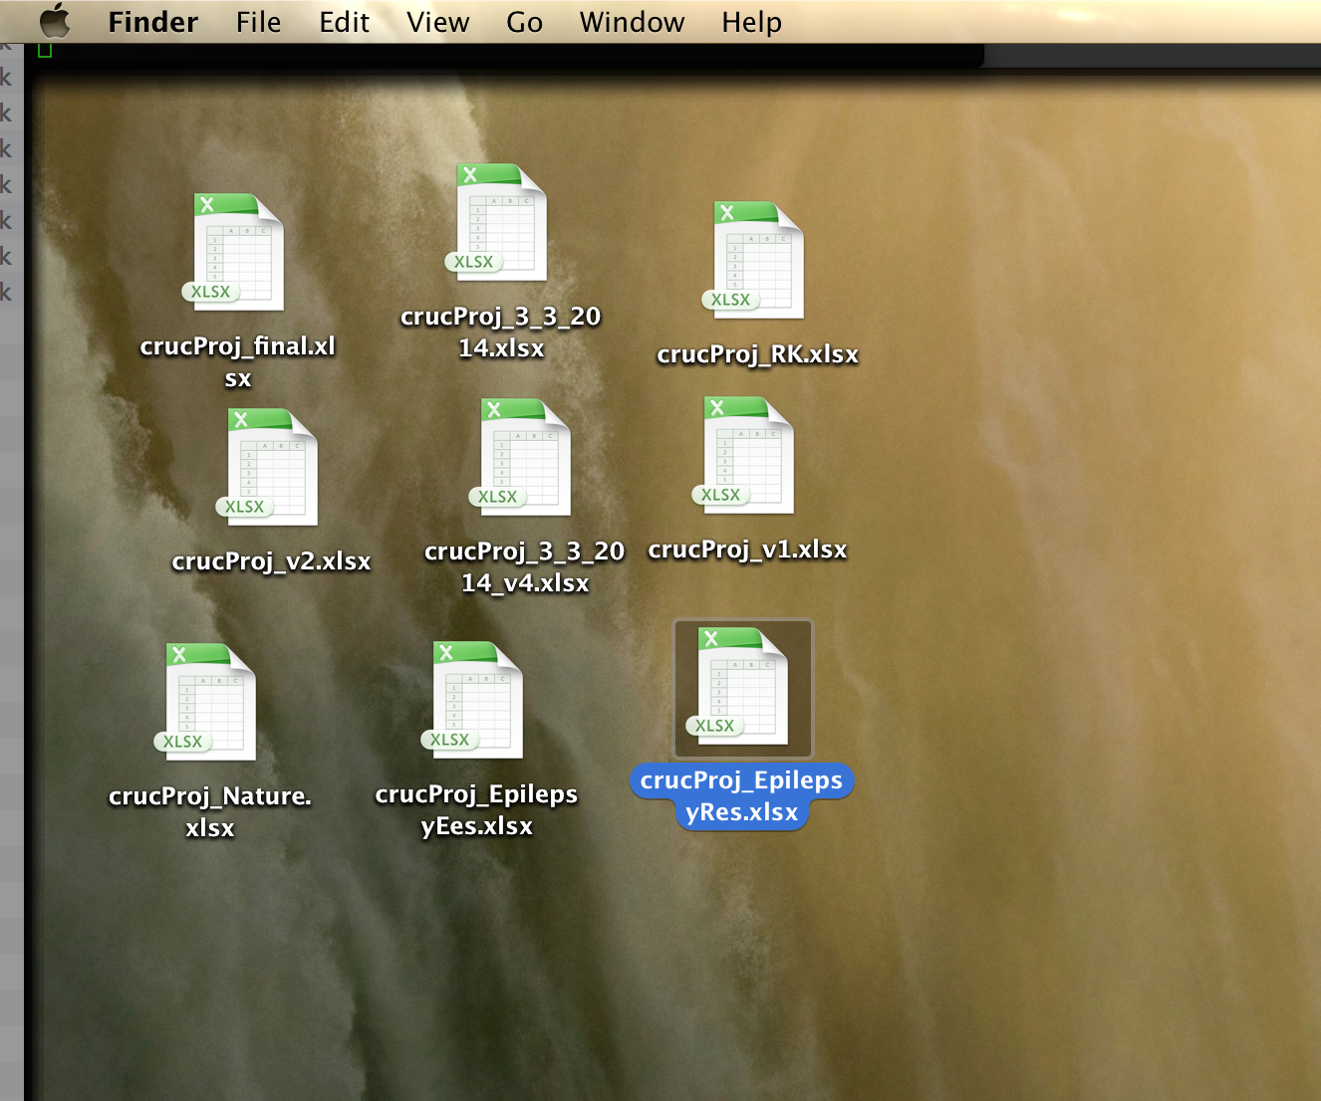
Your data management
Data archival by Outlook

Slide 4
All data processing is computation.

Slide 5
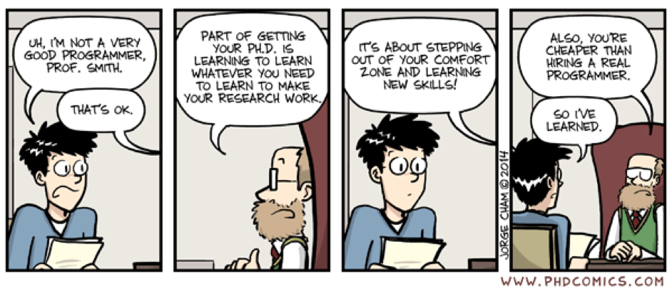
So you’re not a programmer…

Slide 6
This introduction
What is data management and data stewardship?
FAIR data
How data stewardship and data management plans can help
Reproducible research
Data management for you
Tidy data
Backup
Filenames
Sharing data

Slide 7
Data stewardship vs data management
﻿Management
Local, manipulating data
Data flow within the project
Examples
File naming conventions
Collecting metadata
Back-up
How to name files
﻿Stewardship
Organizing data before and beyond the project
Examples
Choice of repositories
Decisions on meta data collection
Archival
Long-term care of valuable digital assets for additional discovery and downstream investigations
Notably includes all digital objects including documentation and analysis code

Slide 8
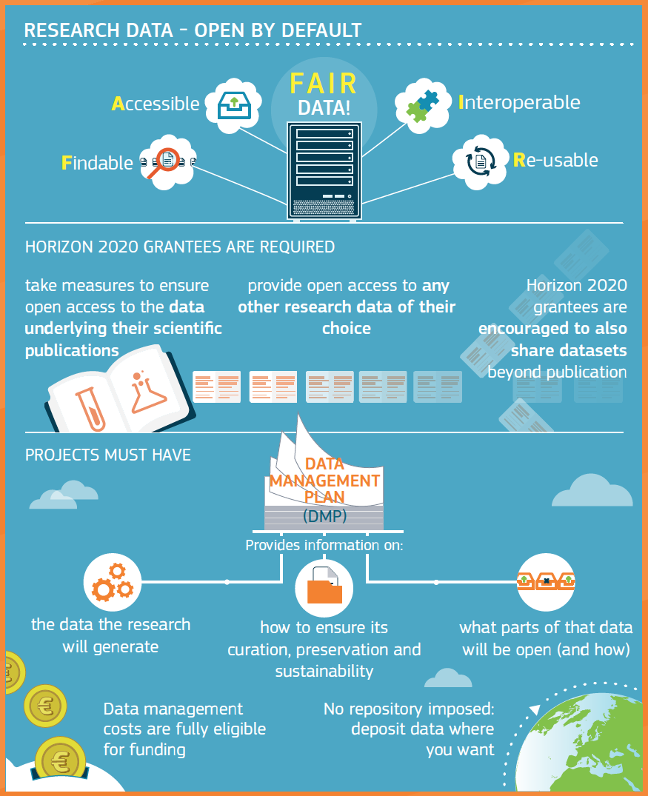
Do you need a data management plan?
http://ec.europa.eu/research/openscience

Slide 9
Good data management and stewardship
— The FAIR principle
Guideline
Findable
Accessible
Interoperable
Reusable
What FAIR is not
A standard
Equivalent to RDF, Linked Data, or the Semantic Web
Equivalent to open

Slide 10
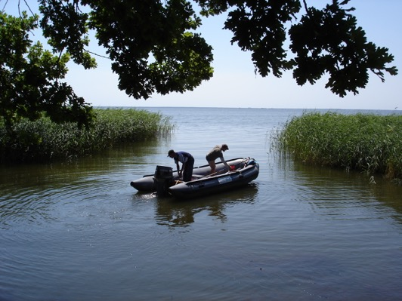
Findable
— for computers and humans
F1 - (meta)data are assigned a globally unique and persistent identifier
Computer-accessible global, unique persistent identifiers (PID)
F2 - data are described with rich metadata
Discoverable by humans
F3 - metadata clearly and explicitly include the identifier of the data it describes
Verify correct identification of resource requested
F4 - (meta)data are registered or indexed in a searchable resource
From lab note books to search engines
Notes:
Findable comprises two major attributes: the data set be identifed by a PID, so that it can be unambiguously located by a machine and the data be described by sufficient metadata so that it an be discovered by a human. F3 connects the identifier to this rich metadata so that a human can verify that the dataset is corretly resolved. Finally, the data must be registered or indexed so that it can be found. The more machine-readable metadata that a data resource provides for its contents, the more likely a web search through a search engine like Google will find them.

Slide 11
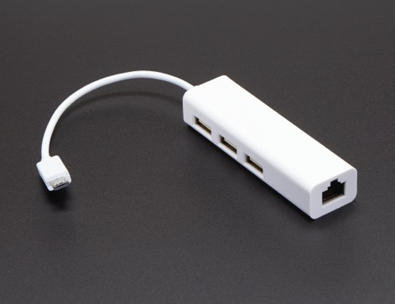
Accessible
A1 - (meta)data are retrievable by their identifier using a standardized communications protocol
HTTP is a standardized communications protocol
A1.1 - the protocol is open, free, and universally implementable
A1.2 - the protocol allows for an authentication and authorization procedure, where necessary
Access restrictions apply (see data protection, legal aspects)
A2 - metadata are accessible, even when the data are no longer available
Notes:
Accessible provides requirements for ensuring that third parties can access the data by specifying that the PID is resolvable and that the access protocol is standard, e.g., http, and open. The access protocol should allow for authentiation and authorization to protect sensitive data. Finally, a critical requirement to ensure the integrity of links across the web is that the metadata persist, even if the data they describe have been removed for some reason. In this way, a basic description of the data can still be found at the same PID, much like descriptive metadata of out of print books can still be found. Ideally, the page describing the metadata includes a statement about when and why the data were removed (Starr et al., 2015).

Slide 12
Interoperable
For your collaborators
I1 - (meta)data use a formal, accessible, shared, and broadly applicable language for knowledge representation.
Standard formats
I2 - (meta)data use vocabularies that follow FAIR principles
ISA tools
I3 - (meta)data include qualified references to other (meta)data
Links to Uniprot or citations via doi
Notes:
Interoperable outlines requirements for ensuring that data across databases can be combined with minimal effort. Note that this principle specifically calls for the use of formal vocabularies widely used in a community that are themselves FAIR, i.e., have a persistent identifier and access protocol.

Slide 13
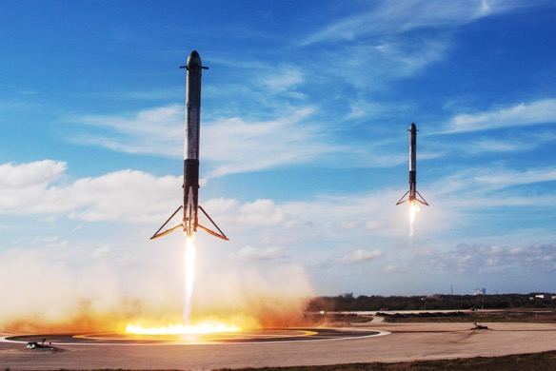
Reusable
First re-use by your future self
R1 - meta(data) are richly described with a plurality of accurate and relevant attributes
Minimal definitions for data formats
R1.1 - (meta)data are released with a clear and accessible data usage license
Creative Commons licenses
R1.2 - (meta)data are associated with detailed provenance
How data was generated and manipulated
R1.3 - (meta)data meet domain- relevant community standards
Notes:
Reusable also emphasizes rich metadata, but in this case so that the dataset can be sufficiently understood by a human so that it can be reused appropriately. Many communities have published minimal information models that provide the minimum set of attributes required for proper interpretation of a given data set, e.g., MIAME. Reusable also specifies that a data licence, preferable in a machine-readable form, accompanies the data specifying how it may be re-used, e.g., a CC-BY license specifies that the data may be re-used without restriction, but attribution of the source must accompany the reuse. And, of course, re-usable emphasizes the use of community-accepted standards for metadata and for data themselves. A major goal of ReproNIM is to help define these standards for neuroimaging.

Slide 14
Issues of data stewardship
Data sharing across institutions
Data is only shared if required
Data deposited to public repositories is only a slice of existing
Data sharing agreements not in place
Note that GDPR requires contracts for processing of sensitive data
Responsible principal investigators far removed from data handling
People handling data do not sit at the Steering Committee
Access to storage limitations
Data is thrown together in directories without provenance
Data is to be deposited in a complex database that the PostDoc never finishes
People leave the project and/or academic research

Slide 15
What’s in a DMP
data to be generated during research
metadata, standards and quality assurance measures
plans for sharing data
ethical and legal issues or restrictions on data sharing
copyright and intellectual property rights of data
data storage and back-up measures
data management roles and responsibilities
costing or resources needed

Slide 16
Resources for DMP
DMPonline
https://dmponline.dcc.ac.uk/
Lots of free text boxes
Data stewardship wizard
https://dmp.fairdata.solutions/
Click-through questionnaire.
Does not write a document

Slide 17
Perspectives on open data
When make data open?
On production
On publication
On end of the project
Take your filthy hands of my data
Who owns data anyway?
Principal investigator
Institutions
Funding bodies
Patients donating samples
How useful is data published without accompanying analysis?

Slide 18
Reproducible Research

Slide 19
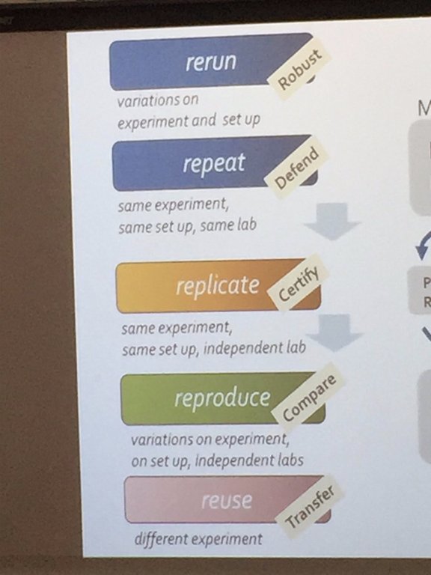
Scales of reproducibility
Source: Carole Goble

Slide 20
Approaches to reproducibility
Narrative descriptions
Custom scripts and code
Software frameworks to resolve dependencies
Literate programming
Workflow-management systems
Virtual machines

Slide 21
Typical analysis workflow
Source data
Large scale data sets
Intermediate data
Derived by computation
Analysis data
Derived by computation
Final analysis
Manuscript stage
External data sets
Required time
MRI, NGS, measurements
VCF
Filtered variants, derived networks
Images
Summaries
All numbers of your paper
Manually collected data
Cleaned data
“Tidy data
One analysis project
Unix tools
Web downloads
Electronic data capture
Specialized tools
… MS Word
R
Matlab
SPSS
Excel

Slide 22
Why is your analysis not reproducible?
Data provenance
Copy & paste operations
Manual text entry
Intermediate and final data not stored or overwritten
Input data from downloaded from “some website”
Analysis not coded

Slide 23
How bad can it be?
All your analysis will be required to be made available
Reinhart-Rogoff “Growth in a time of debt”
Potti et al., “Genomic signatures to guide the use of chemotherapeutics”
CLCN2 variants in IGE
Excel manipulations are inherently non-tractable
It’s the data and data structure, not the tool

Slide 24
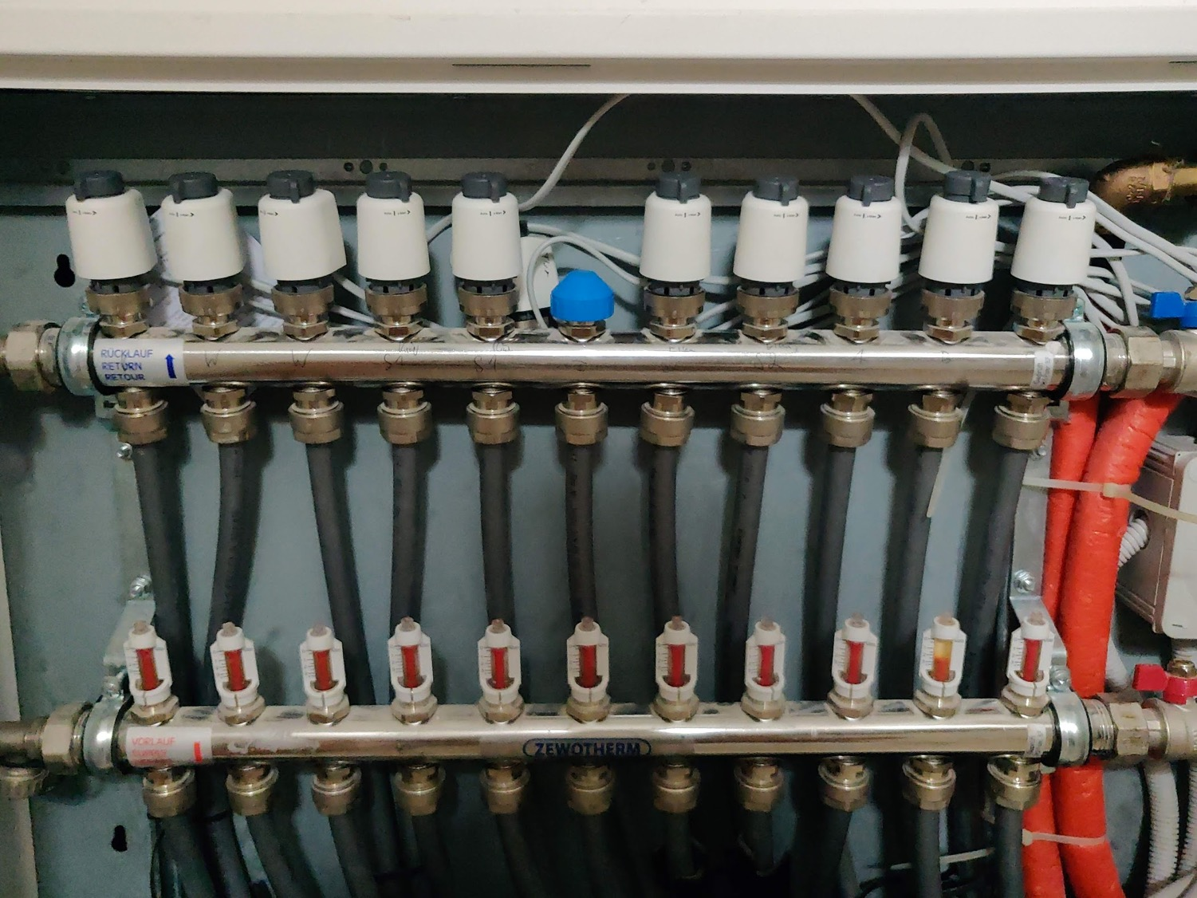
Data management for you

Slide 25
Source data
Ingest
Meta-data
Back-up
Protection

Slide 26
Ingesting data from other sources
Downloaded data needs to be managed
Save provenance
Date and time of download
URL
Versions
Ideally scripted
curl
Write meta-data description

Slide 27
Protect your source data
One master copy with meta-data in one place
Write-protected to reduce risk of accidental deletion
Readable by the data owner and/or data steward only
Encrypted to reduce risk of accidental release
Key management

Slide 28
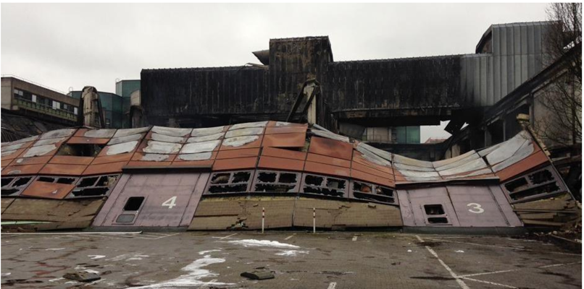
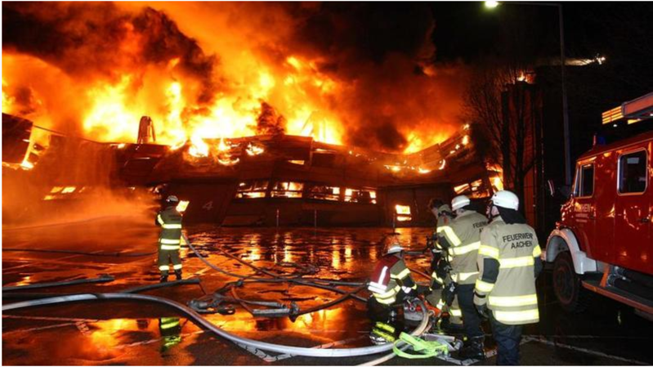
https://www.dw.com/en/brazil-museum-fire-a-loss-for-the-whole-world/a-45350820

Slide 29
3-2-1 Back-up
Three copies
Two different media
One off-site copy
Example
Data set on your machine
Copy on an external hard drive
Online share (owncloud)

Slide 30
Getting your data
Sensitive data should be encrypted
Pertains to all data that include a pseudonym
Avoid all transfer of any data by e-mail
Data can be read on passage
Sensitive data must not be shared by mail
E-mail is a poor repository

Slide 31
Build yourself a repository
Identify a structure that how you would like to store your data
Any structure is better than not thinking about it
Possible considerations
Separate source data and intermediate data strictly
Store meta-data with the source data (e.g. in a README.txt file or a structured doc)
Use infrastructure
University-led file sharing or servers
Dropbox or ownCloud shares
Cloud environments
Avoid personal hard-drives for primary storage

Slide 32
Protecting your data
Minimize the number of unmanaged copies of a resource
Data with meta-data in one place, write protected
Resource duplication should either be
Scripted for processing
Automated back-up

Slide 33
How to name files
From Jenny Bryan by CC-BY
https://speakerdeck.com/jennybc/how-to-name-files

Slide 34
File naming
Bad file names
myabstract.docx
Joe’s Filenames Use Spaces and Punctuation.xlsx figure 1.png
fig 2.png
JW7d^(2sl@deletethisandyourcareerisoverWx2*.txt
Better filenames
2014-06-08_abstract-for-sla.docx
joes-filenames-are-getting-better.xlsx
fig01_scatterplot-talk-length-vs-interest.png
fig02_histogram-talk-attendance.png
1986-01-28_raw-data-from-challenger-o-rings.txt

Slide 35
Three principles for file names
machine readable
human readable
plays well with default ordering

Slide 37
Machine readable
avoid
spaces
Punctuation
accented characters
case sensitivity
deliberate use of delimiters
regular expression and globbing friendly
easy to compute on

Slide 38
Example of globbing
Excerpts
Narrow file listing

Slide 39
Deliberate use of delimiter
Concious use the delimiters “_” and “-” allows us to recover meta- data from the filenames.
“_” underscore used to delimit units of
“-” hyphen used to delimit words for easier reading

Slide 40
Machine readable
easy to search for files later
easy to narrow file lists based on names
easy to extract info from file names, e.g. by splitting
new to regular expressions and globbing? be kind to yourself and avoid
spaces in file names
Punctuation
accented characters
different files named “foo” and “Foo”

Slide 41
Human readable
name contains info on content
connects to concept of a slug from semantic URLs

Slide 42
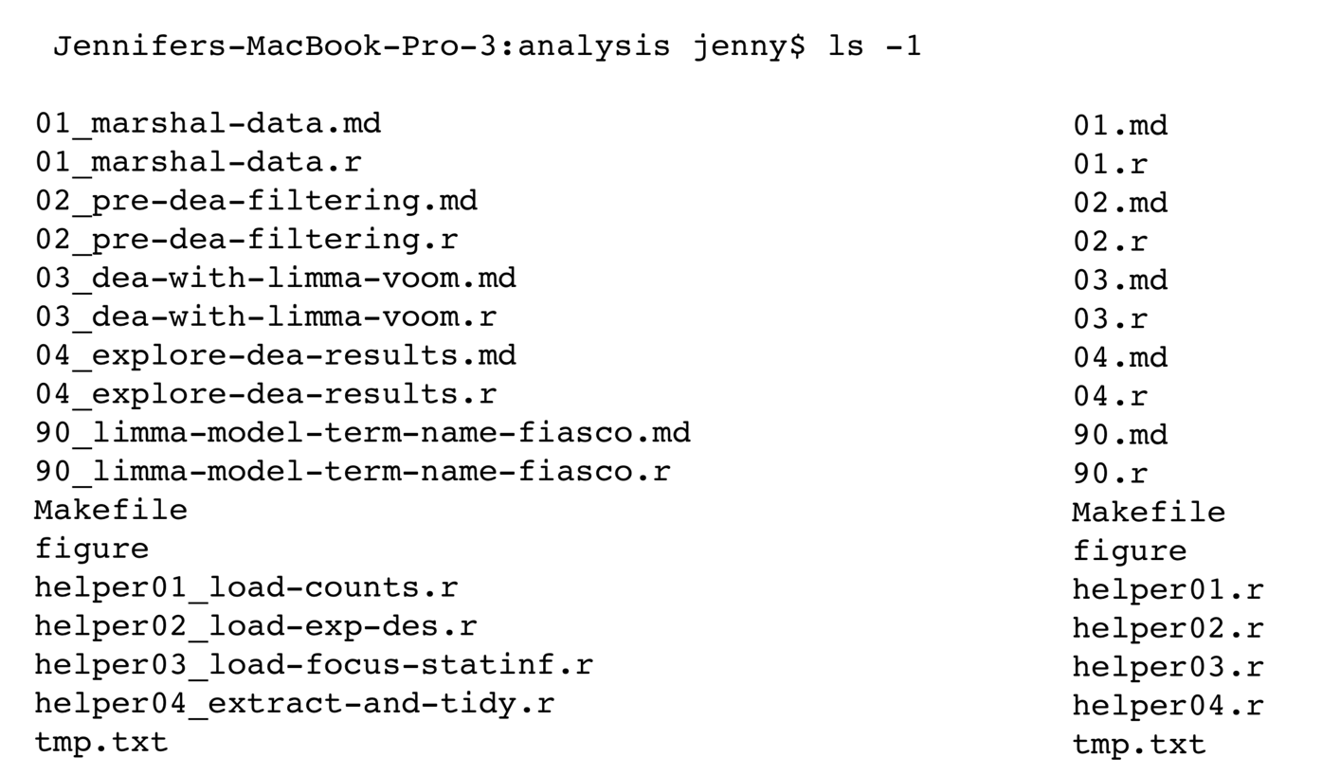
Human readable

Slide 43
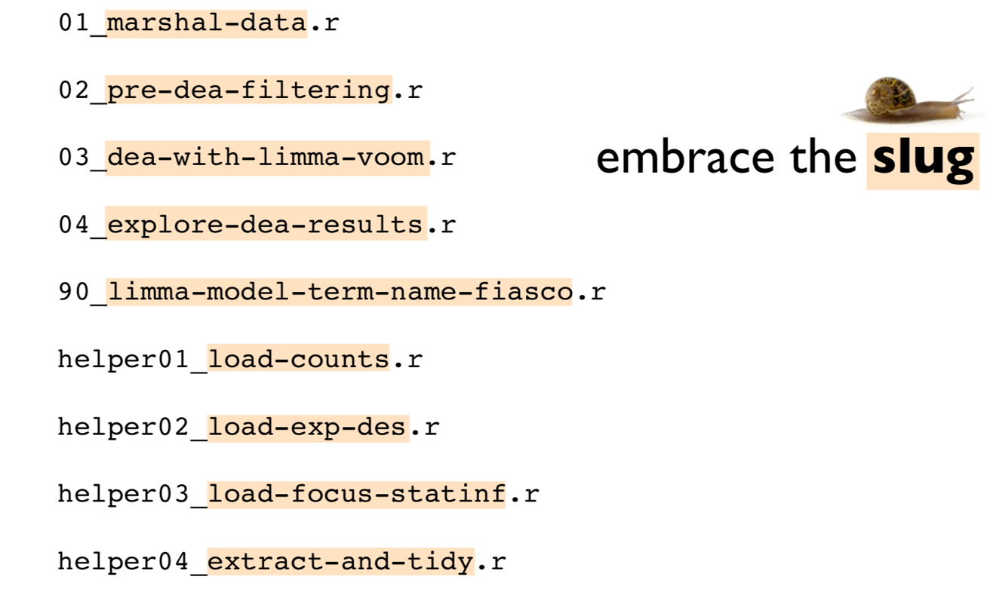
Human readable

Slide 44
Default ordering
Put something numeric first
Use the ISO 8601 standard for dates
Left pad other numbers with zeros

Slide 45
xkcd.com/1179/

Slide 46
Naming your files
Machine readable (delimiters)
Human readable (slugs)
Orders (time stamps in ISO8601, zero-pad analysis files)

Slide 47
Sharing data

Slide 48
Do not share data by e-mail
Unmanaged copies everywhere on servers outside of your control
Not ever OK under GDPR unless encrypted
Sharing of non-sensitive data
Still not managed
No provenance

Slide 49
Encrypting your sensitive data
All modern operating systems support encryption out of the box – Bitlocker, FileVault2, etc.
Create encrypted shares
Use screen locking
Good combination
Encryption and file sharing

Slide 50
Structuring your data
… in Excel

Slide 51
Define Contents of Data Files
Create a Project Document File (Lab Notebook)
Details such as:
Names of data & analysis files associated with study
Definitions for data and codes (include missing value codes, names)
Units of measure (accuracy and precision)
Standards or instrument calibrations
Notes:
More documentation:
Documentation can also be called metadata
Description of the data file names (especially if using acronyms and abbreviations).
Record why you are collecting data,
Details of methods of analysis
Names of all data and analysis files
Definitions for data (include coding keys)
Missing value codes
Unit of measures.
Structured metadata (XML) format standards for discipline (Ecological Metadata language – EML)

Slide 52
Data Documentation
Project Documentation | Dataset Documentation
Context of data collection Data collection methods Structure, organization of data files Data sources used Data validation, quality assurance Transformations of data from the raw data through analysis Information on confidentiality, access and use conditions | Variable names and descriptions Explanation of codes and schemas used Algorithms used to transform data File format and software (including version) used
Notes:
In fact, you probably already have metadata in some form. You just may not recognize it as such. For instance, among your work records, you certainly have notebooks stuffed with color-coded pages or assorted keys to your data stored on your computer. Perhaps the most common form of metadata that you may already have is a file folder filled with notes on your data sources and the procedures that you used to build your data. However, unless you’ve been unusually diligent, your information is probably not organized so that a stranger could stroll into your office at any time, and read and understand it easily.
Start at the beginning of the project and continue throughout data collection & analysis
Why you are collecting data
Exact details of methods of collecting & analyzing
Good for reproducability. Some of the issues include reproducibility of science that you can go back when questioned or when updating your results, and reproduce the algorithms.
There’s also efficiencies in how the science is done. If you have to spend a lot of time figuring out what was done last time you are losing some efficiencies in reproducing those results or updating analysis.
Along the line of those efficiencies is sharing across groups. Much of the work we do nowadays is collaborative, involves more than one agency or university or partner and if you can document the data and the analysis it helps to share the information and have everyone in that collaborative team understand what’s being done.
We also, like documenting the data and the analysis create a provenance that gives a full history of when the project was started how the analysis was done and how the final results were completed.

Slide 53
Choosing File Formats
Accessible Data (in the future)
Non-proprietary (software formats)
Open, documented standard
Common, used by the research community
Standard representation (ASCII, Unicode)
Notes:
Storing data in recommended formats with detailed documentation will allow your data to be easily read many years into the future.
Spreadsheets are widely used for simple analyses
But they have poor archival qualities
Different versions over time are not compatible
Formulas are hard to capture or display
Plan what type of data you will be collecting. Want to choose a file format that can be read well into the future and is independent of software changes.
These are formats more likely to be accessible in the future.
to replace old media, maintaining devices that can still read the proprietary formats or media type
Format of the file is a major factor in the ability to use the data in the future. As technology changes, plan for software and hardware obsolescence.
System files (SAS, SPSS) are compact and efficient, but not very portable. Use software to “export” data to a portable (or transport) file.
Convert proprietary formats to non-proprietary. Check for data errors in conversion.

Slide 54
Best Practices for Creating Data
Use Consistent Data Organization
Use Standardized Naming, Codes and Formats
Assign Descriptive File Names
Perform Basic Quality Assurance / Quality Control
Preserve Information - Use Scripted Languages
Define Contents of Data Files; Create Documentation
Use Consistent, Stable and Open File Formats
Notes:
Remember create spreadsheet so it can be automated
Date/Time standards, Geospatial coords, Species, other standards from discipline
Descriptive File Names – File names can help id what’ inside
Quality Assurance – when planning on data entry can “program” data checks in forms (Access and Excel), create pick lists (codes), missing data values
Make it easier to replicate data transformation, can be documented
Document EVERYTHING, dataset details, database details, collection notes – conditions, You will not remember everything 20 years from now! What someone would need to know about your data to use it.
Stable File Formats – easier if all files were same format, also knowing what formats are better in the long-term

Slide 55
Keep your data tidy
Tidy data is a concept for data analysis
Helps to design spreadsheets but also CRFs
Note that data coming out of REDCap might not be tidy

Slide 56
Tidy data
One variable per column
One observation per row
Tables hold elements of only one kind

Slide 57
Exercise
Reorganise the baddata.xlsx data (using Excel or another )
Make data tables tidy
Consider how data collection could be improved with ontologies
Organize the source data and derived data
Analyze the data in your tool of choice
Which variants are most frequent?

Slide 58
Solving problems
Rubberducking
Oracle
Group work

Slide 59
Rubberducking

Slide 60
Ask the Oracle
The Oracle gives the precise answer to your problems
You have to submit the problem in writing
The Oracle answers a questions only once or if it finds the problem interesting
If you supply a trivial problem, it will stop answering

Slide 61
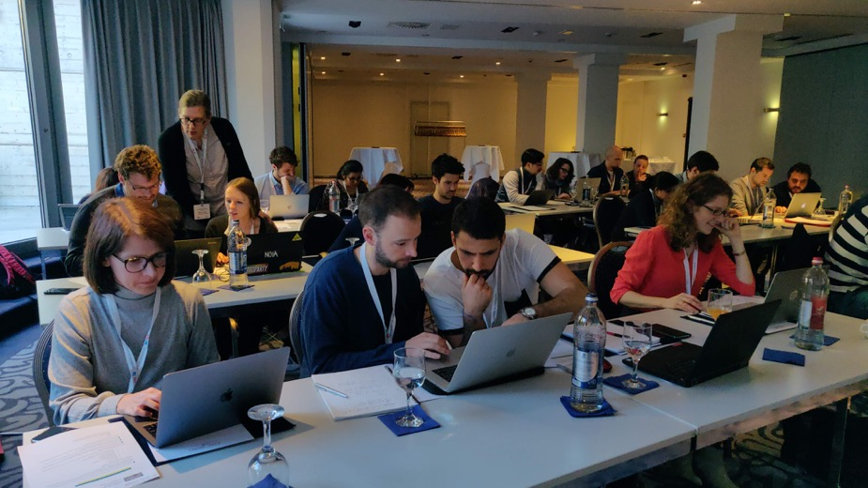
Working in groups
Limit time spent together
Set up roles
See pair programming and code review

Slide 62
Googling for help

Slide 63
Googling for help
Read help pages and the official documentation well before turning to Google
Use stack exchange, forums and related resources carefully
Answers for Excel questions are worst
Write down what you want to achieve before Google

Slide 64
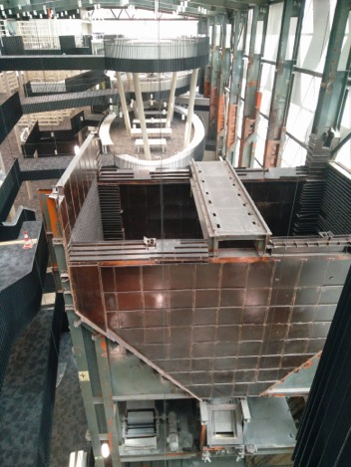
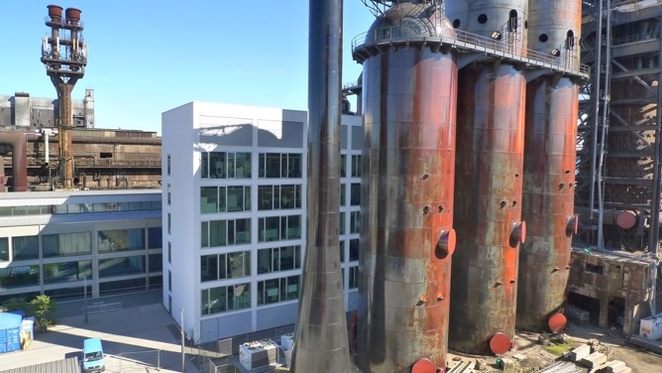
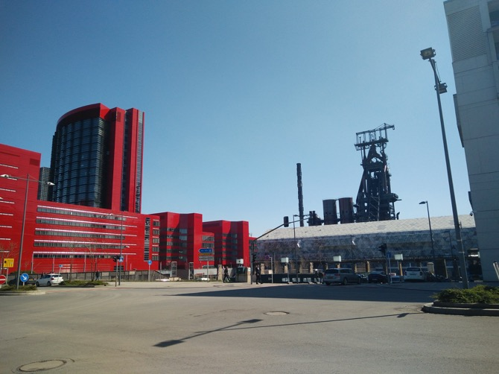
Thank you for your attention!
http://epilepsygenetics.net
roland.krause@uni.lu
@spitshine - @elixir_lu

